Slide 1
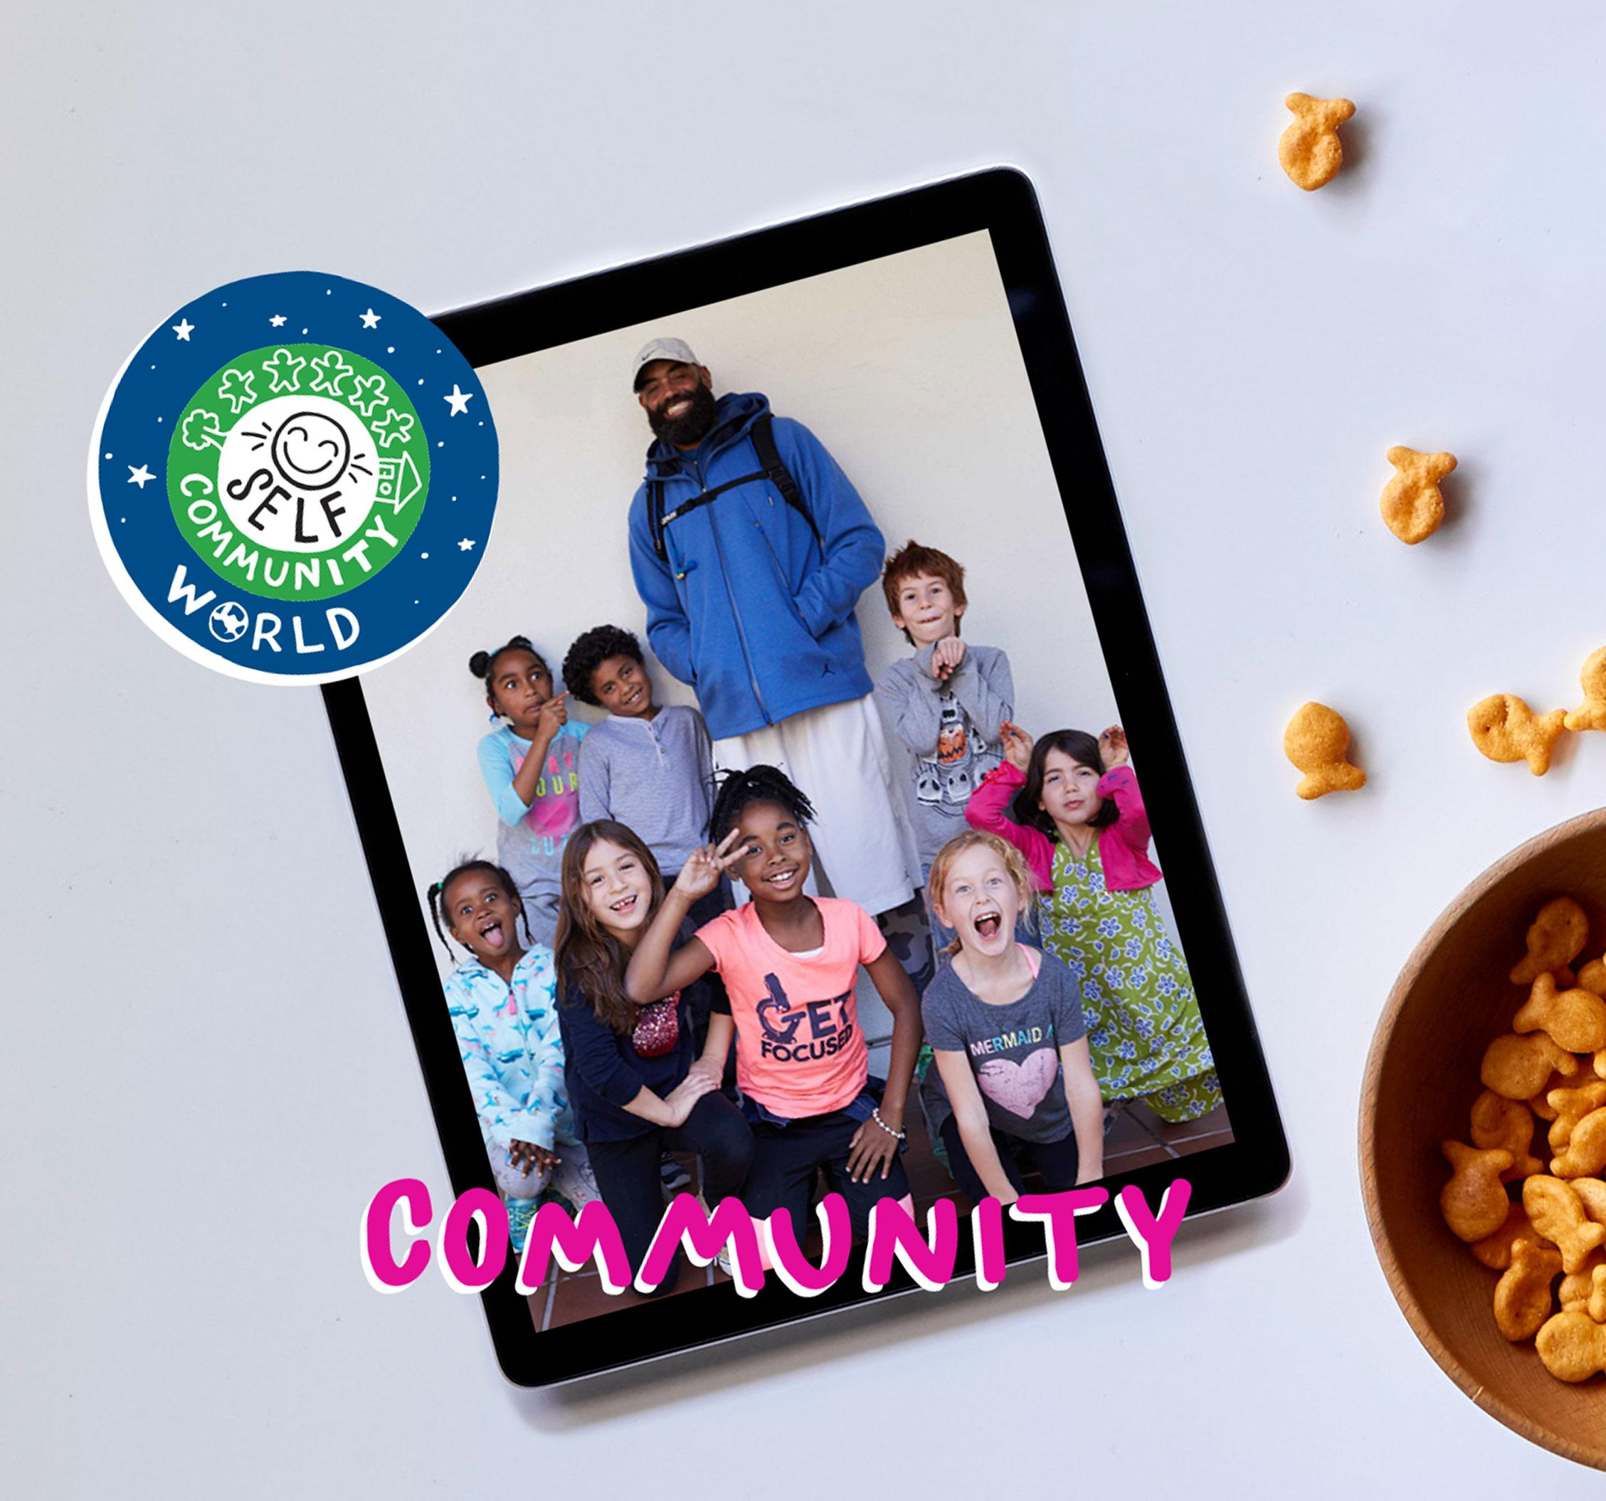
DIGITAL CITIZENSHIP | GRADE 3
Your Rings of Responsibility

Slide 2
How do good digital citizens take responsibility for themselves, their communities, and their world?

Slide 3
Learning Objectives
l
Examine both online and in-person responsibilities.
Describe the Rings of Responsibility as a way to think about how our behavior affects ourselves and others.
Identify examples of online responsibilities to others.
2
3

Slide 4
KEY VOCABULARY
Responsibility
A duty you have to yourself or others

Slide 5
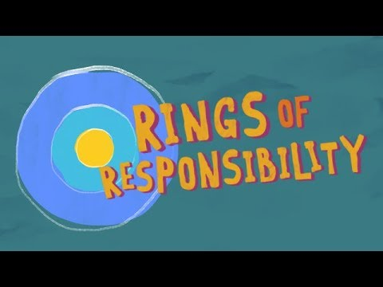
WATCH + DISCUSS
Discuss:
How could throwing a bottle out of your window be similar to something you do online?
Use Safe YouTube Link to watch:
https://video.link/w/RCB7c
To watch this video on the Common Sense Education site, click here.

Slide 6
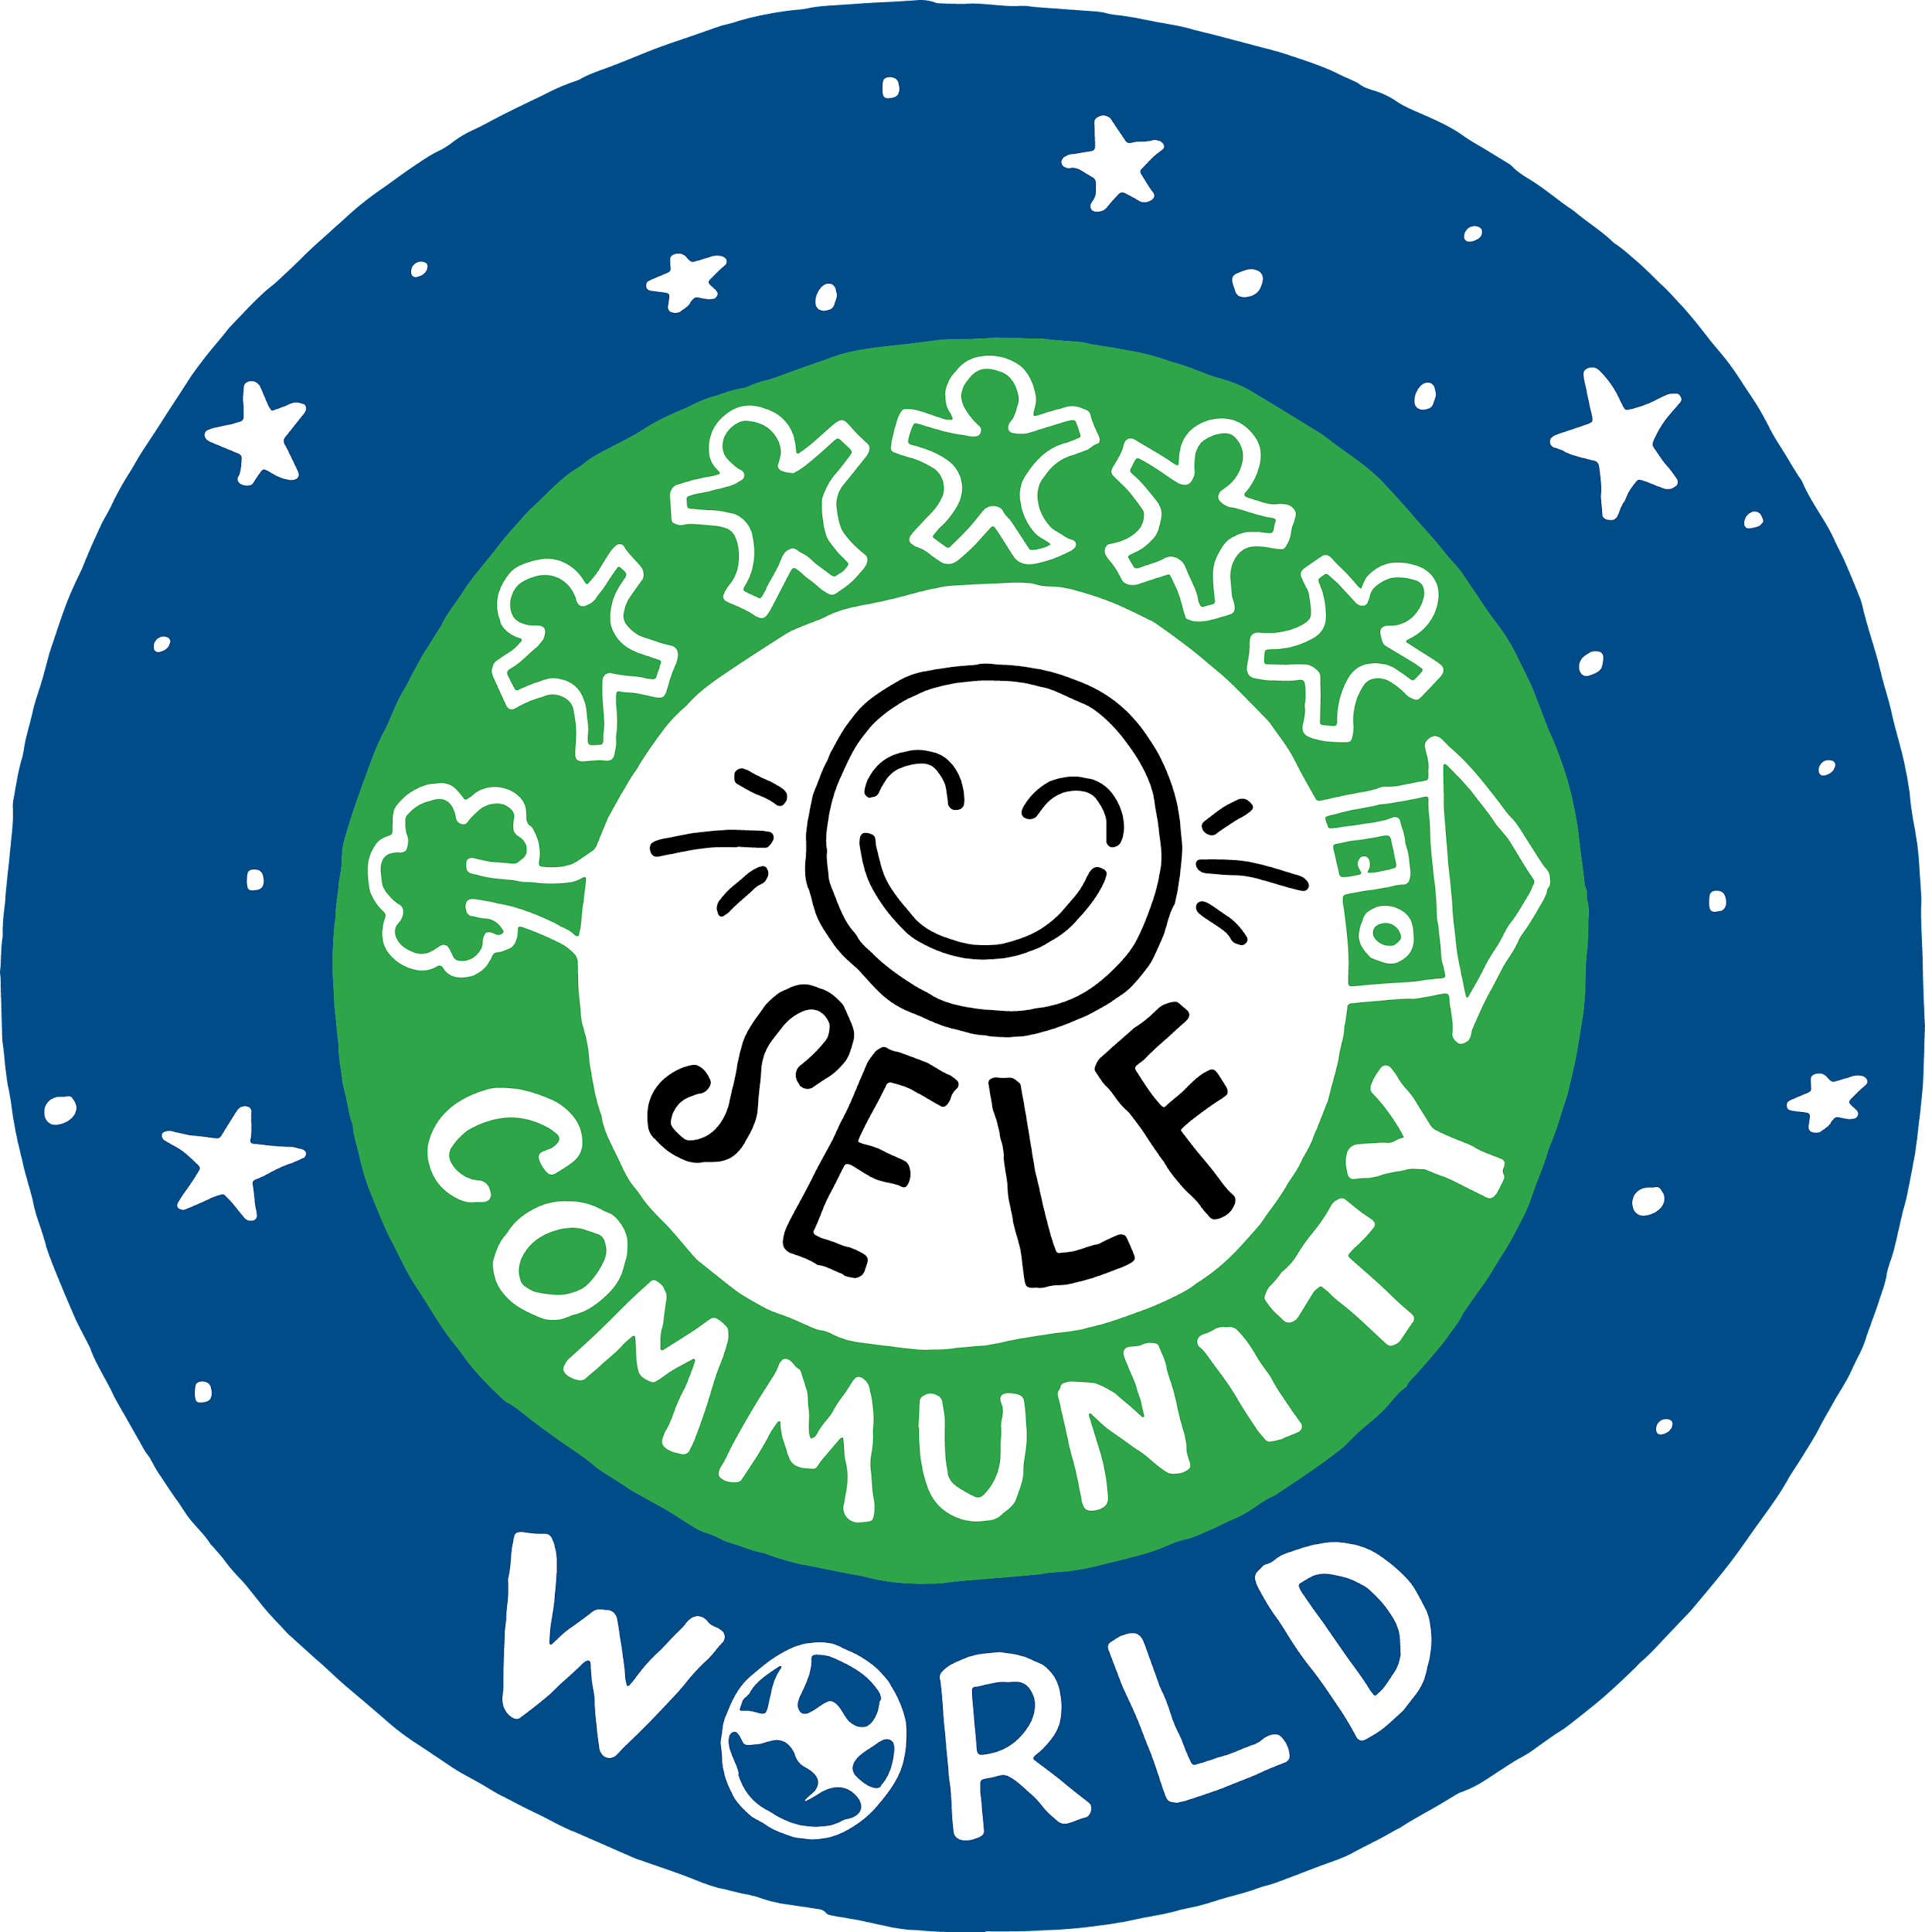
OBSERVE + ANALYZE IMAGE
The Rings of Responsibility
What responsibilities do you have to yourself?
What responsibilities do you have to your community?
What responsibilities do you have to your world?

Slide 7
KEY VOCABULARY
Digital Citizen
Someone who uses technology responsibly
to learn, create, and participate

Slide 8
ACTIVITY: MY RINGS OF RESPONSIBILITY
Directions
First, choose three colors and use them to color in the key. Then, use the key colors to color in the correct ring or rings for each statement.

Slide 9
WRAP UP: EXIT TICKET
Directions
Pick one example from your My Rings of Responsibility handout.
Write an explanation of why it belongs in the ring(s) that you chose for it.

Slide 10
