Slide 1
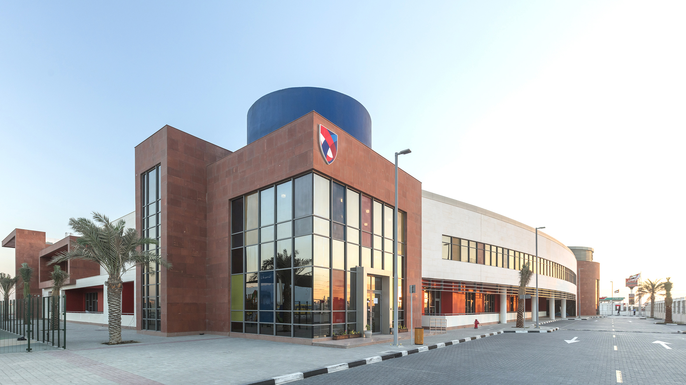
ASCS Nad Al Sheba
Ladder of Responsibility

Slide 2
In this lesson students will
Explain the difference between responsible and irresponsible actions.
Create a responsibility ladder that highlights personal responsibilities.

Slide 3
What is Responsibility?
Notes:
Explain that responsibility is when you can be relied on to do the things that are expected or required of you. You do what you say and you say what you do. Others can rely on and trust you with both the little things as well as the big things in life.

Slide 4
Responisbility is…

Slide 5
When you think of the word “responsibility”, what comes to mind?
Getting your school homework done on time?
Helping your family with the daily chores?
Watching out for your little brother or sister?
Responsibility definitely means all those things, but it means something more too.
Responsibility is also about looking inside yourself and doing all you can to be the best person possible. And trying to see what you can do to help others. In short, when you practice responsibility, you’re on your way to making your life the very best it can be!

Slide 6
What is Self-Discipline?
We are responsible for our own behaviour.
For example, when you get really frustrated, can you control yourself by taking deep breaths or walking away?
If so, you are practicing self-discipline! Self-discipline takes lots of practice, so don’t be discouraged if you need to keep trying! Even adults must practice this skill every day.
Notes:
Explain that self-discipline means we are responsible for our own behavior.

Slide 7
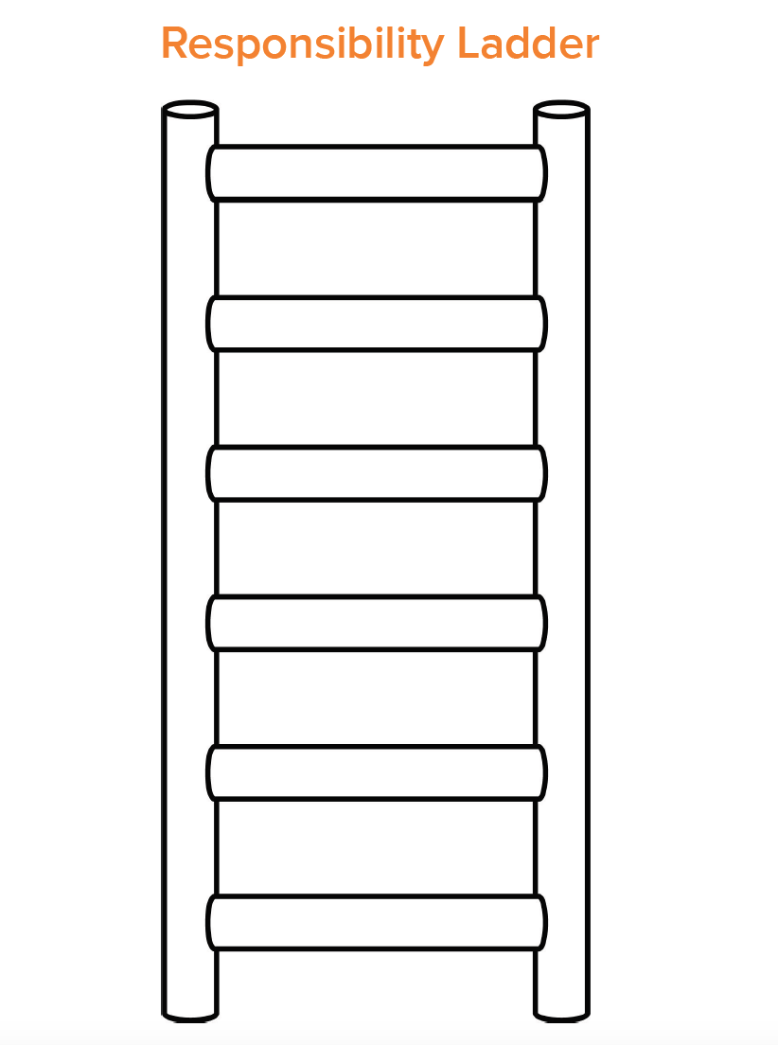
Ladder of Responsibility
You will create you own “Ladder of Responsibility” which will highlight all the different ways you are personally responsible both at school and home.
Notes:
Draw a ladder on the board. Write responsibility on the left side of the ladder, perpendicular to the rungs. On each rung, write one personal responsibility you have as a teacher. If desired, you can increase the seriousness and importance of each responsibility as you head to the top of the ladder. As an example, your bottom rung may say, “Grade papers,” and your top rung may say, “Showing up daily”.
● After you write each responsibility, discuss with the class what would happen if you did NOT follow through. Example: If I did not show up every day you would not have a teacher and would not be able to earn! One option could be to erase the rung each time you don’t complete your responsibility. The ladder will no longer work when the rungs are missing!
● Pass out the ladder template below and have each student label it with the word RESPONSIBILITY on the side like in the Teacher example.
● Allow 10 minutes for students to add personal responsibilities to each rung. If needed, students can draw their answers as an alternative. Encourage them to decorate their ladder as time allows.

Slide 8
Reflection
Would anyone like to share their Ladder of Responsibility?
What happens if we don’t complete one of our responsibilities?
Notes:
As a class, discuss the consequences if one of the responsibilities was not completed as promised.
Every person in our class has important personal responsibilities they must complete everyday. Sometimes we don’t feel like what we have to do is very important or necessary. However, if we all stopped being responsible, our class would be a messy, disorganized, unkind place without any teacher!
When we are kind and responsible, our class can run smooth and everyone has an opportunity to learn and grow.

