Slide 1
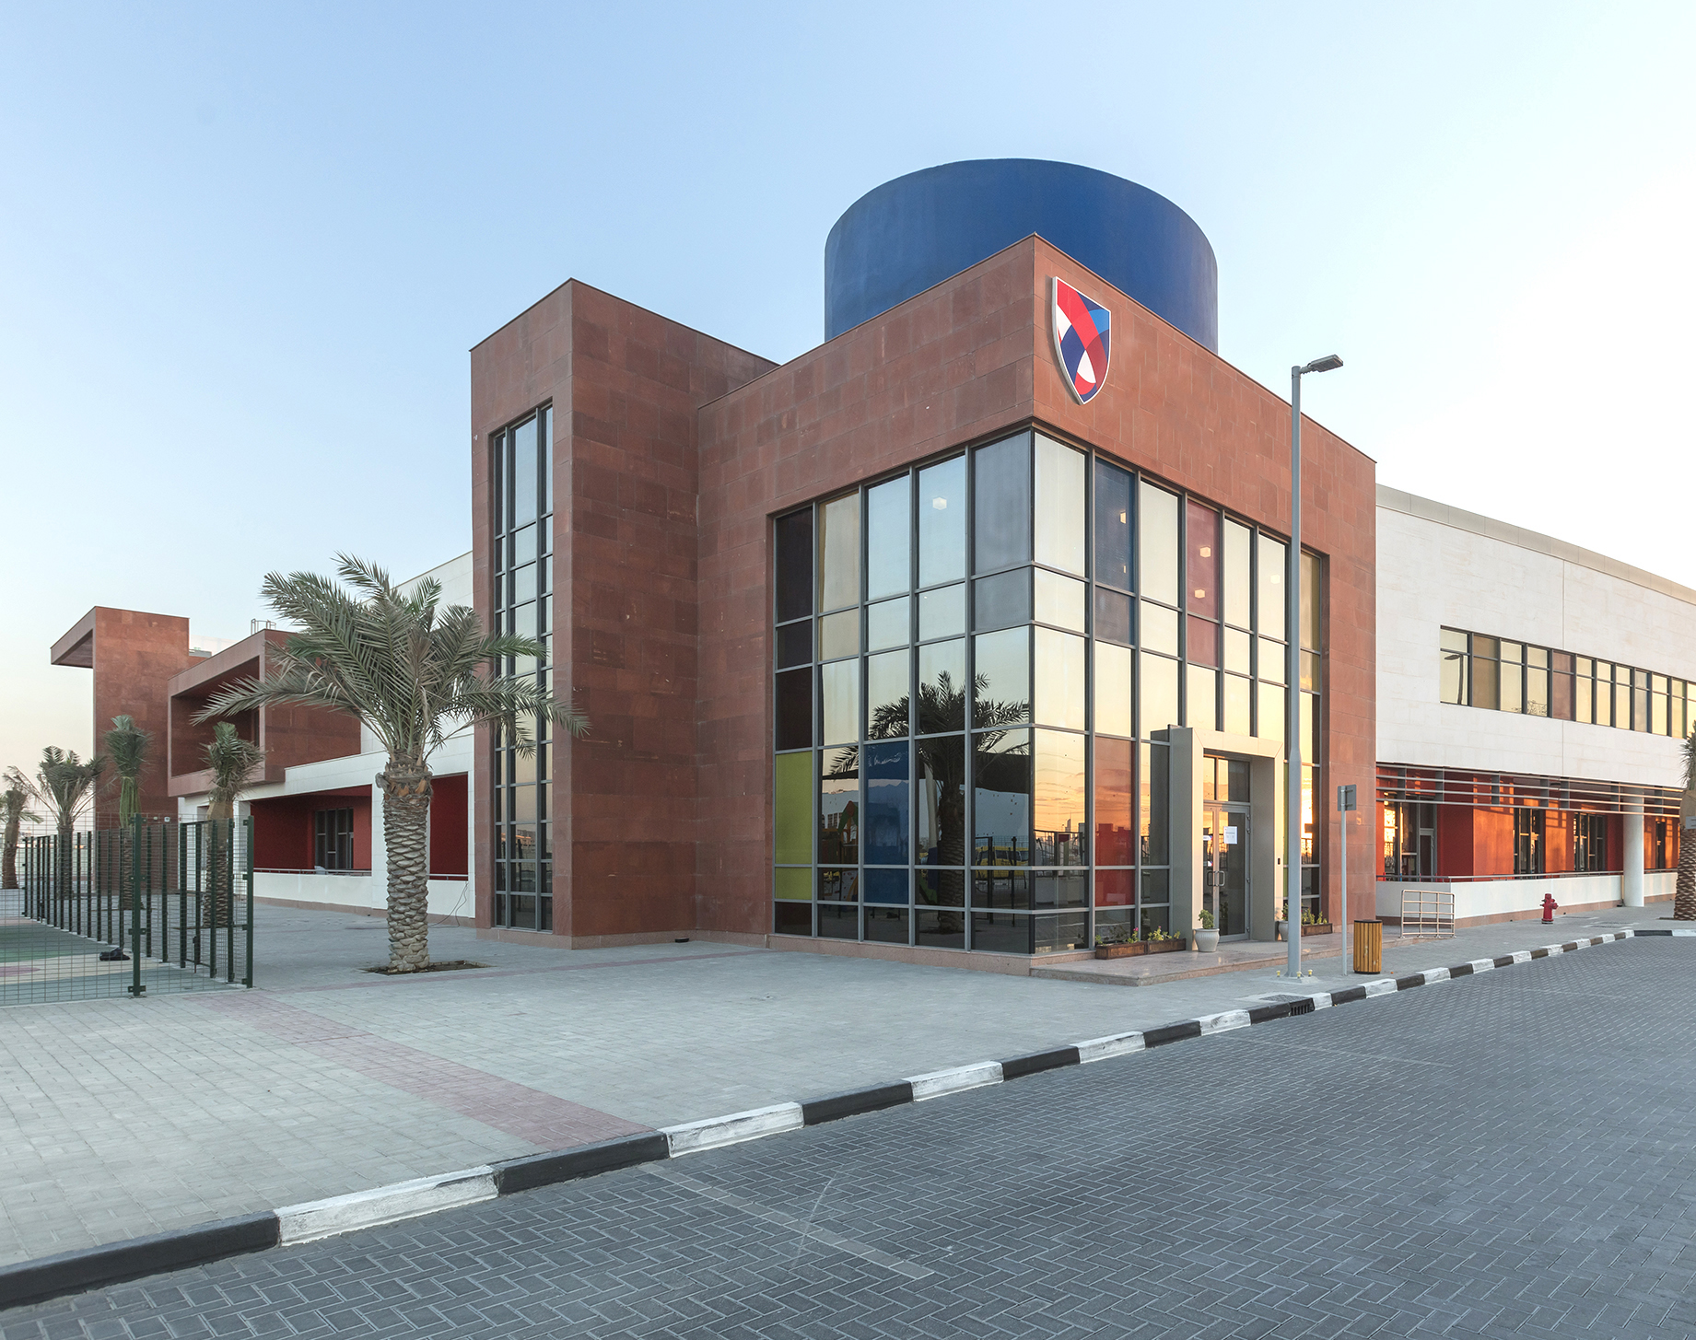
ASCS Nad Al Sheba
Be an Upstander

Slide 3
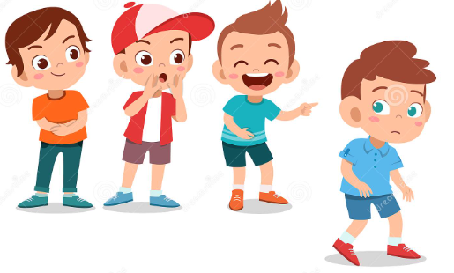
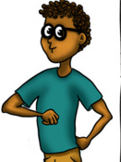
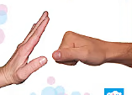
A bystander is someone who sees or knows about bullying or other forms of violence that is happening to someone else, but takes no action to address it or report it. ​
An upstander is someone who recognises when something is wrong and acts to make it right. When an upstander sees or hears about someone being bullied, they speak up and do their best to help, protect and support the person.​

Slide 4
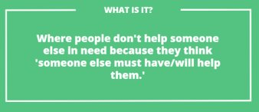
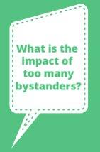

Slide 5
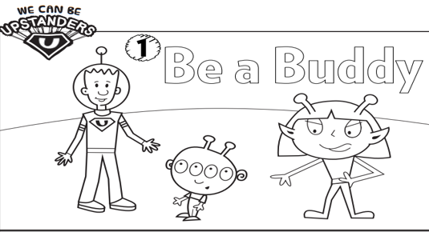
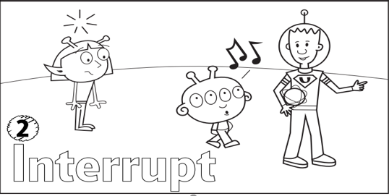

Slide 6
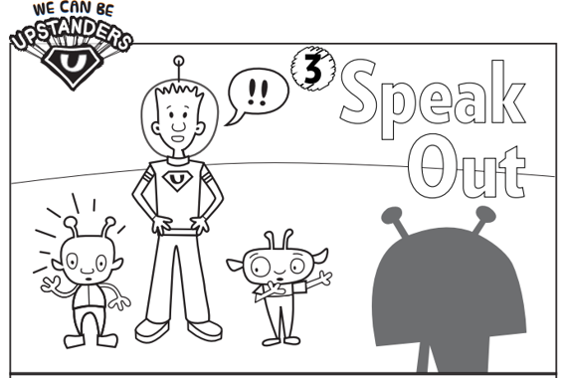
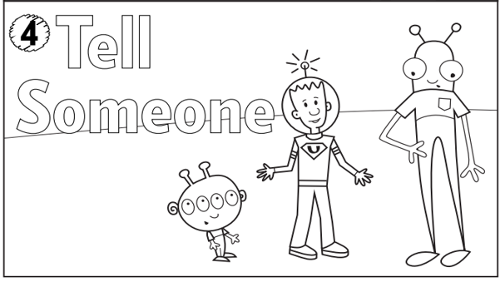

Slide 8
Think of what it must be like to hear or see somebody being bullied as
A Bystander
An Upstander
How you would feel being a BYSTANDER
How you would feel being an UPSTANDER

