Slide 2
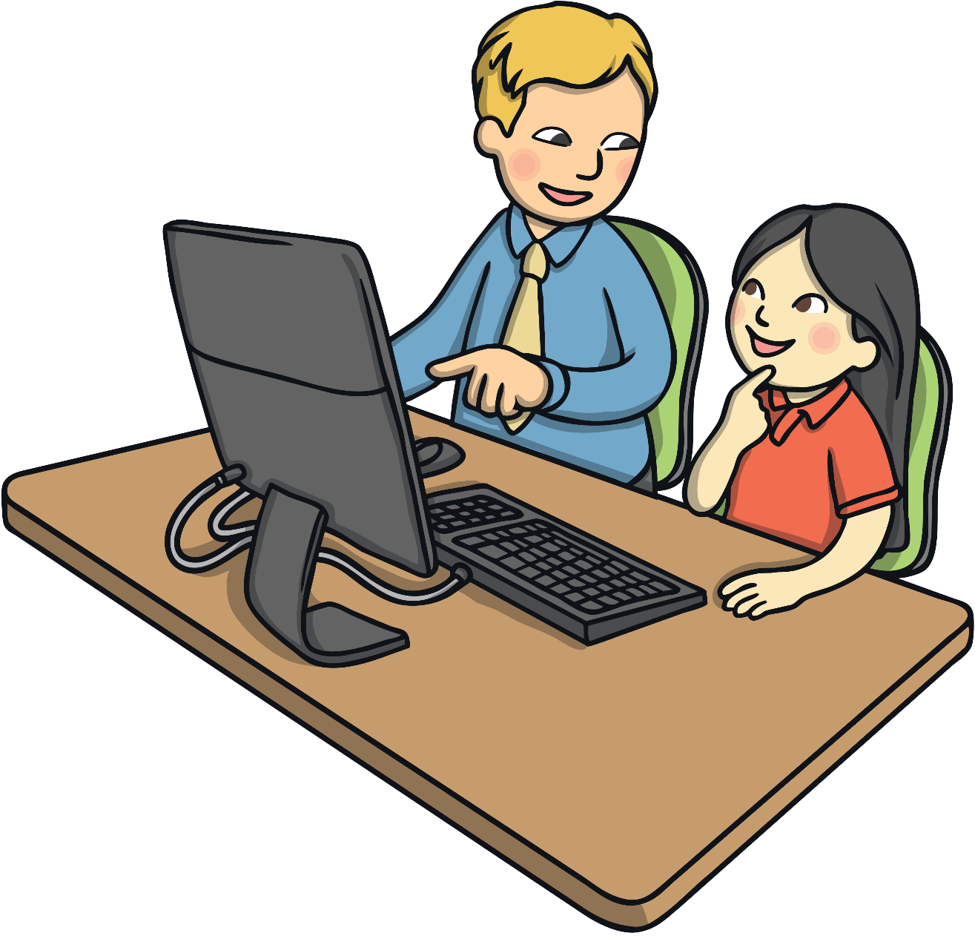
Safer Internet Day Tuesday 6th February 2024
The theme for Safer Internet Day 2024 is ‘Inspiring change? Making a difference, managing influence and navigating change online’.

Slide 3
Going Online
Talk about it:
When do you go online? Why do you go online?
We can go online for lots of reasons, such as to:
watch TV shows
play games
watch online videos
talk to friends
find out information
complete homework
The Internet can be loads of fun!

Slide 4
But…
Who do you think owns the Internet?
Who do you think decides what can be put on to it?
Who makes sure the things on the Internet are truthful and real?
No one owns the Internet. No one decides what can be put on.
The Internet can be used by everyone and everyone can add things to it!
Talk about it:
Trust means to be able to count on someone and know they are telling the truth. Do you think you can trust everything and everyone on the Internet?

Slide 5
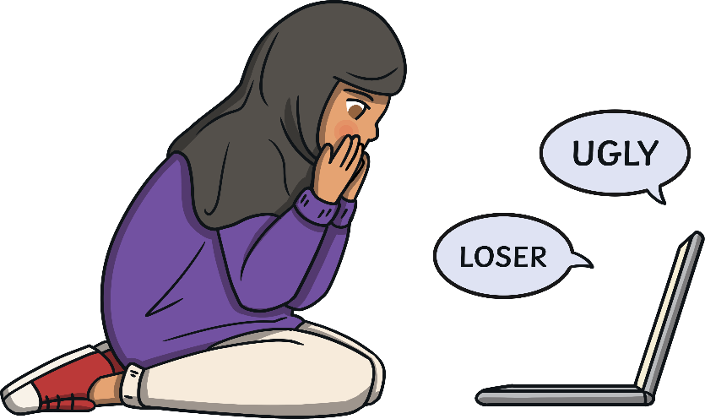
Would You…?
Talk to your partner about these two different situations. Tell them whether you would or wouldn’t do each thing and explain why.
If a stranger told you that they had a free gift for you as long as you wrote down your name and address, would you share your personal information?
If someone was saying nasty things about one of your friends, would you join in and say them too?

Slide 6
Would You…?
Here are some important things to remember when you are online.
Just like in the real world, the Internet has both nice and unkind people using it.
There might be people who want to help you and people who may want to trick you or be unkind to you. But you can’t see the people using the Internet and it is hard to tell who is trustworthy and who isn’t!

Slide 7
Stay Safe Online
Remember, anyone can use and add things to the Internet. This means that we can’t always trust what we see on it.
We can’t always trust that people who want to talk to us on the Internet are trustworthy.
We can’t always trust the websites on the Internet. Some may have viruses that can stop our computers from working properly!
So, how can we use the Internet for all the fun things but still stay safe?

Slide 8
How to Stay Safe
Try to only use websites you know can be trusted. If you aren’t sure, ask an adult!
Try to use websites that are for children as much as possible.
Remember, some people might pretend to be children to talk to you. Never give out your name or address! We don’t really know who we are talking to when we chat through the Internet.
Never arrange to meet an online friend. If someone online asks you to meet them, tell an adult you trust right away.
Remember if you aren’t sure about anything, always ask a trusted adult.

Slide 9
Bullying
Talk about it:
What is bullying?
Bullying is when a person tries to hurt someone on purpose, either in what they say or what they do. It usually happens more than once.
Some people use the Internet to bully others. This is called online bullying.

Slide 10
Online Bullying
Online bullies may:
send nasty text messages or emails
say unkind things about people on social networking sites
try to get others to say unkind and nasty things too
send unkind photographs to lots of people
Online bullying hurts people just the same as any other bullying.

Slide 11
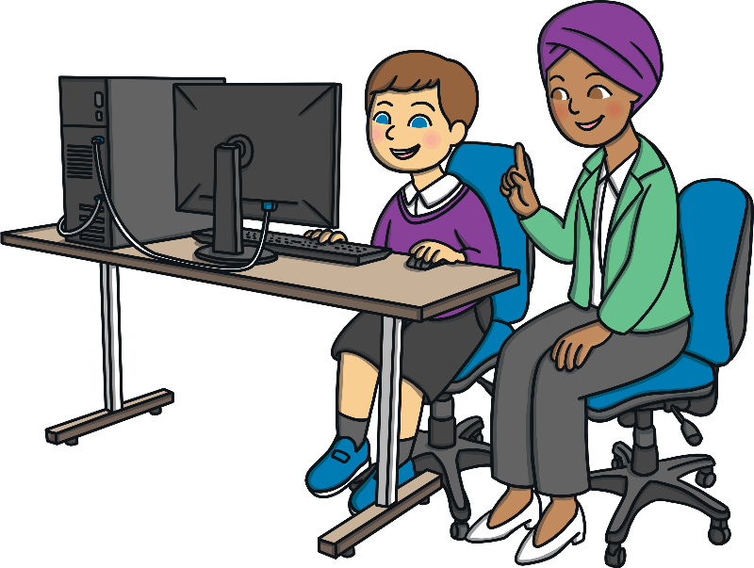
What If You or Someone Else Is Bullied Online?
The most important thing to remember is that if you are upset by something that happens online, to you or to someone else, tell a trusted adult right away. It might be a grown-up you live with or a teacher at school.
They can help you to report the thing you saw.
They can talk to you and help you feel safe.
They can help to stop the bullies hurting other people too.
No one has the right to hurt or upset anyone else, even online!

Slide 12
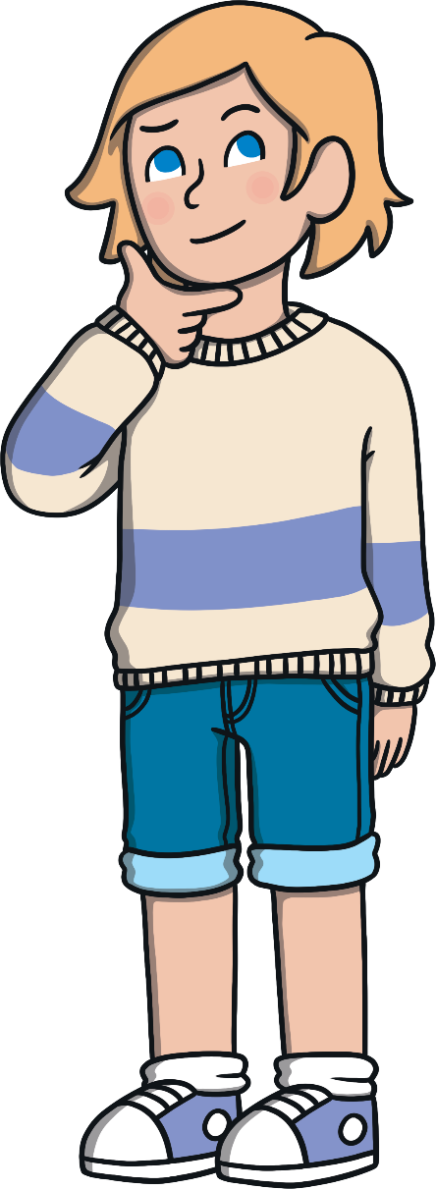
What Should You Do?
If you see someone else being bullied online, do not join in or be nasty to the bullies. Tell an adult you trust.
Do not write unkind things about other people or use nasty words. You can’t see the person but it will still hurt them!

Slide 13
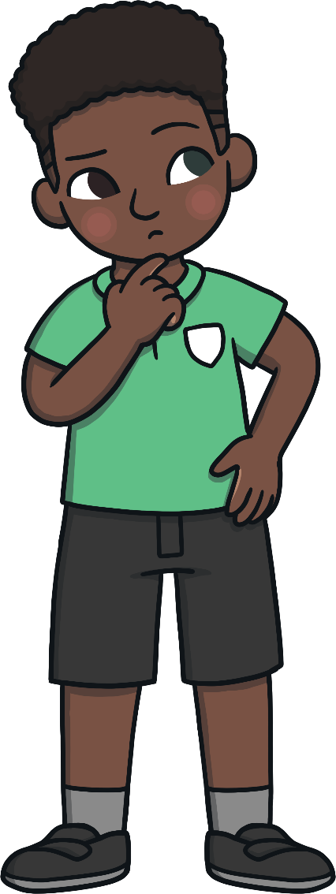
How Can You Help Make the Internet a Kinder Place?
Talk about it:
What could you do to help make the Internet a kinder place to be?
Always be kind online.
Block people who are unkind online.
Tell an adult. Don’t let the bullies win.
Only use safe websites and apps.

Slide 14
Remember to Be SMART
Stay Safe: Never give your name, address or passwords out to anyone online. They may say they are the same age as you but they could be lying.
Meet: Never go to meet someone you have made friends with online. If an online friend wants to see you, talk to an adult you trust. Remember that they might not be who they say they are.
Accepting: If someone sends you a photo or a file, ask a trusted adult for help. Do not open the photo or file. It could have a virus.
Reliable: Remember that you can’t trust everyone who uses the Internet. Not everyone is kind or trustworthy.
Tell: Tell a trusted adult if something online upsets you or makes you worried.

