Slide 1
Sticky Friendship Problems: Strategies

Slide 2
What Are Sticky Friendship Problems?
Friendships that change or become difficult
Examples:
Your best friend starts playing with someone else
A friend says something that hurts your feelings
You and your friend disagree about something important
It's normal to face these challenges as you grow

Slide 3
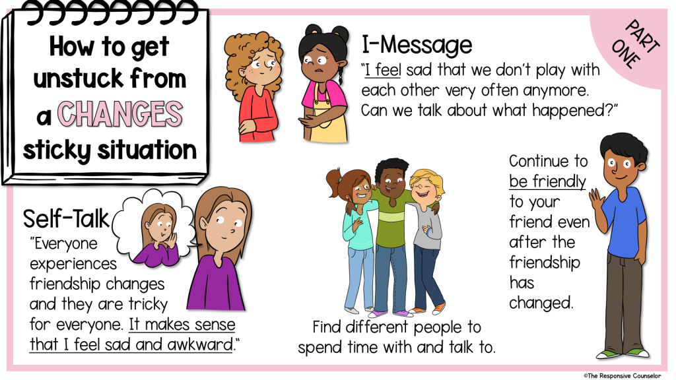
Strategy 1: I-Messages
I-Messages help you express your feelings without blaming others
Format: "I feel _____ when _____ because _____."
Example: "I feel sad when you play with others at recess because I miss spending time with you."
Practice: Create your own I-Message for a friendship problem

Slide 4
Strategy 2: Helpful Self-Talk
Self-talk is what you say to yourself in your mind
Positive self-talk can help you feel better and solve problems
Examples:
"I can handle this."
"This is hard, but I'll get through it."
"There are other friends I can play with too."
Try saying these to yourself when you face a friendship problem

Slide 5
Strategy 3: Planning for the Future
Think about how you want your friendship to be
Make a plan to improve things:
Talk to your friend using an I-Message
Suggest a fun activity to do together
Ask a trusted adult for advice if needed
Remember: It's okay if friendships change, and you can make new friends too!

Slide 6
Let's Practice!
In small groups, act out a sticky friendship situation
Use the strategies we learned:
Share your feelings with an I-Message
Practice positive self-talk
Make a plan to move forward
Share your experiences with the class

