Slide 1
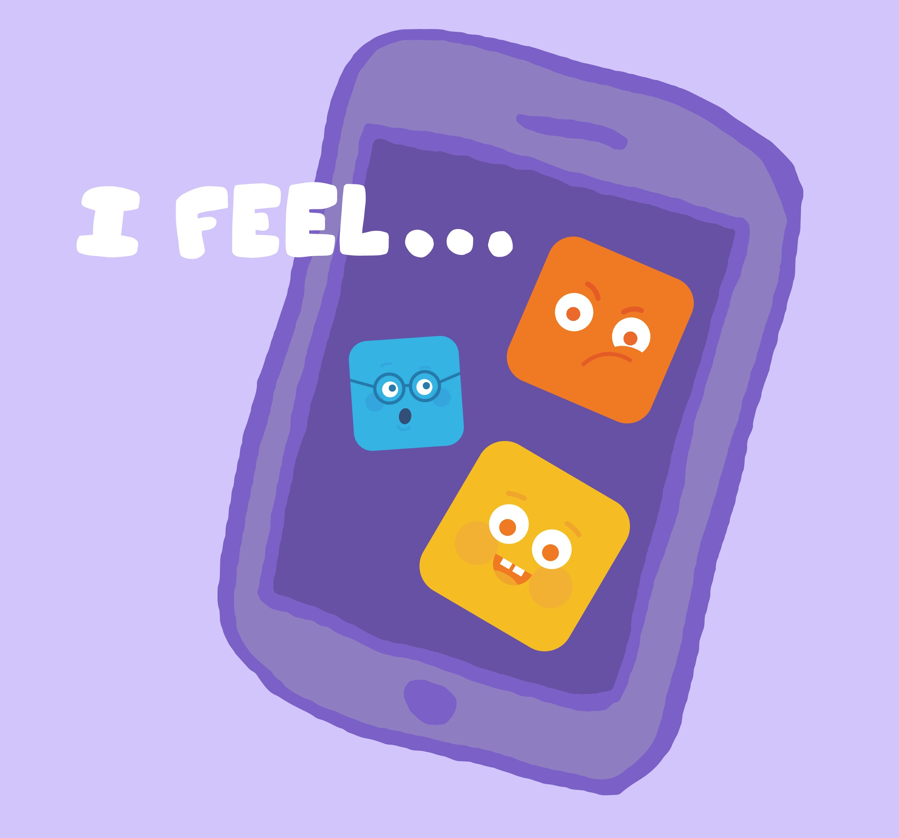
DIGITAL CITIZENSHIP | GRADE 1
How Technology Makes You Feel

Slide 2
Why is it important to listen to your feelings when using technology?

Slide 3
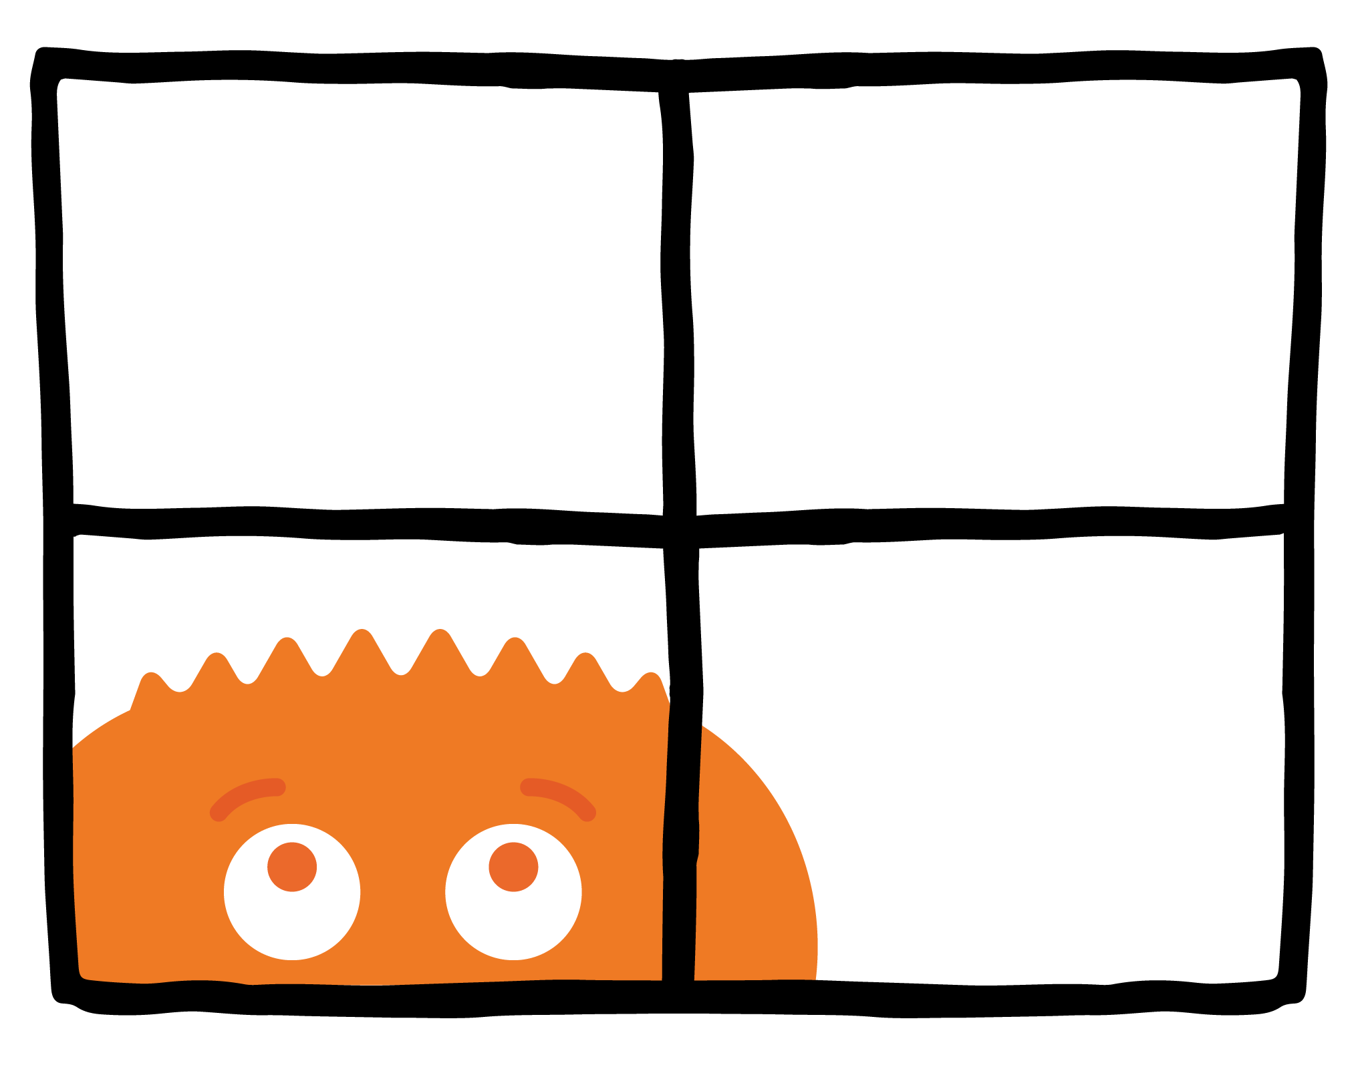
WARM UP
How do you feel when you've spent too much time inside on a rainy day?

Slide 4
PAIR-SHARE
You're watching a show that is supposed to be for kids. But there is a really scary character that you don't like.
How do you feel? What should you do?

Slide 5
KEY VOCABULARY
Uncomfortable
Causing a feeling of hurt or worry

Slide 6
PAIR-SHARE
How do you feel after you are done using technology?

Slide 7
ACTIVITY
Emoji Sticks
Happy
Frustrated
Uncomfortable
Curious

Slide 8
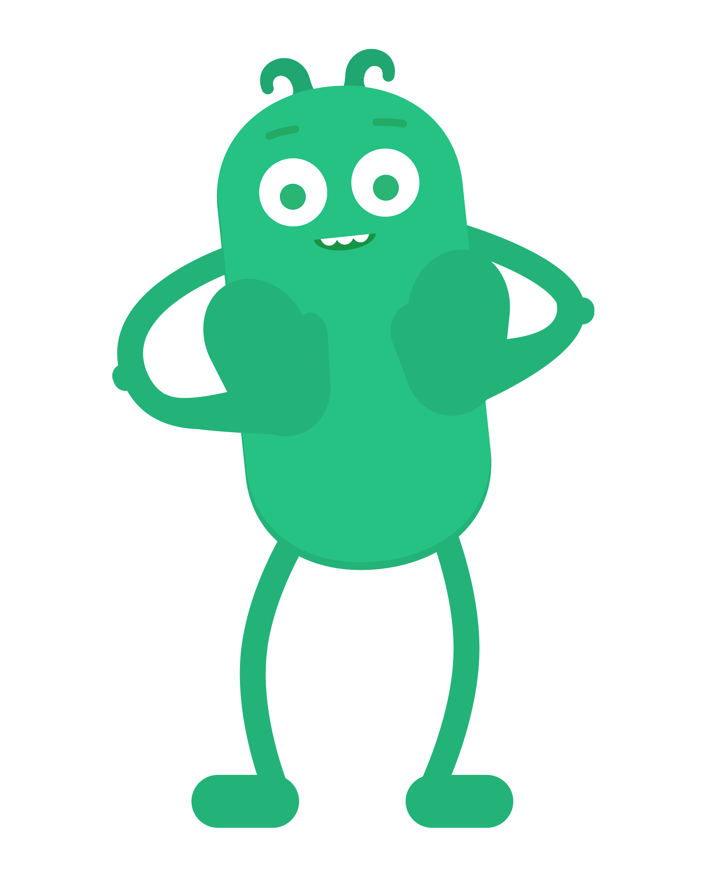
REVIEW
Pause, Think, Ask!
Pause
Think
Ask
When you have a feeling, stop and take a moment to notice it.
Notice your feelings and think about what to do next.
If you're feeling unsafe, unhappy, or unsure, get help from a grown-up.

Slide 9
EMOJI GAME
How do you feel?
What should you do?

Slide 10
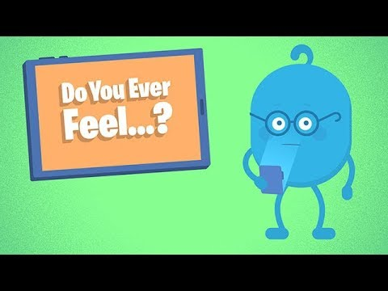
WATCH
To watch this video on the Common Sense Education site, click here.

Slide 11
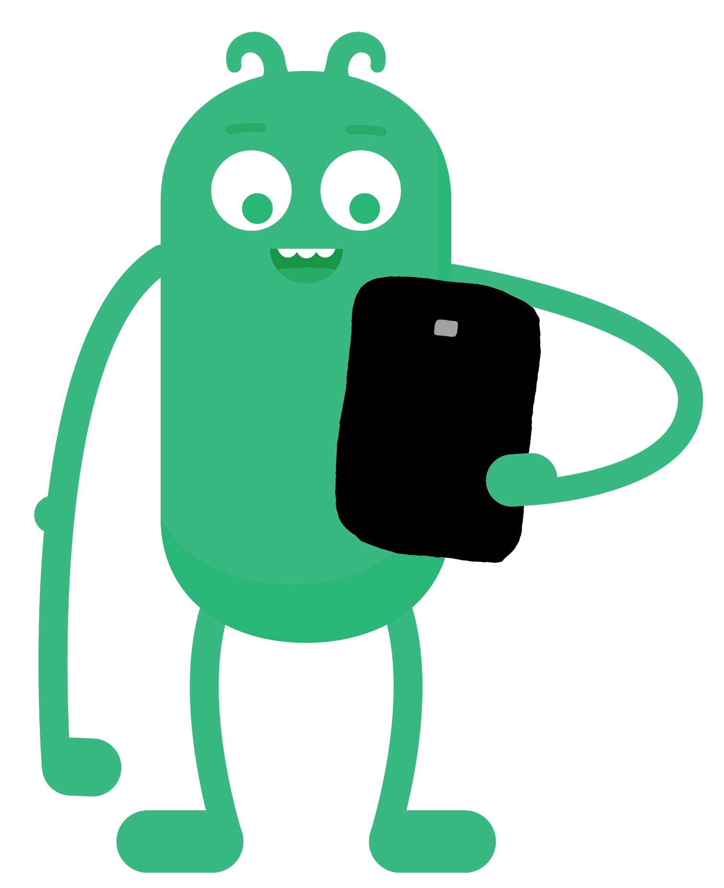
READ TOGETHER
Do You Ever Feel ...
By Wren Brennan
Technology!
It's fun, it's neat.
It makes me feel
Really sweet.
But then sometimes
It makes me blue.
Do you ever feel
That way, too?
When I'm happy,
I say woo-hoo!
When I'm sad,
I say boo-hoo!
When I feel my feelings,
I share them, too!
Whatever I'm feeling,
I say it to you!
When I feel unsure
Or not OK,
I pause and think
And ask away!
I find a grown-up
And I say,
Can you help me
Find my way?

Slide 12
REFLECT HANDOUT
Pause & Think Moment
Draw a picture to show what you will do if you get an uncomfortable feeling using technology.
Write about what you will do if you get an uncomfortable feeling using technology.
and

Slide 13
