Slide 1
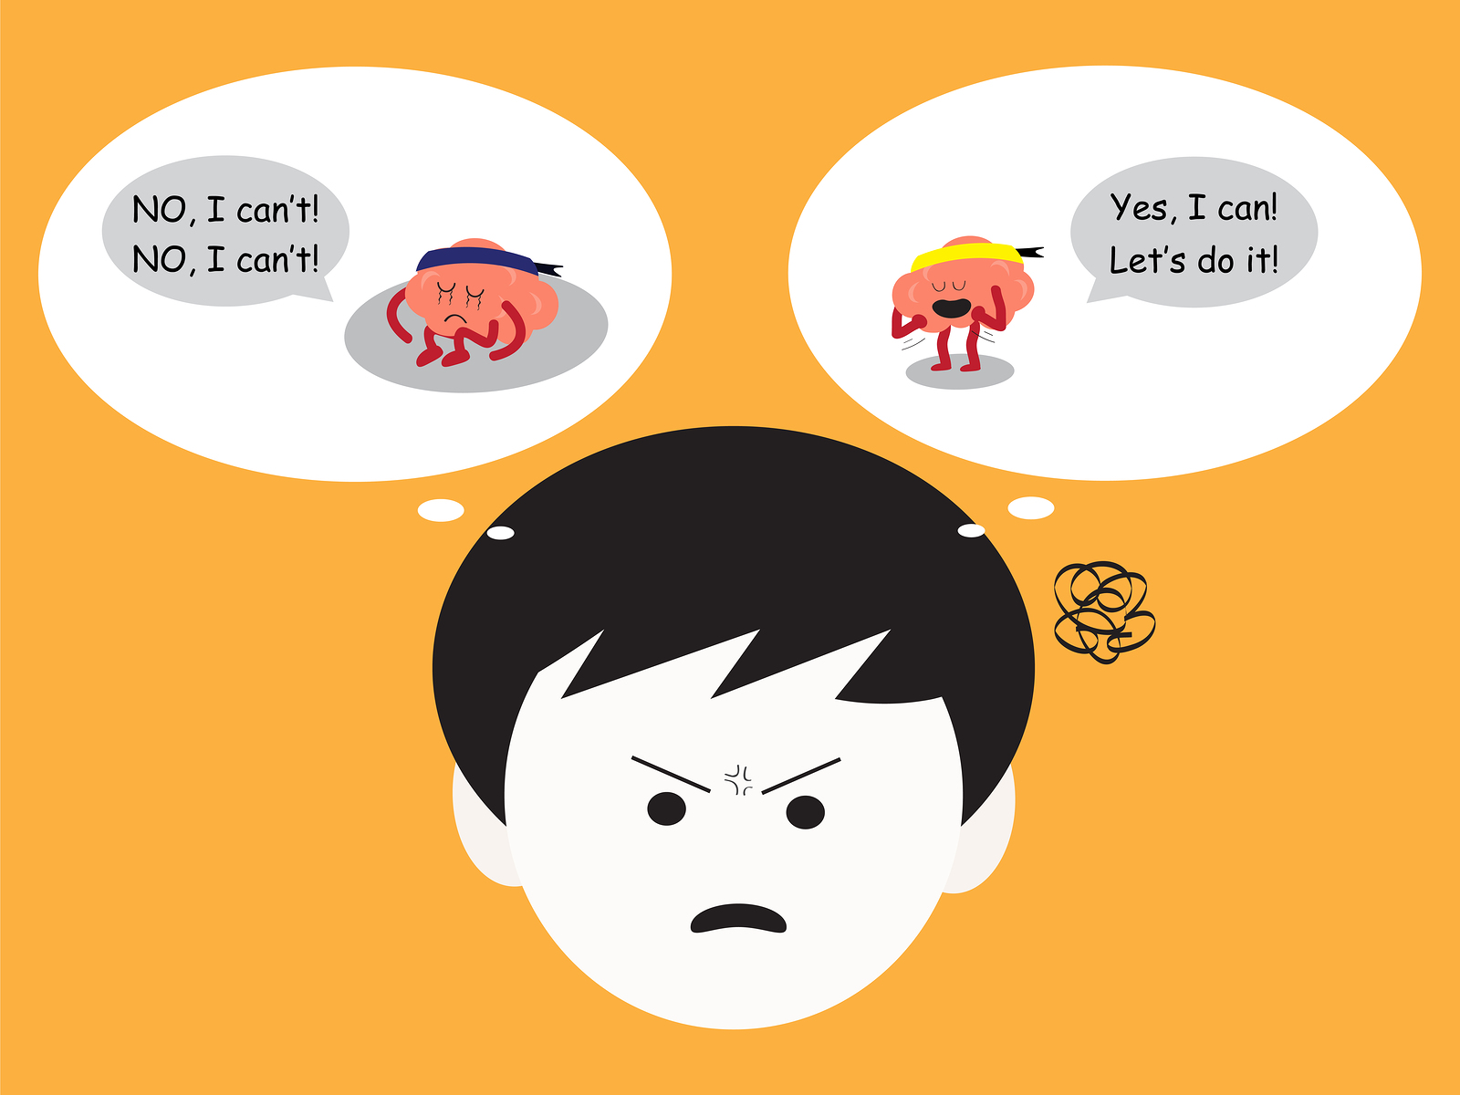
Lesson :
Listening to my positive/negative voice

Slide 2
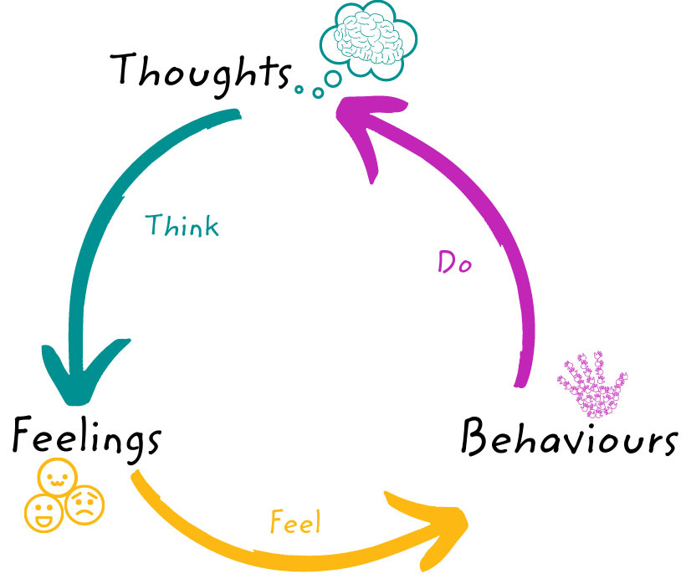
Minds On.......
How are our thoughts affecting our behavior?
Notes:
Teacher Notes –
Let’s help students to separate thoughts and feelings. Most students don't realize that feeling angry is different than thinking, "I'm going to knock my desk over." Thinking, "I'm going to fail my test," is different than feeling nervous.
First, to help children to tell the difference between thoughts and feelings, we have to define them.
Thoughts are words we say to ourselves.
Thoughts happen all the time and often without us realizing it.
Two people can have different thoughts about the same thing.

Slide 3
I will be able to recognize that :
• Positive self-talk helps us feel good and do well.
• Negative self-talk makes us feel down on ourselves.

Slide 4
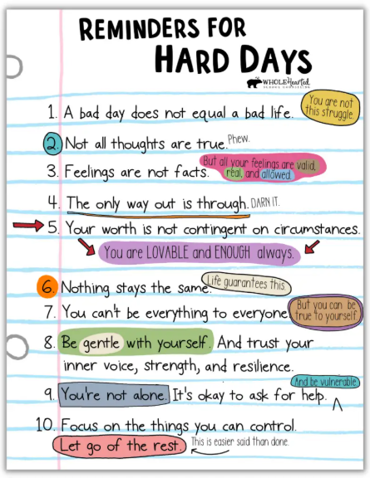
Remember all the time that …….

Slide 5
Let’s Discuss :
When I have a negative voice, I need to………

Slide 6
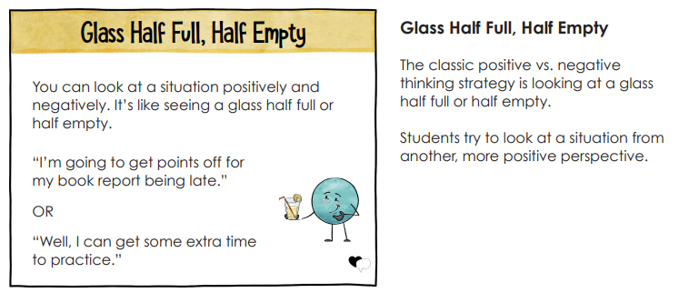

Slide 7
