Slide 1
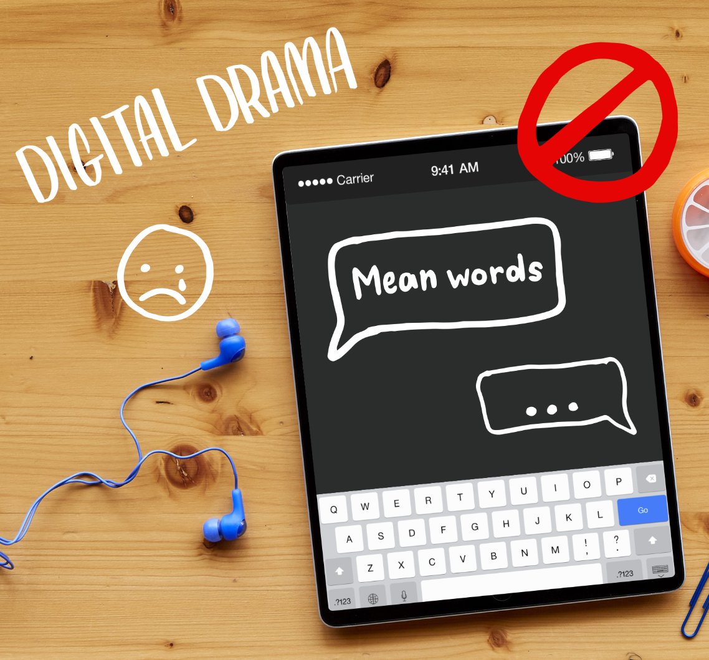
DIGITAL CITIZENSHIP | GRADE 3
The Power of Words

Slide 2
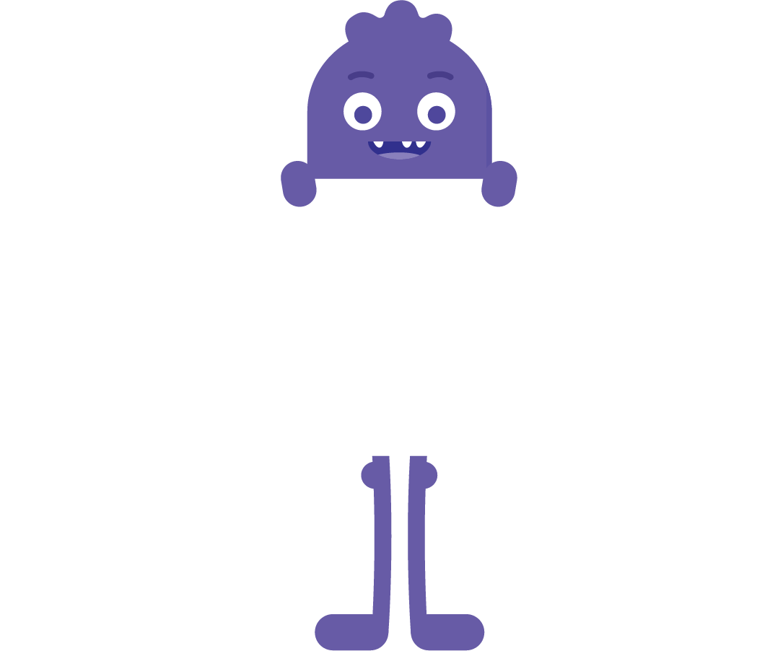
What should you do when someone uses mean or
hurtful language on the internet?
DSN: Have monster holding up as sign with the EQ.

Slide 3
Learning Objectives
l
Understand that it's important to think about the words we use because everyone interprets things differently.
Identify ways to respond to mean words online, using S-T-O-P.
Decide what kinds of statements are OK to say online and which are not.
2
3

Slide 4
WARM UP: CLASS DISCUSSION
Which emoji fits?
1
2
3
4

Slide 5
WARM UP: CLASS DISCUSSION
Hello.
1
2
3
4

Slide 6
KEY VOCABULARY
Interpret
To understand something based on your point of view

Slide 7
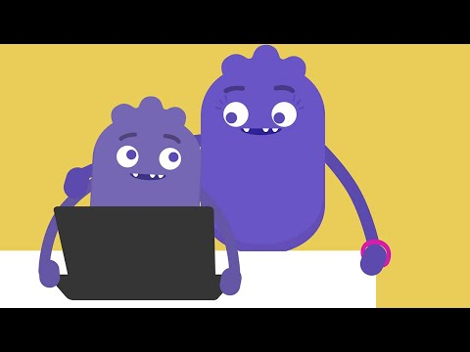
WATCH + ANALYZE
Power of Words
What does this video say about the saying "Sticks and stones may break my bones, but words can never hurt me"?
To watch this video on the Common Sense Education site, click here.

Slide 8
WATCH + ANALYZE
Power of Words
Why do you think those other players said those things to Guts?
To watch this video on the Common Sense Education site, click here.

Slide 9
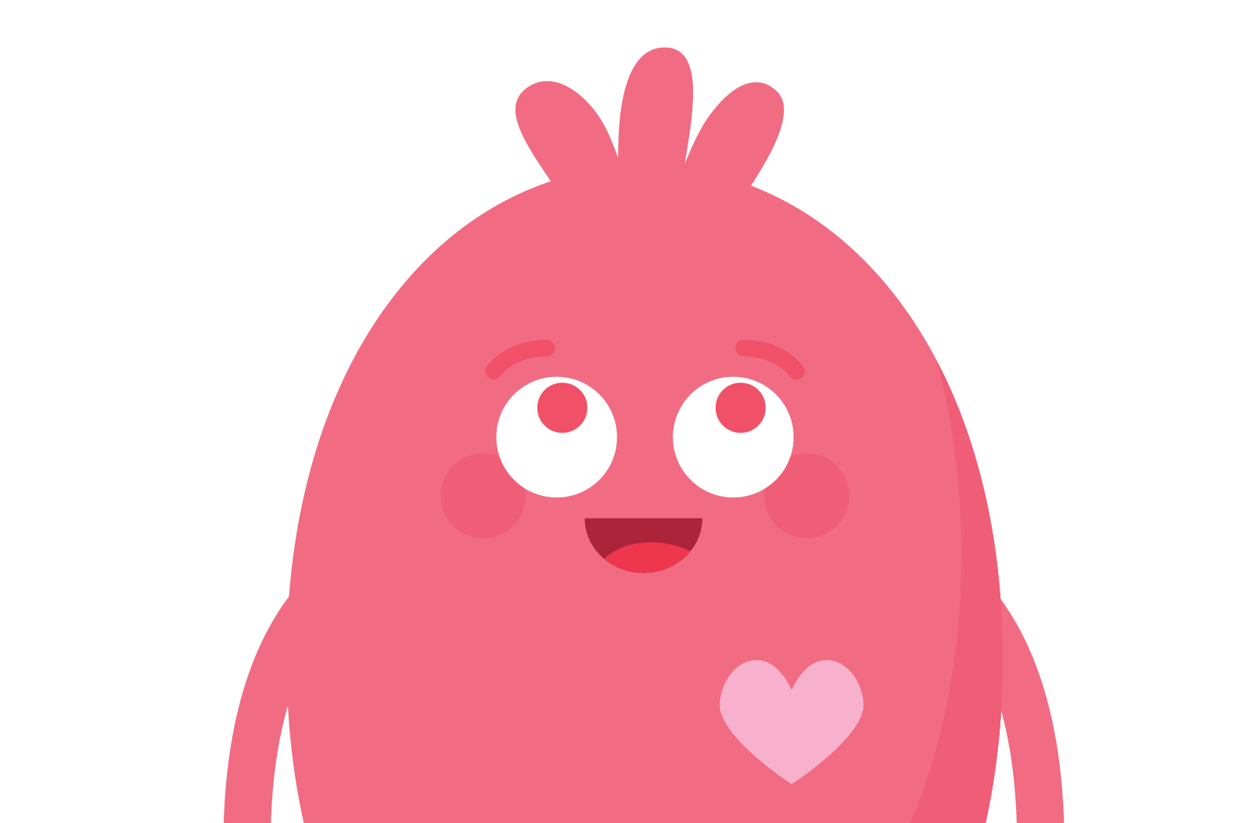
KEY VOCABULARY
Empathy
To imagine the feelings that someone else is experiencing

Slide 10
Step away.
Tell a trusted adult.
OK sites first.
Pause and think online.

Slide 11
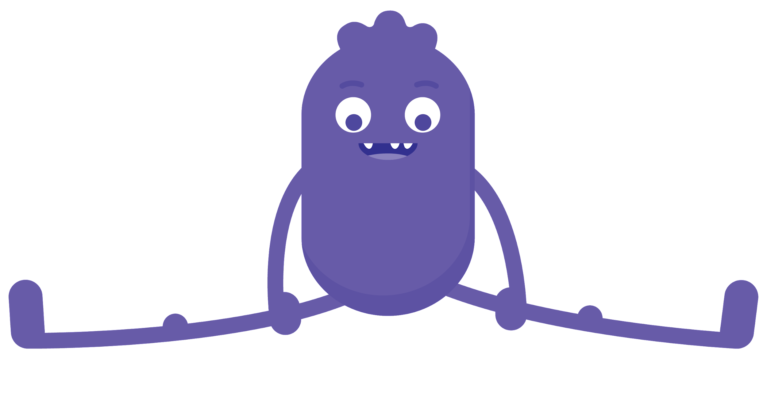
WRAP UP: CROSSING THE LINE
Directions
For each statement that is read, think about whether it would be OK or not to send that as a message to someone in a video game or as a comment.
After you decide:
If you think it's OK, move to or stay on the OK side.
If you think it's not OK, move to or stay on the Not OK side.
If you're not sure, stand on top of the line.
Be prepared to share why you chose the side you did.

Slide 12
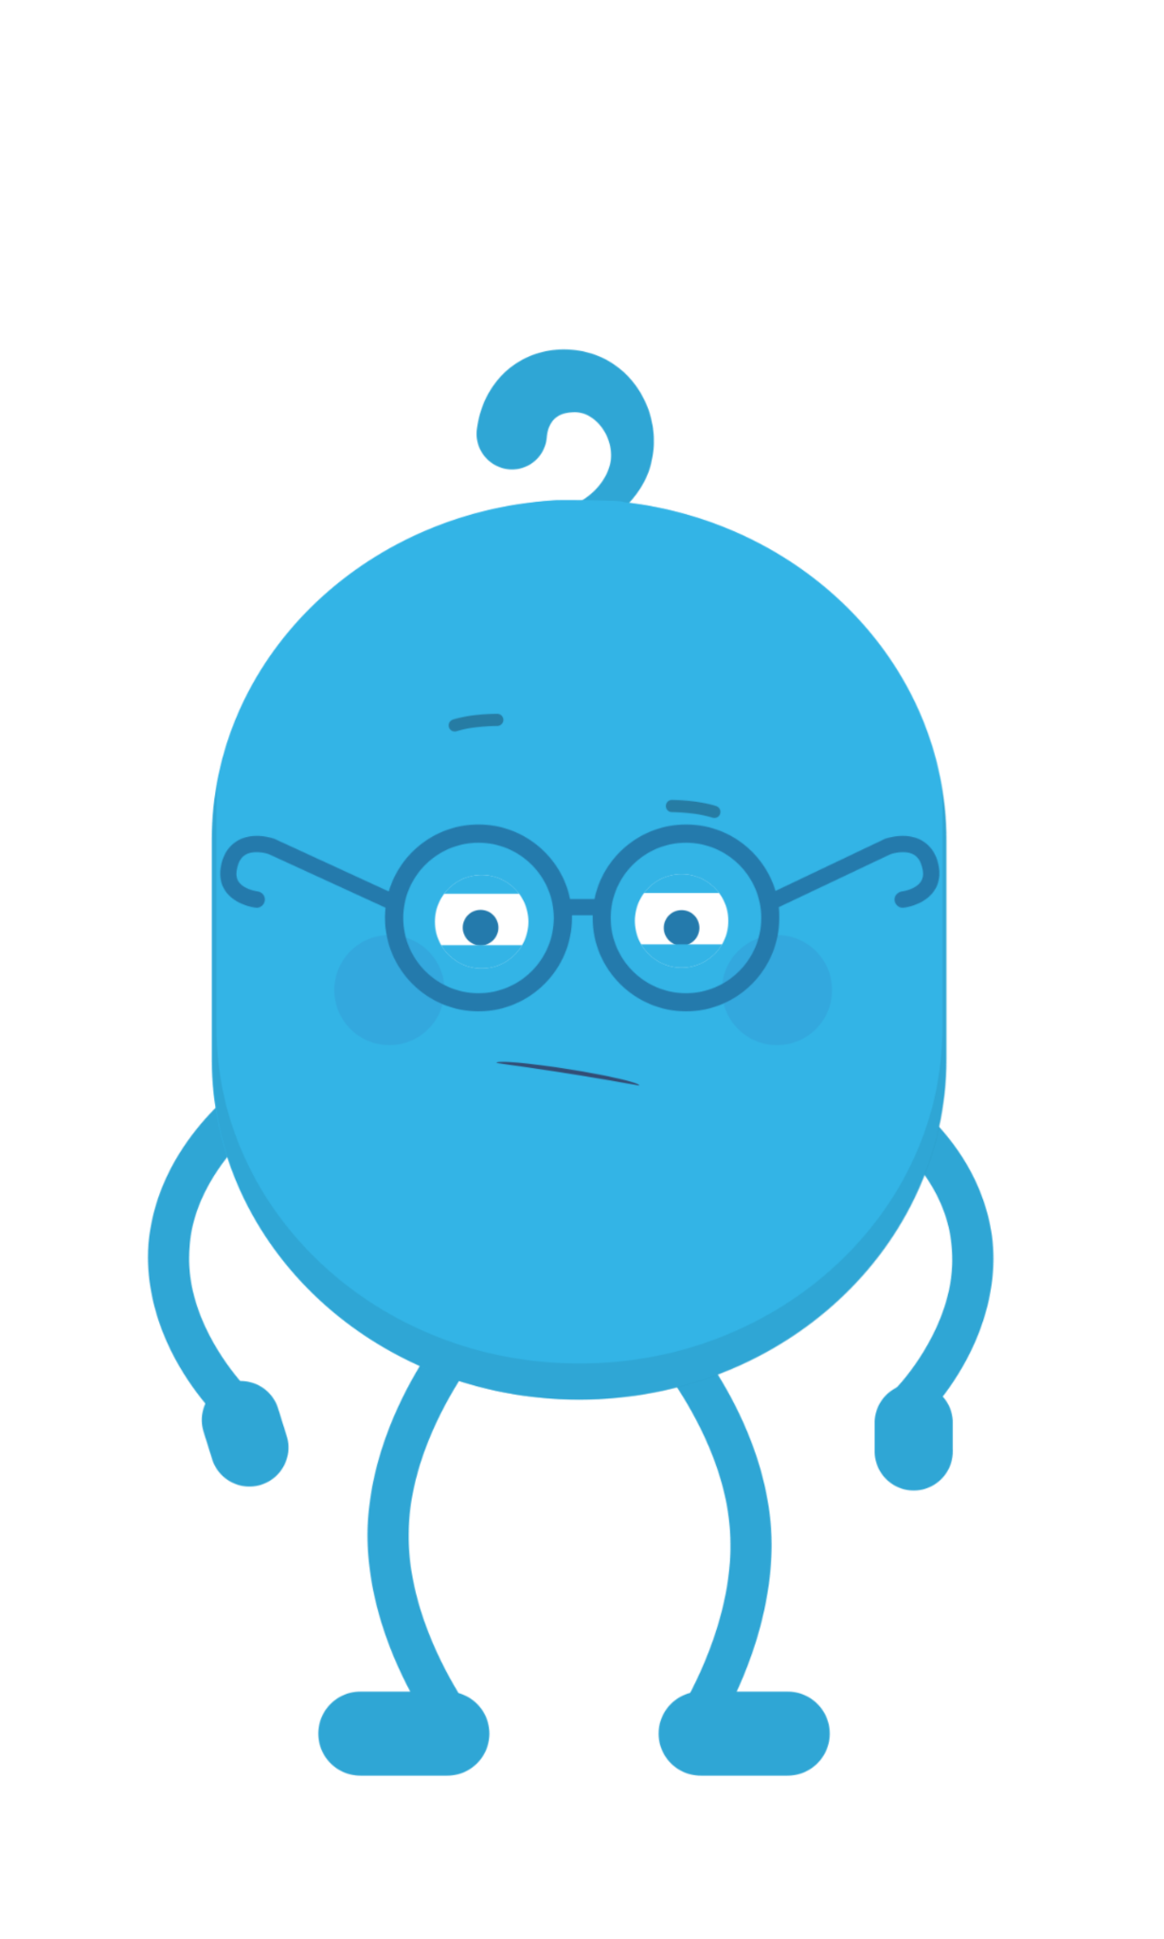
WRAP UP: CROSSING THE LINE
"You are an idiot."

Slide 13
WRAP UP: CROSSING THE LINE
"I'm having a party and
you're not invited."

Slide 14
WRAP UP: CROSSING THE LINE
"I like your new haircut."

Slide 15
WRAP UP: CROSSING THE LINE
"Thanks for the advice. Next time, would you mind telling me in
person rather than by texting?"

Slide 16
WRAP UP: CROSSING THE LINE
"Did you finish your
homework?"

Slide 17
