Slide 1
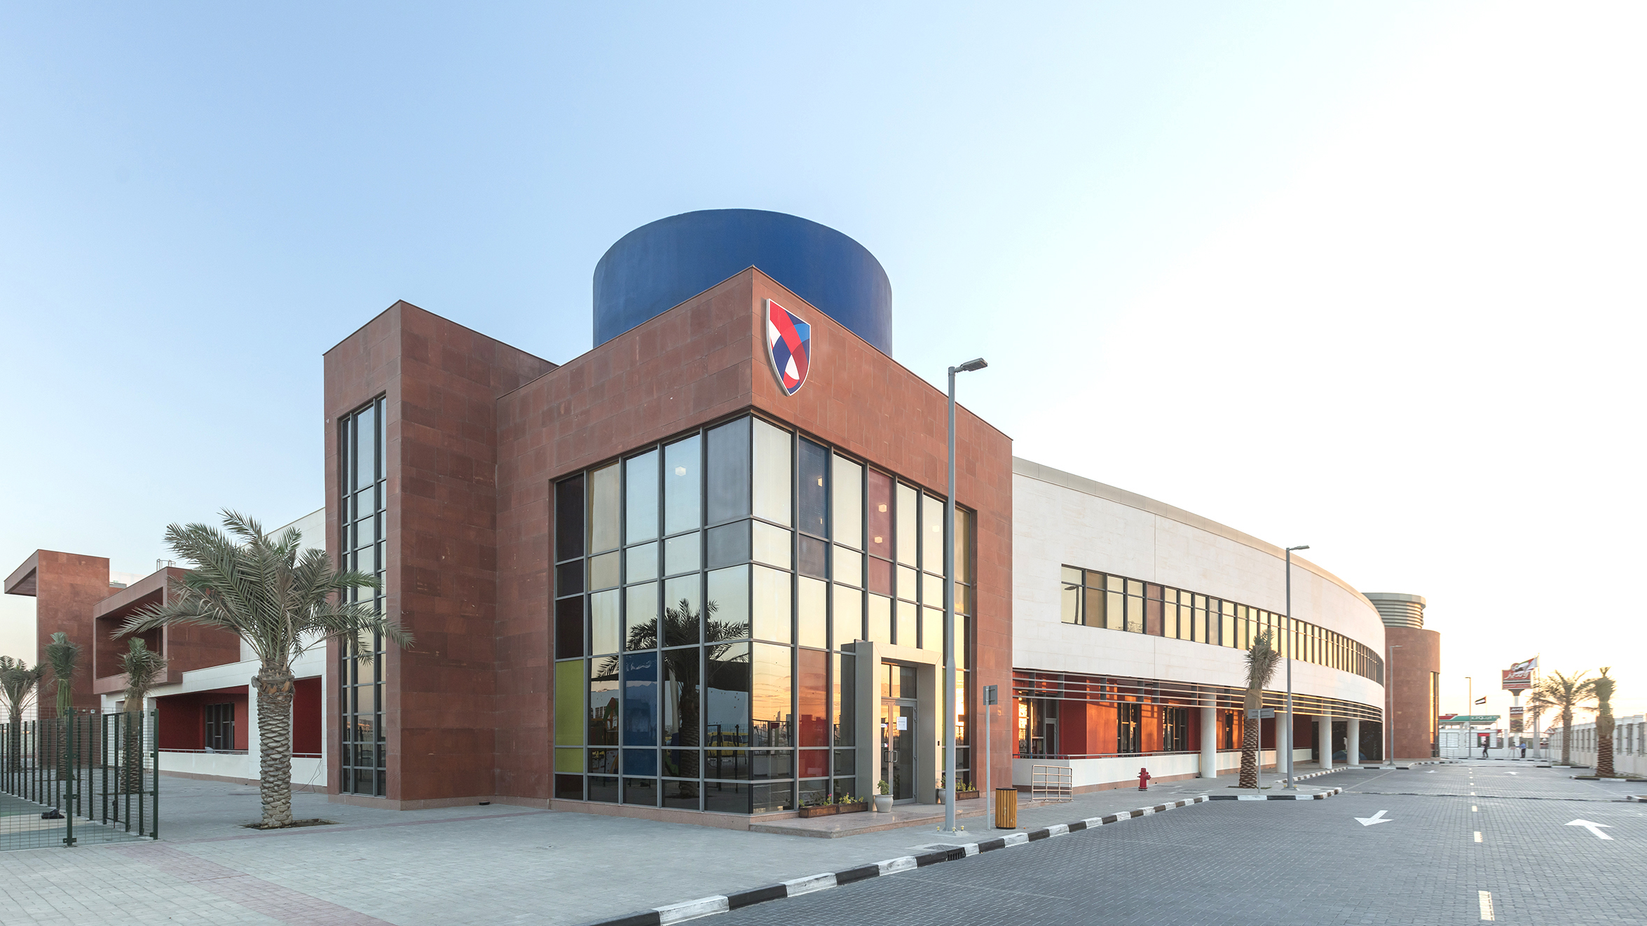
ASCS Nad Al Sheba
Responsibility & Kindness

Slide 2
In this lesson students will
● Identify ways children can be responsible during difficult situations
● Explore ways to be responsible using charades

Slide 3
During our last lesson we brainstormed ways we could go green and become environmentally responsible. Let’s check in and see how we are doing with our goals.
Has anyone gone green since our last wellbeing lesson?
Although your actions seem simple and small, all of our little green actions build on top of each other to truly make a kind impact on our world!
Notes:
Ask each child to name one way they have been successful in going green.

Slide 4
Responding with Kindness
The first part of the word RESPONSIBILITY is actually RESPONSE.
A response is another word for choice.
We can respond kindly or meanly. We can choose kindness or choose meanness.
You have this choice many times throughout the day!
Think back to this morning when each of us arrived at school. What choices did you make?
How were you able to respond with kindness when you got here?
Did you choose kind words with the bus driver?
Did you chose to hold the door open for others?
Did you say thank you?
Notes:
Ask each child to name one way they have been successful in going green.

Slide 5
How can each of us respond with kindness throughout our day?
We can respond with kindness, even when others choose to be mean or
unkind! It takes self-discipline to show kindness no matter what. We can do it!
STUDENT | TEACHER | PARENT

Slide 6
How can someone respond with kindness and show self-discipline in the following scenarios:

Slide 7
How can someone respond with kindness and show self-discipline in the following scenarios:
You forgot your homework and the book you need for your book club at school today.
Admitting you forgot your materials is a great first step. However, responding with kindness includes making a plan to remember next time so you don’t waste your group’s time in the future.
A bully yells at you and invites you to a fight on the playground.
Walking away is a great idea. However, responding with kindness can also mean you reach out to invite the bully into your games at some point in the near future.
Your sister slams the door in your face as you try to walk in the house.
Ignoring the behavior can be very helpful. One way to respond with kindness is to take it to the next level by holding the door open for her in the future.
The construction next door has left an empty lot that no longer has trees.
Planting a tree is a beautiful life-giving solution for that empty lot. Trees give us oxygen. If you plant a tree, you are giving others a chance for nice clean air!
Your dad is not feeling well and could really use some help.
Helping out around the house is a truly kind response

Slide 8
Reflect
We explored a variety of situations that allow us to respond with kindness today. If we pay attention, we can see opportunities every single day. Let’s think of other scenarios to respond with kindness.
Every day you are faced with numerous choices: to respond with kindness or not. Although we don’t often think about every choice we make, we are presented with options every single time we interact with someone. Our entire day is filled with friends, teachers, family, familiar people, and new people we are just meeting. Let’s try to be more conscious as we move forward and try to respond with kindness, regardless of the situation!
Notes:
Allow students to share their responses.

