Slide 1
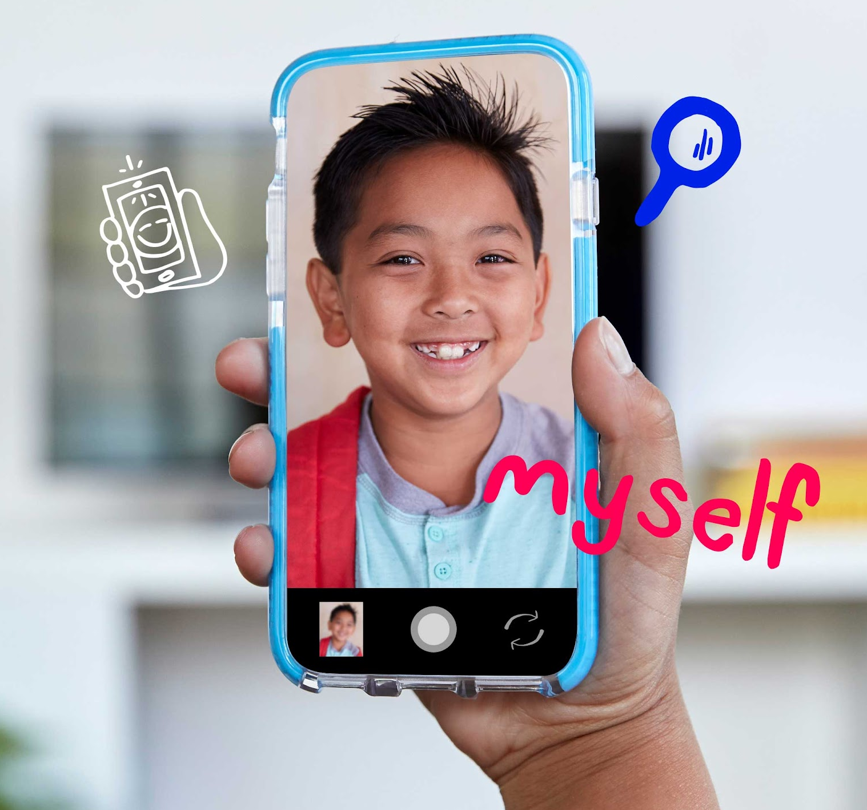
DIGITAL CITIZENSHIP | GRADE 3
This Is Me

Slide 2
How does what I post online affect my identity?

Slide 3
Learning Objectives
l
Consider how posting selfies or other images will lead others to make assumptions about them.
Reflect on the most important parts of their unique identities.
Identify ways they can post online to best reflect who they are.
2
3

Slide 4
WARM UP: THINK–PAIR–SHARE
When and where do people take "selfies"? Why do you think they take them?
Directions:
Take a moment to think silently about these questions.
Then, take turns sharing your response with your partner.

Slide 5
ACTIVITY: INTRODUCING … ME! – PART 1
Directions
Pretend you are going to take a selfie to post to a public website for anyone to see. Where would you take it? What would you be doing? What would you look like? Draw your selfie below using as much detail as possible.

Slide 6
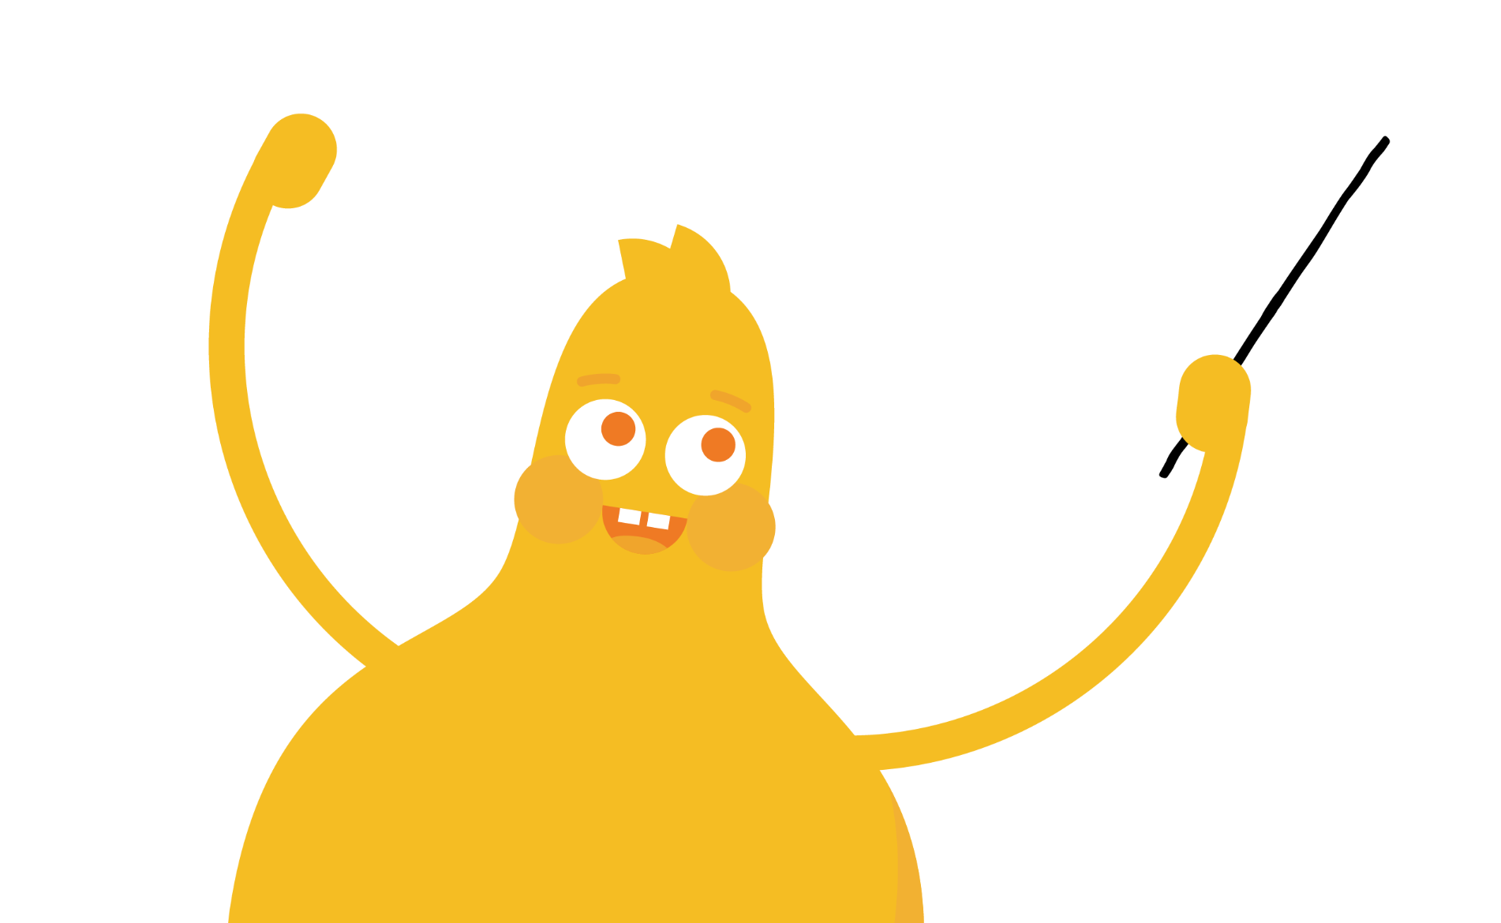
KEY VOCABULARY
Assumption
Something that someone thinks is true but, in reality, may or may not be

Slide 7
KEY VOCABULARY
Identity
Different parts of your culture, experiences, and interests that make you unique

Slide 8
ACTIVITY: INTRODUCING … ME! – PART 2
Directions
Answer the reflection question, and then use it to redo your selfie so it accurately reflects the most important details of your identity.
Brainstorm: What are the most important things that make you YOU? Is it where you live? Your personality? Where your family is from? Write as many details about your identity as possible.
Selfie redo: Using those details, redo your selfie so it shows the most important details about your identity. Remember to be creative and use images and props to show who you are!

Slide 9
