Slide 1
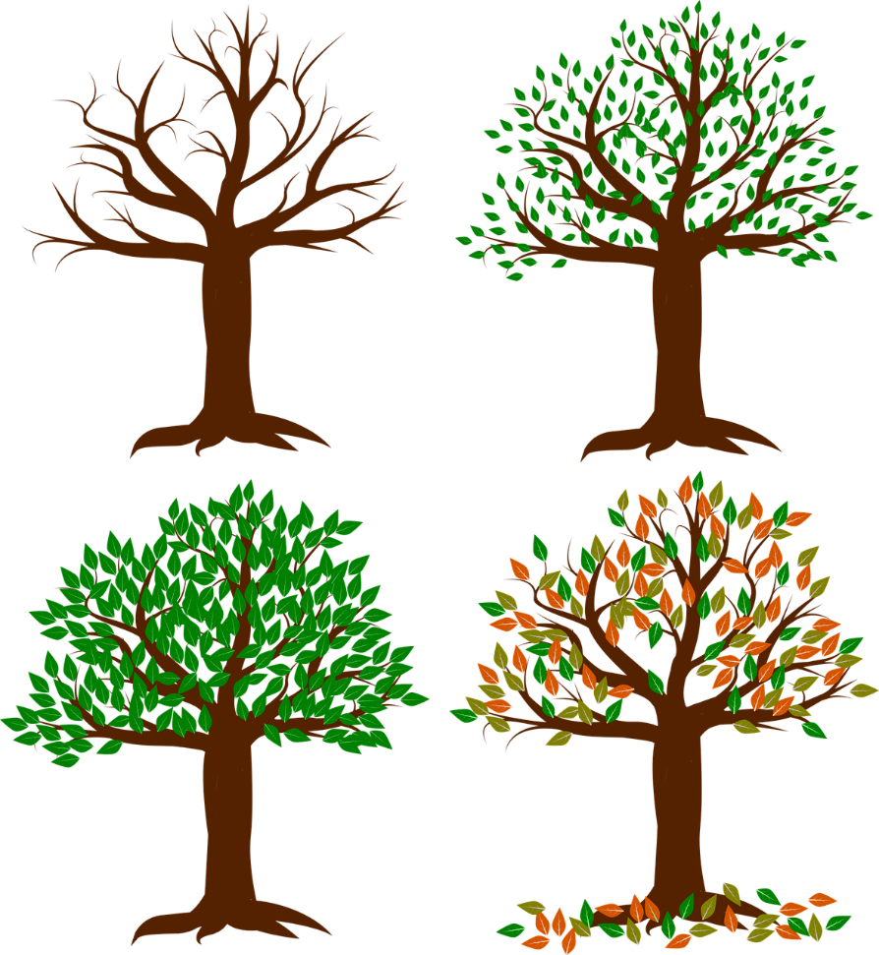
Lesson 4:
Change, loss and grief

Slide 2
We are learning about the impact of different life changes, and strategies for dealing with grief
We will be able to:
recognize that life is made up of different stages and that death is when life ends
describe different situations that may cause someone to grieve
identify some different responses someone might have to grief
identify activities, actions and sources of support that can help a person to manage grief
Notes:
Teacher Notes – Learning objective and outcomes
Introduce the learning objectives and outcomes for the lesson, which will focus on understanding the effects of change, loss and grief, and how to manage these effects and get help and support.

Slide 3
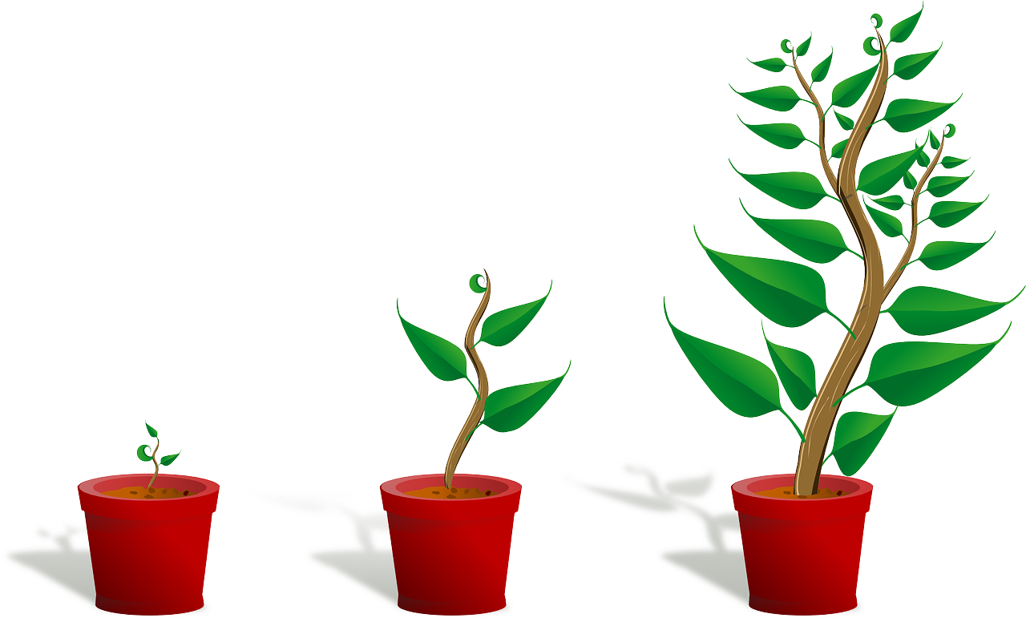
Things that are born, grow, and die
Complete the table, listing everything that you can think of:
things that are born/germinate
things that grow
things that die
Do plants, animals and people go through the different stages in the same way?
Notes:
Teacher Notes - Baseline assessment (10 mins)
Ask pupils to complete the table in Resource 1: Baseline activity, listing everything they can think of under the three headings: things that are born/germinate, things that grow, things that die. This will enable you to find out pupils’ existing knowledge, understanding and feelings about the life cycle. Whilst pupils are recording their responses, circulate the room to see what ideas and thoughts pupils are adding, then take whole class feedback at the end.
While pupils may list different specific examples, by the end of the feedback pupils should be able to recognise that plants, animals and humans all complete the three stages of this life cycle.
Then, ask pupils to discuss in pairs: do plants, animals and people go through the different stages in the same way? E.g. do animals and people only die when they have lived for a long time?
Click to show the question.
Take some feedback. Explain that plants, animals and people move through the stages at different times; in the same way that all flowers, plants and trees live to be different ages, people and animals do not only die when they are old, although most do.

Slide 4
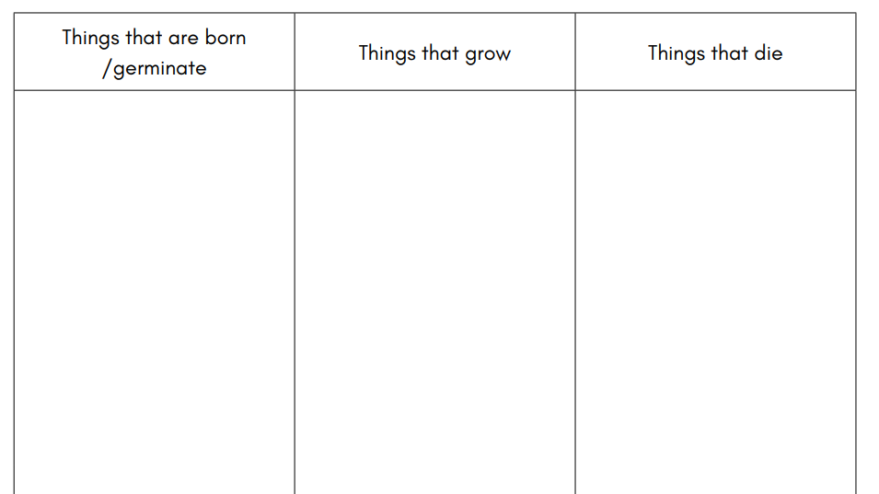

Slide 5
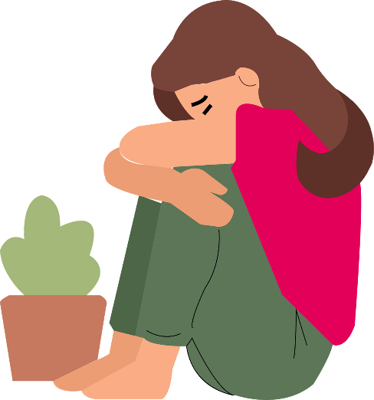
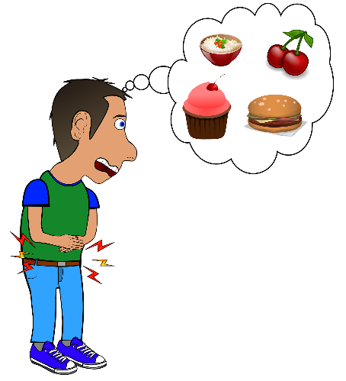
Grief
Grief is a natural response to loss, and can cause someone to experience a wide range of feelings, emotions, or physical reactions.
How might someone show that they are grieving or need some help and support?
Notes:
Teacher Notes – Grief (5 mins, including next slide)
Explain that grief is a natural response to loss and can cause someone to experience a wide range of feelings, emotions, or physical reactions. Discuss with pupils that grief may not always be about physical death (experiencing a bereavement) - it can occur in response to other losses too, for example: injury or illness (experienced by self or others); separation from home or family; changes to family arrangements; change in home/schools.
In small groups, ask pupils how people in these situations might show that they are grieving and/or need some help and support?
See next slide for suggested answers.
Support: Direct pupils towards the image prompts on the slide to help them come up with ideas.
Challenge: Ask pupils to consider what the most obvious signs of grief are, and which ones are more likely to be hidden by someone?

Slide 6
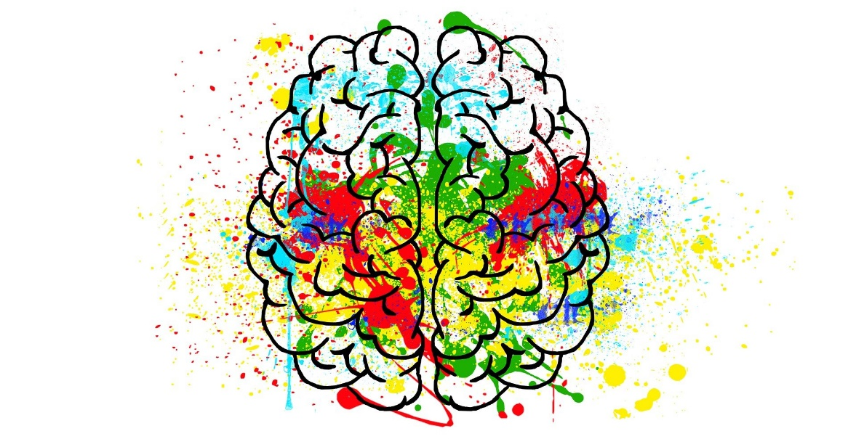
How might people show that they are grieving?
changes in their personality
changes in their relationships
changes in their behaviour
Notes:
Teacher Notes – Grief (5 mins, including previous slide)
Pupils might suggest: changes in their personality (for example, being sad a lot more often, crying or wanting to cry more, displaying more anger, becoming more withdrawn); changes in their relationships (for example, not wanting to be away from someone, wanting to be around friends or family more, falling out with friends, not wanting to be alone, wanting to be alone more, not wanting to speak to anyone); changes in their behaviour (for example, worrying about things more, finding it hard to concentrate at school, not enjoying the things they usually do, experiencing panic or anxiety, not wanting to eat, wanting to eat more, not being able to sleep, sleeping much more).
Emphasise that these are all completely normal responses when grieving and that everyone grieves differently and at different times. Additionally, some people do not ‘show’ that they are feeling sad or grieving. What is most important is that people have time to grieve and can access help and support if needed.

Slide 7
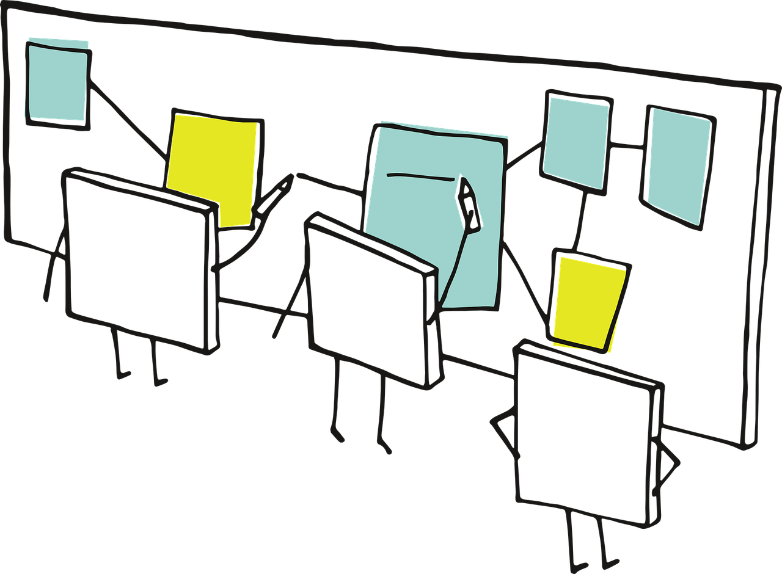
Scenarios
Read your scenario and answer the questions around it.
Notes:
Teacher Notes – Scenarios (15 mins, including next slide)
Assign pairs one of the scenarios in Resource 2. They should write down their answers to the 5 questions surrounding their scenario.
Then, ask them to pass their scenario to the next pair and see if they can add anything else to their new scenario. They should do this twice more, so that every pair has seen, and had the opportunity to add to, all four scenarios.
Support: Who could Jamal, Andrea, Nathan or Tara talk to, to help them feel better?
Challenge: If you were either Jamal, Andrea, Nathan or Tara’s friend what could you do to help them?

Slide 8
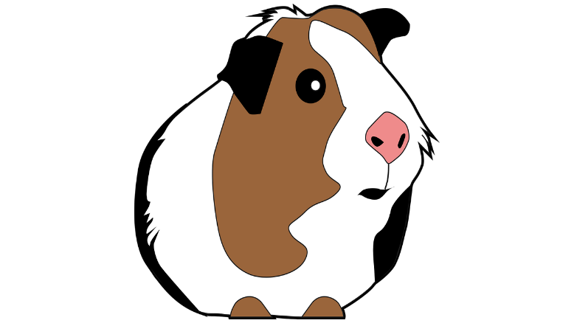
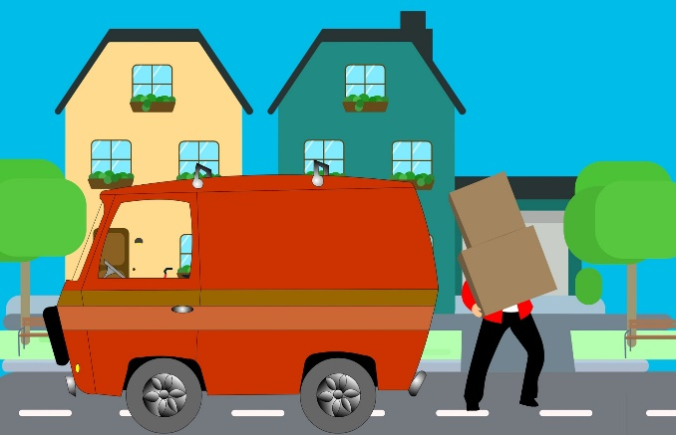
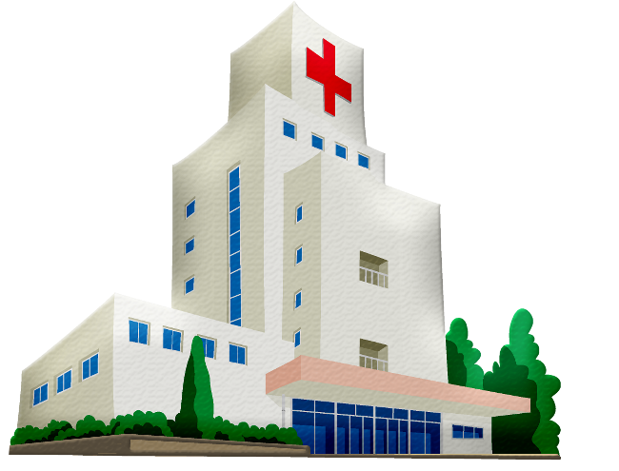
Scenarios
Scenario 1: Jemal
Scenario 3: Andrea
Scenario 2: Tara
Scenario 4: Nathan
Notes:
Teacher Notes – Scenarios (15 mins, including previous slide)
Take some feedback from the class, once everyone’s original sheets have been returned.
Pupils might suggest:
Scenario 1: Jemal is grieving the loss of his home (his country, family and friends); he is acting differently to normal – he has become less outgoing; he might be feeling sad, worried about the future, unsure how he will adapt to his new life, angry that he has had to leave his old life behind; with time, these feelings might ease as he settles into his new home and new school, and makes more friends; he could speak to his parents, or another family member about his feelings, or speak to a teacher or another adult at school (who can then provide additional help and support if necessary).
Scenario 2: Tara is grieving the loss of her family unit and the loss of her father’s presence in the family home; she was behaving in a way that she thought her parents would approve of, but now is arguing with her mum and acting aggressively; she may be blaming herself for their separation, especially as she thought adapting her behaviour would ensure her parents remained together (it is important to emphasise to pupils here that the separation of parents is never the fault of their child/children), she is upset and angry about what has happened; with time, these feelings might ease as she adapts to a new routine and gets used to the ‘new normal’; she could speak to her mum or dad when she is feeling calmer, or speak to another family member or trusted adult, or speak to an adult at school.
Scenario 3: Andrea is grieving the death of her guinea pig; she is very upset and is thinking about the time that she didn’t spend with her pet, rather than all the time she did; she is feeling guilty and may be blaming herself for what has happened – she might think that she is being ‘punished’ for not playing with the guinea pig over the weekend; after some time has passed, she may be able to manage her grief better and recognise that what has happened was not her fault, nor is she being punished; she should talk to her mum or another family member about how she is feeling, she might consider having a memorial for her pet, or creating something to remember her pet by.
Scenario 4: Nathan is grieving the loss of his Auntie – although she has not died yet, he knows that things are permanently changing; he is unsure how to react to what is happening and feels numbness, rather than the sadness his family feel; he is also confused about why the hospital cannot make her better; his grief may intensify before it gets better, as Nora will die in the near future; in a year’s time, however, he may understand his feelings more and have a better grasp on what has happened; he could speak to his family about his feelings, or speak to a teacher or trusted adult.
Reiterate that grief is something that most people will experience at some point in their lives, but that, over time, feelings of grief can become much more manageable. Feelings can also change from day to day – some days might be better than others and it’s important to understand that it’s ok to not be sad all the time. Grief, for example after the death of a loved one, may not go away completely, but feelings will change over time and can feel less intense.

Slide 9
What might they be grieving for?
How are they behaving?
How might they be feeling now?
How might they feel in a year’s time?
What could they do to manage their feelings?

Slide 10
Managing grief
What might help people who are experiencing grief?
Notes:
Teacher notes – Managing grief (10 mins, including next slide)
Ask pupils if they can think of anything that might help people who are experiencing grief. For example, pupils might suggest: collecting photos and putting them in an album, creating a display or collage about what they have lost, writing in a diary, writing letters, drawing pictures, speaking to someone about their loss – family, friends, or another trusted adult etc.

Slide 11
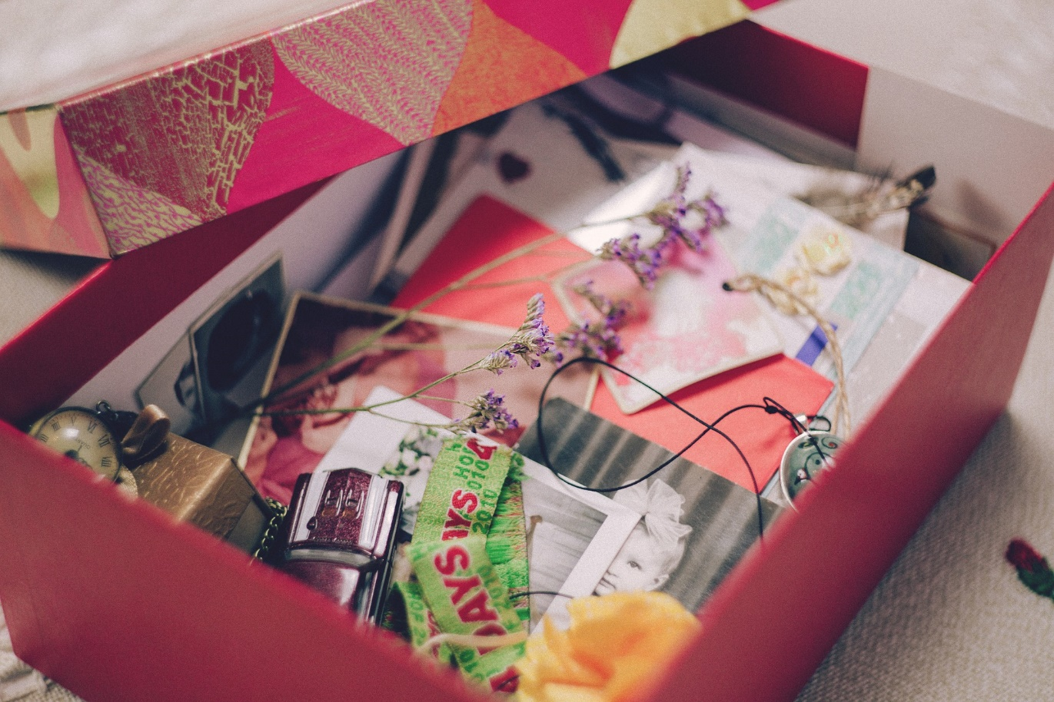
Managing grief
What might Jemal and/or Andrea put into their memory box?
Notes:
Teacher notes – Managing grief (10 mins, including previous slide)
Tell pupils that some people like to create a memory box to help them manage their grief. This could contain anything at all that they associate with the thing/person/place they have lost. In their pairs, ask pupils to discuss what Jemal and/or Andrea might put into their memory box and take some feedback.
Pupils might suggest: photos, maps of places they have been, drawings of their memories, items that remind the character of what they have lost, reflections on happy moments, creating something as a family, writing a song, drawing pictures, creating collages etc.. Reiterate to pupils that everyone reacts differently to grief and there is no one ‘right’ way to either express grief, or manage it.

Slide 12
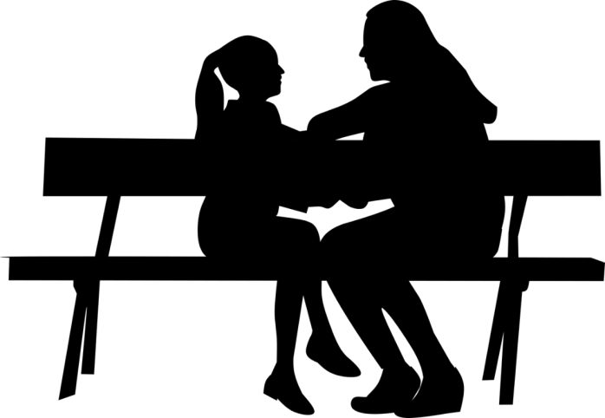
Signposting support
Where could the characters go to get help and support?
Speak to someone that you trust in school or at home if you are having trouble with any feeling, big or small, or if you are feeling particularly sad, scared or worried about something.
Notes:
Teacher Notes – Signposting support (5 mins)
Ask pupils where the characters could get help and support. Explain to pupils that the feelings associated with grief can be very difficult to manage. However, it is really important to tell an adult if they or someone they know are struggling to manage their feelings, so that appropriate help and support can be put in place. For example, they might speak to:
A parent/carer
A teacher
Another trusted adult or family friend

Slide 13
What has been learned?
What do you think are the top three most important things that someone could do to help them manage their grief?
Add one point to each post-it note and stick these on the board.
Notes:
Teacher notes – Endpoint assessment (10 mins)
Independently, on post-it notes, ask pupils to write down what they think are the top three most important things that someone could do to help them manage their grief (one per post-it) and stick these on the board. Briefly review and summarise these for the class.

Slide 14
More activities
Write a supportive message to one of the people in the scenarios.
Suggest some ideas to help them manage their grief.
Notes:
Teacher Notes – Extension activities
Ask pupils to write a supportive message to one of the people in the scenarios, outlining some ideas to help them manage their grief.

