Slide 1
DIGITAL CITIZENSHIP | GRADE 3
Our Digital
Citizenship
Pledge

Slide 2
What makes a strong online community?

Slide 3
Learning Objectives
l
Define what a community is, both in person and online.
Explain how having norms helps people in a community achieve their goals.
Create and pledge to adhere to shared norms for being in an online community.
2
3

Slide 4
WARM UP: THINK, PAIR, SHARE
How would you describe the people where you live? Do most people know each other?
Directions:
Take a moment to think silently about these questions.
Then, take turns sharing your response with your partner.

Slide 5
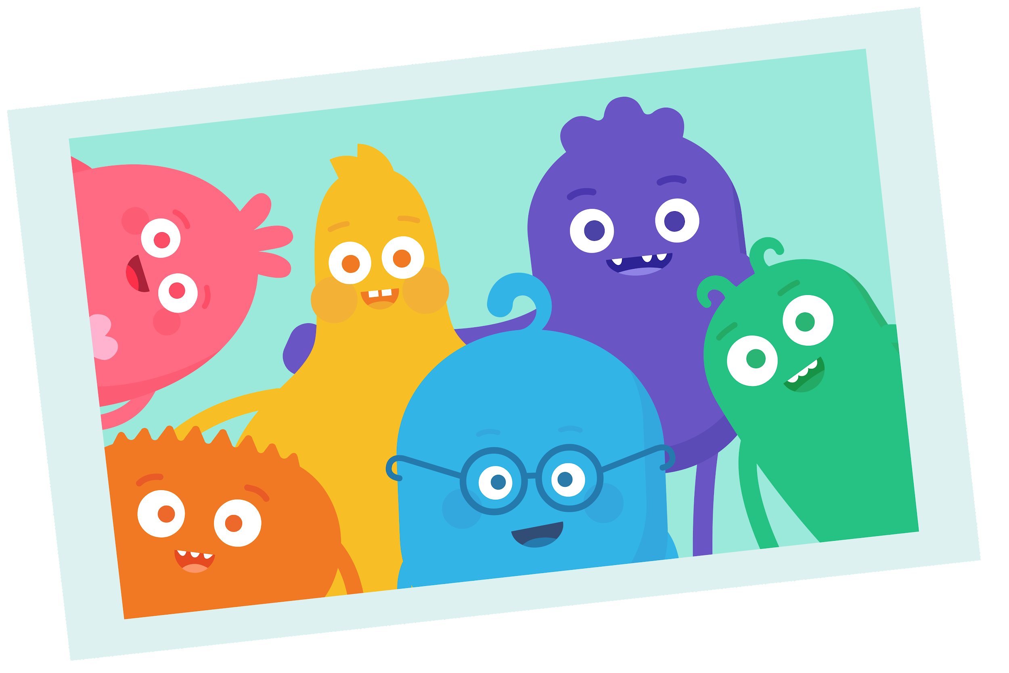
KEY VOCABULARY
Community
A group of people who share the same interests or goals

Slide 6
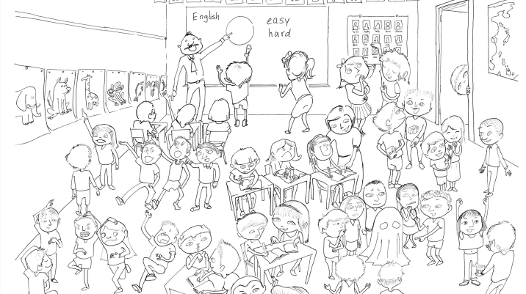
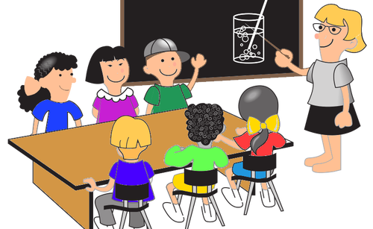
OBSERVE + ANALYZE IMAGE
Which classroom community would best reach everyone's shared goal of learning?
1
2

Slide 7
Our Classroom Norms
[Capture student responses here.]

Slide 8
ACTIVITY: PAIR WORK
Directions
Work with your partner to explain how you think each norm helps the community reach its goal.
Write your answers in the empty box for each example.

Slide 9
KEY VOCABULARY
Digital Citizen
Someone who uses technology responsibly to learn, create, and participate

Slide 10
ACTIVITY: GROUP WORK
Directions:
Write your group's category at the top of your group handout.
In your group, come up with one norm for how you should act toward others when you're online.
Once you have the norm that you all agree on, write it on the handout and pledge to follow it by signing your name.
Category | Group(s)
1. When I share with others ...
2. When I respond with others ...
3. When I work with others ...
4. When I play with others ...

Slide 11
