Slide 1
DIGITAL CITIZENSHIP | GRADE 3
Is Seeing Believing?

Slide 2
Update slide template so it has a more fun and friendly feel.
Have monster holding up as sign with the EQ.
Why do people alter digital photos and videos?
DSN: Have monster holding up as sign with the EQ.

Slide 3
Learning Objectives
l
Recognize that photos and videos can be altered digitally.
Identify different reasons why someone might alter a photo or video.
Analyze altered photos and videos to try to determine why.
2
3

Slide 4
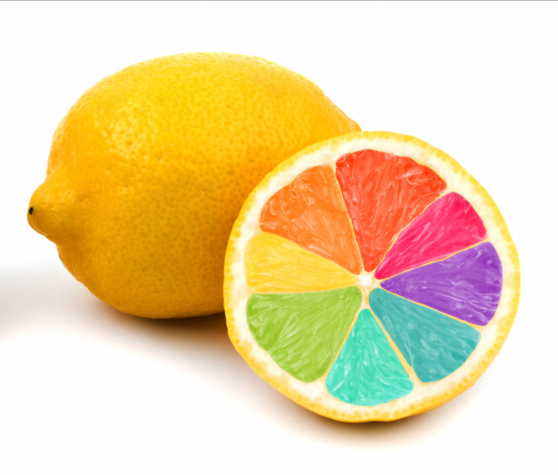
OBSERVE + ANALYZE IMAGE
Vote:
Do you think the lemon in this photo is real or fake?
This is what happens when you put food coloring in a lemon!

Slide 5
KEY VOCABULARY
Alter
To change the way something looks, sometimes using a computer or other digital tools

Slide 6
OBSERVE + ANALYZE IMAGE
Why do you think this photo was altered this way?
What was the person who altered it trying to accomplish?
This is what happens when you put food coloring in a lemon!

Slide 7
KEY VOCABULARY
Persuade
To cause someone to believe something

Slide 8
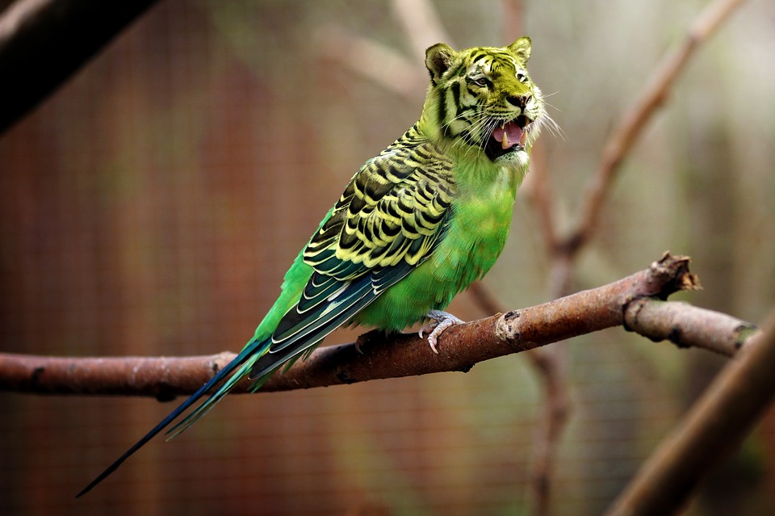
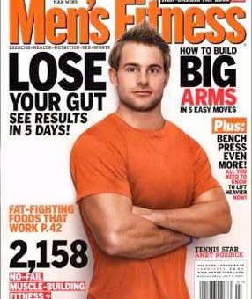
More obvious
Less obvious

Slide 9
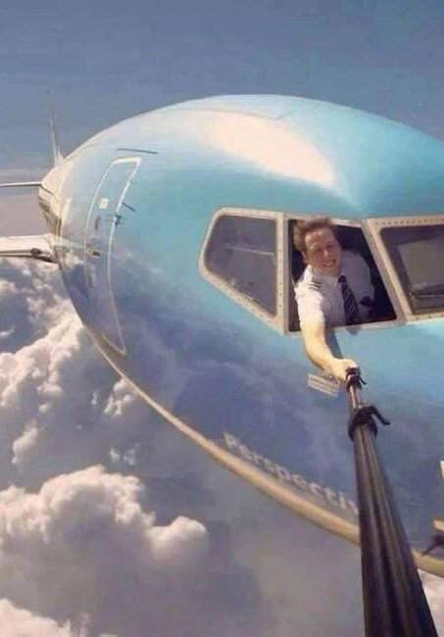
1
2
3

Slide 10
ACTIVITY: GROUP WORK
Directions
Review the image and, with your group, decide what was altered in your photograph.
As a group, answer the questions on your handout.
Be prepared to share your group's ideas with the class.

Slide 11
OBSERVE + ANALYZE IMAGE
Notes:
Source: http://www.agecomputer.org/

Slide 12
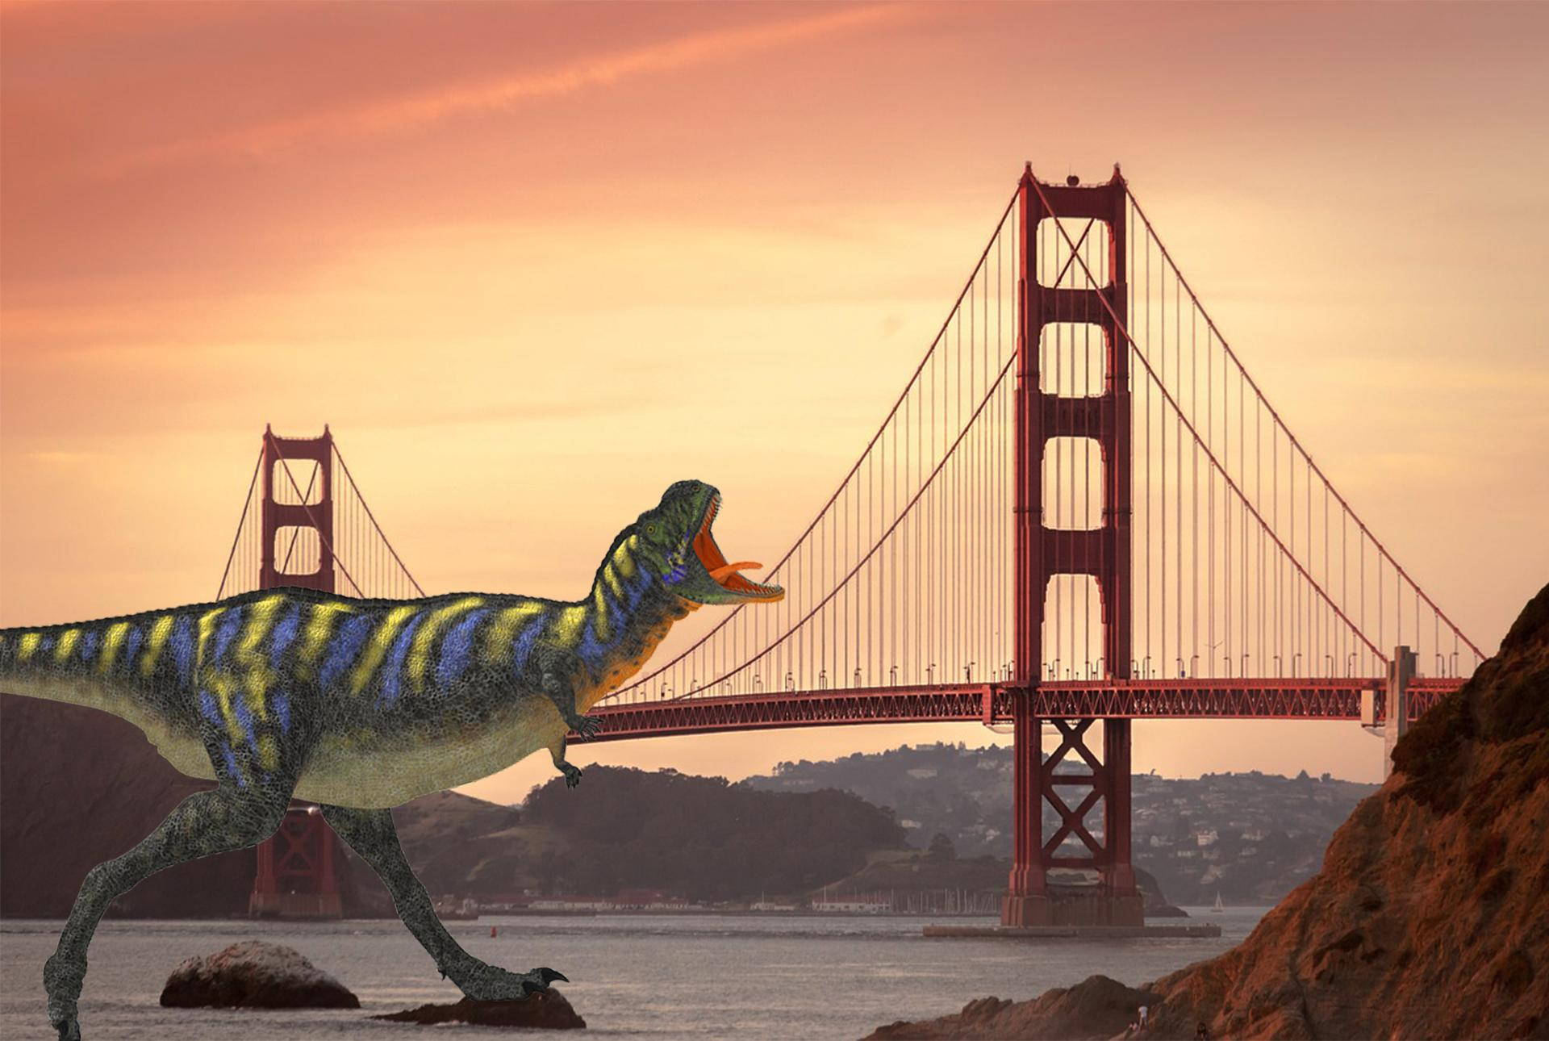
OBSERVE + ANALYZE IMAGE

Slide 13
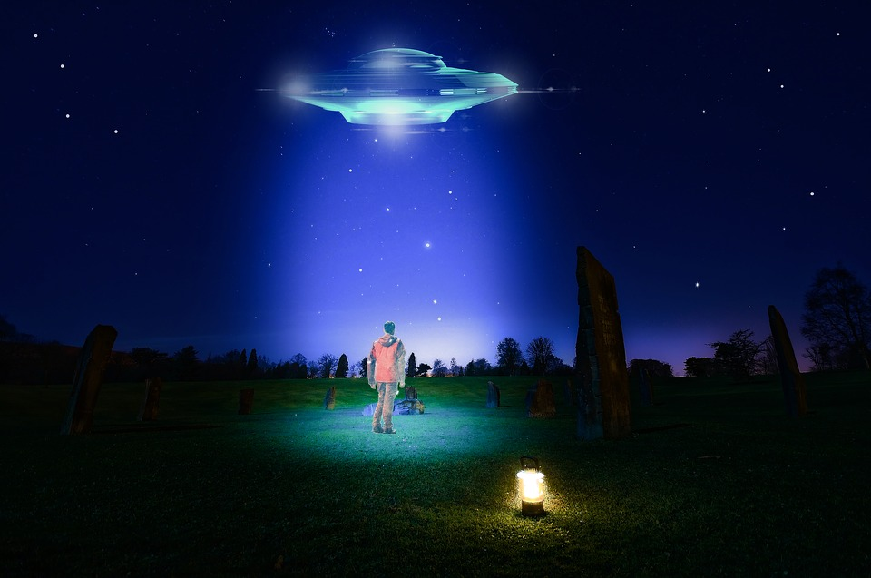
OBSERVE + ANALYZE IMAGE

Slide 14
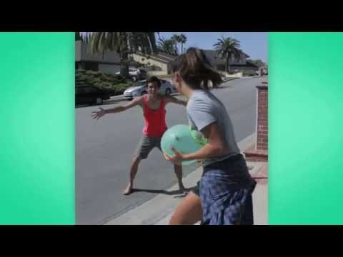
WATCH + DISCUSS
Video: "How to Change Your Shirt"
Pair-share:
How was this video altered?
Why do you think Zach King created this video?

Slide 15
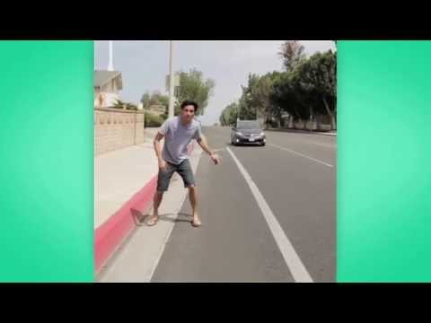
WATCH + DISCUSS
Video: "How to Hitchhike"
Pair-share:
How was this video altered?
Why do you think Zach King created this video?

Slide 16
WRAP UP: FINAL THOUGHTS
What do you think about altering photos? Is it OK to do? Does it depend on the type of alteration? How so?
Directions:
Take a moment to think silently about these questions.
Then, take turns sharing your response with your partner.

Slide 17
