Slide 1
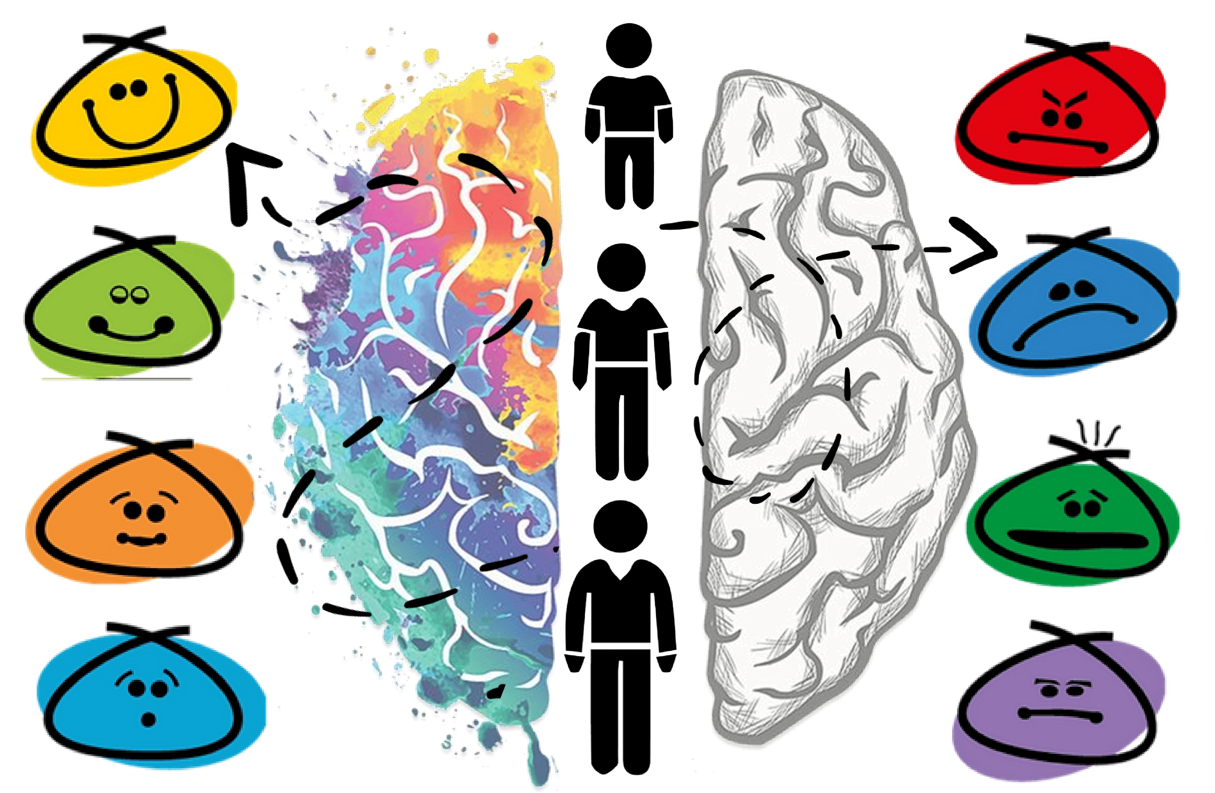
Lesson :
Brain Stress Response System
Notes:
Consider using the following questions to co-develop success criteria with your students:
“How will we know we are achieving our learning goals? What will that look like/sound like?”
Sample success criteria to help guide you
• I can tell the difference between the brain’s stress responses (fight, flight, freeze).
• I know my strengths.
• I can determine which brain stress response I most often react to.

Slide 2
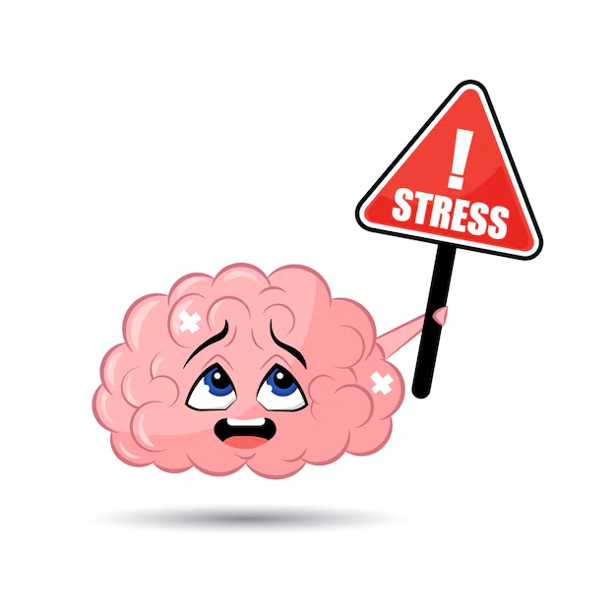
Minds On.......
Think of a time when you were worried about something?
What did you do and why?
Notes:
Teacher Notes –
Discuss with students how the brain is the most powerful part of your body. It’s amazing to think that your brain works as a control center of the entire body. Brainstorm with students what they already know about the brain and make a list on chart paper or whiteboard. Ideas: • it helps you remember things • used for thinking, feeling emotions, learning • controls everything, like breathing and heart pumping • stores memories • there are different parts to the brain that have special jobs • the brain is the control center of the whole body • the brain is the center of our nervous system, allowing us to control movements, thoughts and decisions. Ask students: Your brain controls so many things including your feelings. Think of a time when you were worried about something? What did you do and why? Discuss. [SEL 1.1] Feel free to give students an example of when you were worried about something. (Eventually the goal is to use flight, flight, or freeze as a possible response but the language is not needed for the introduction.) (**it’s important to know your students and that this may elicit a fight, flight or freeze response from a child if they have experienced trauma.

Slide 3
We are learning:
We are learning…
• the three basic ways people often react to fear: fight, flight, freeze.
• to determine the differences between fight, flight and freeze using pictures and words.
• how people react when they are feeling scared.
I will be able to:
Tell the difference between the brain’s stress responses (fight, flight, freeze).
Know my strengths.
Determine which brain stress response I most often react to.

Slide 4
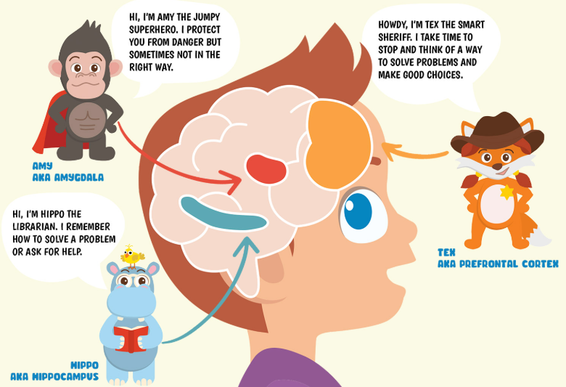
What are some of the things that you think can make this alarm go off in our body? What do you do about it?
Notes:
Suggested Teacher prompt: “If our brain senses that we are worried about a threat or danger, it sets off an alarm to alert us by making us feel that something is not okay – it might make our heart beat a little faster, or our stomach might feel upset. This alarm can be very important in getting us ready to take action. But sometimes, like a real alarm, the ‘alarm’ in our body can be too sensitive and we experience a ‘false alarm’ – we get nervous feelings in our body, even when there is nothing really to be afraid of. This is our brain’s way of letting us know that there is something we need to pay attention to. When the alarm goes off, we need to figure out if there is a real threat or not. Then it’s easier to know how to respond.

Slide 5
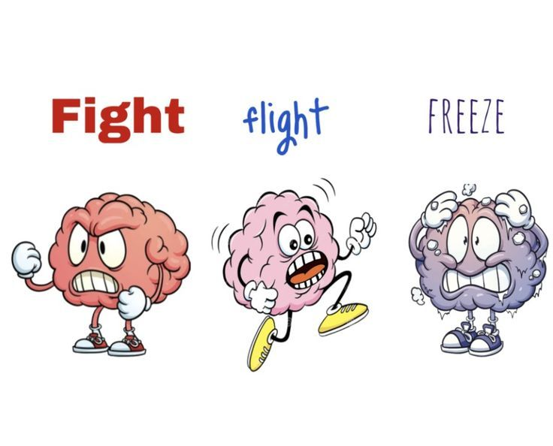
Let’s Discuss :
Notes:
Teacher notes –
The fight, flight, freeze response is how the body naturally reacts when it senses danger. In stressful situations, individuals might prepare to face the threat (fight), run away from it (flight), or stay still and quiet (freeze) as a way to protect themselves. Although these reactions can help in staying out of danger, they can lead to increased stress and affect a person’s decision-making.

Slide 6
