Slide 1
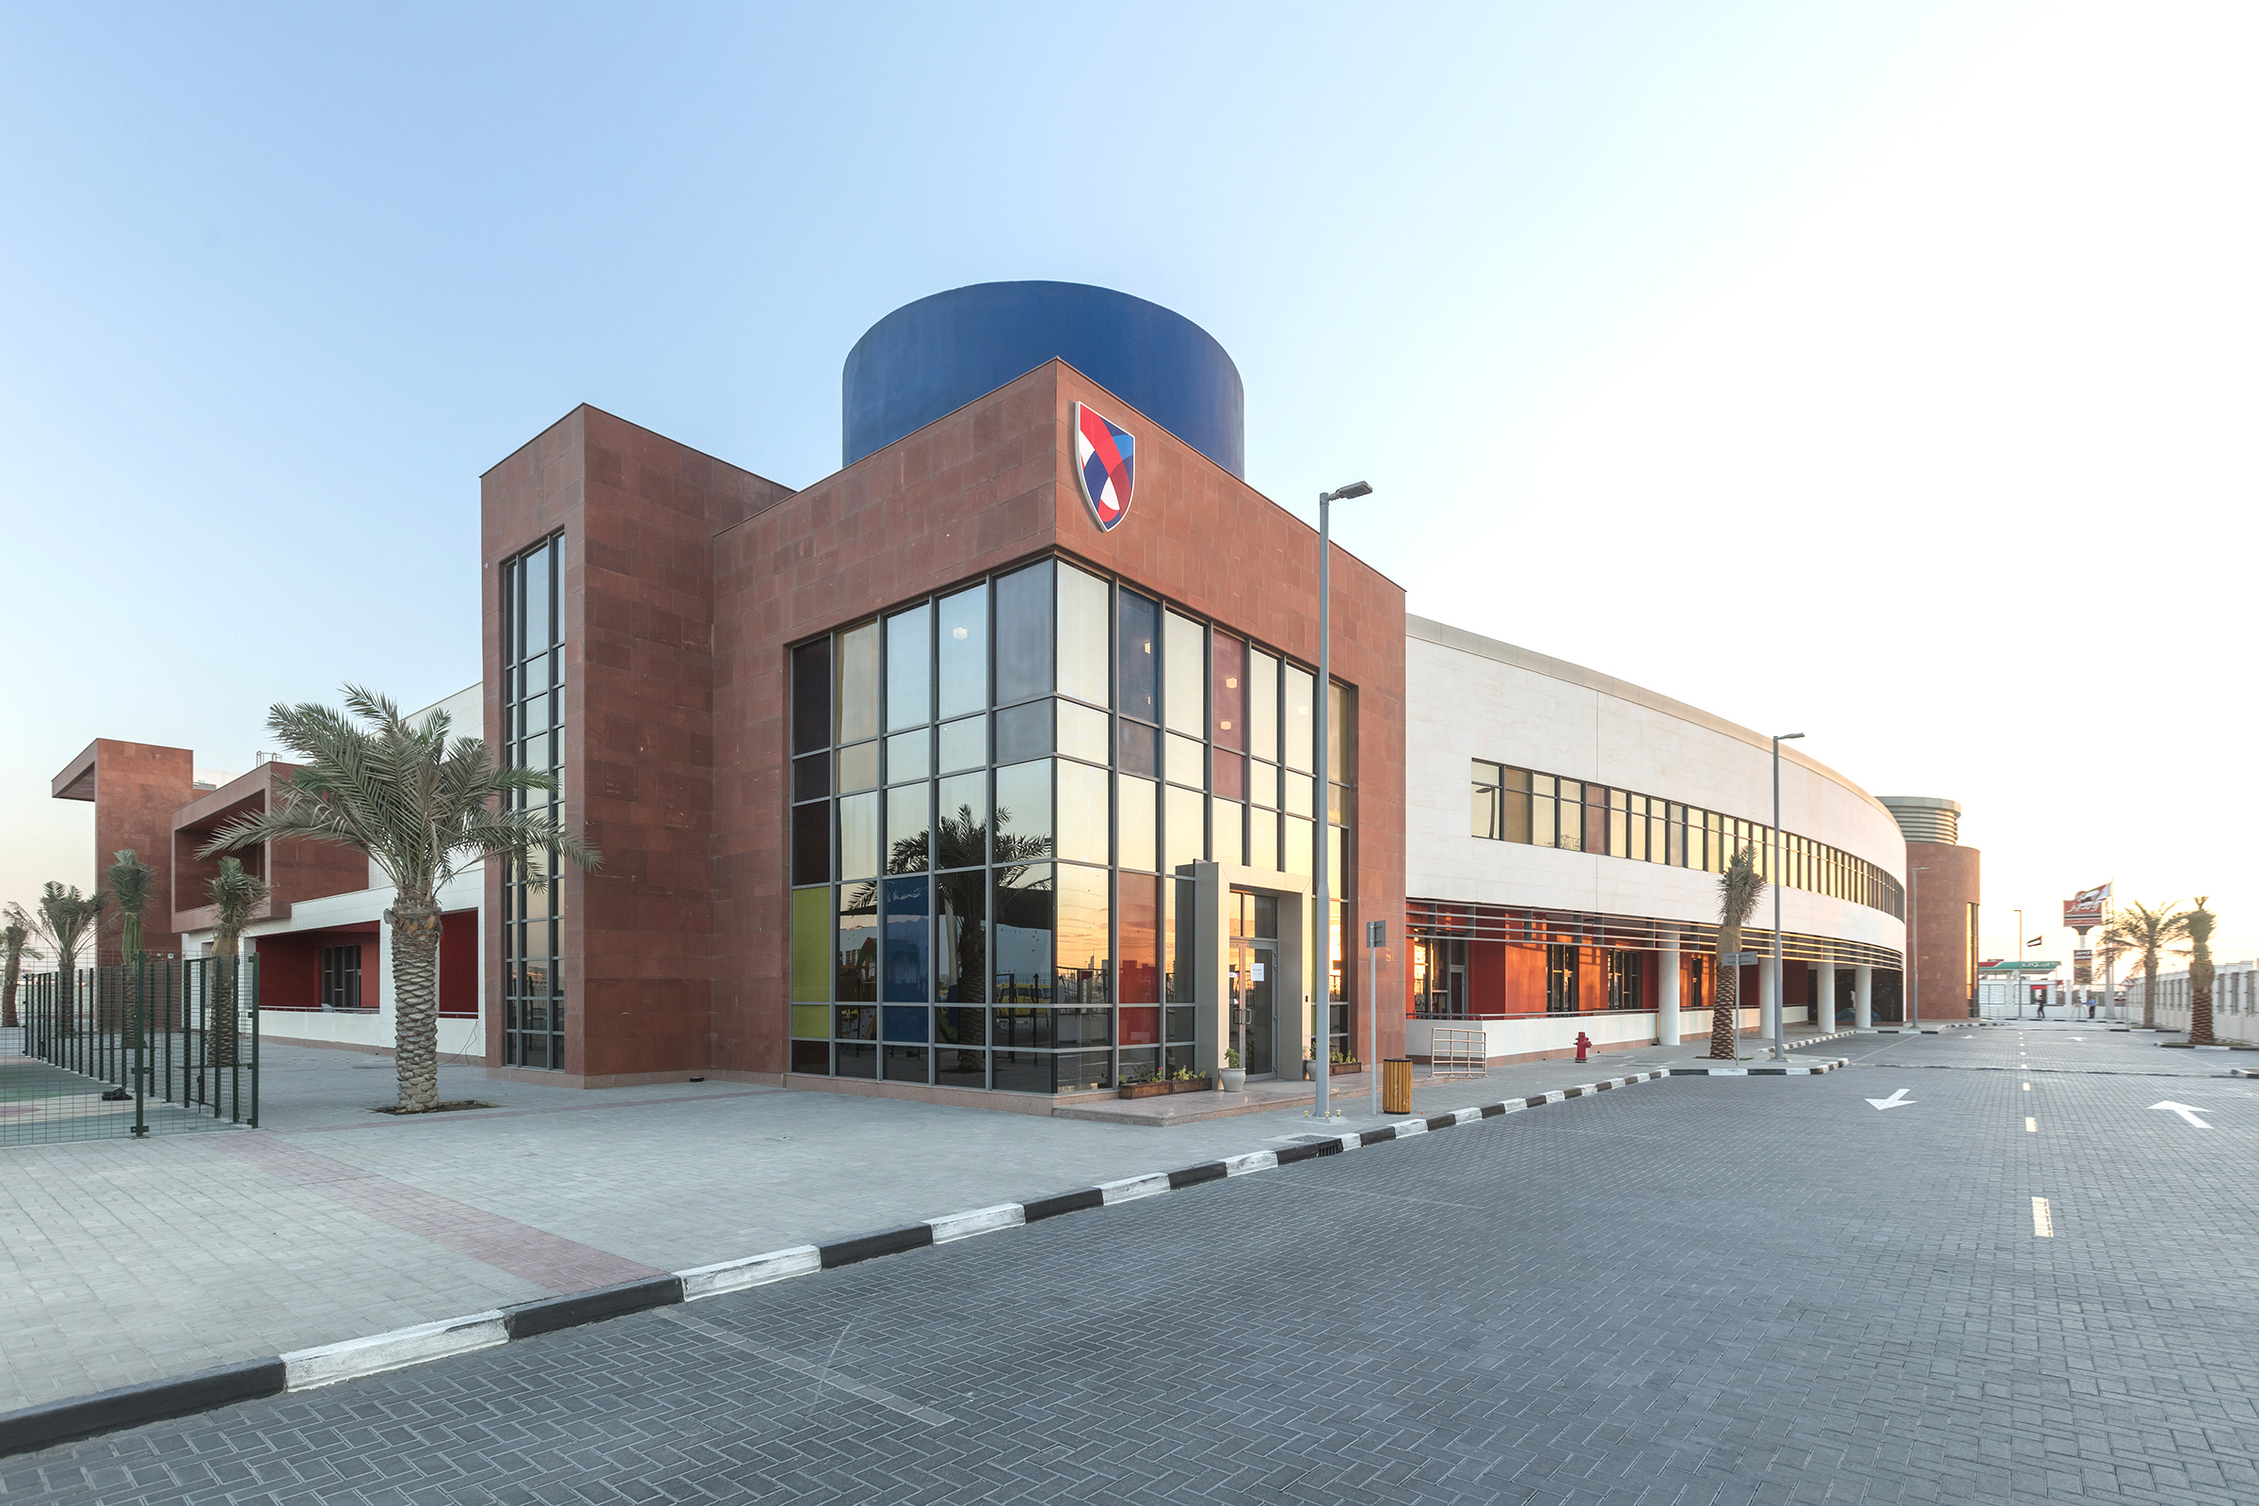
ASCS Nad Al Sheba
Digital Safety Charter

Slide 2
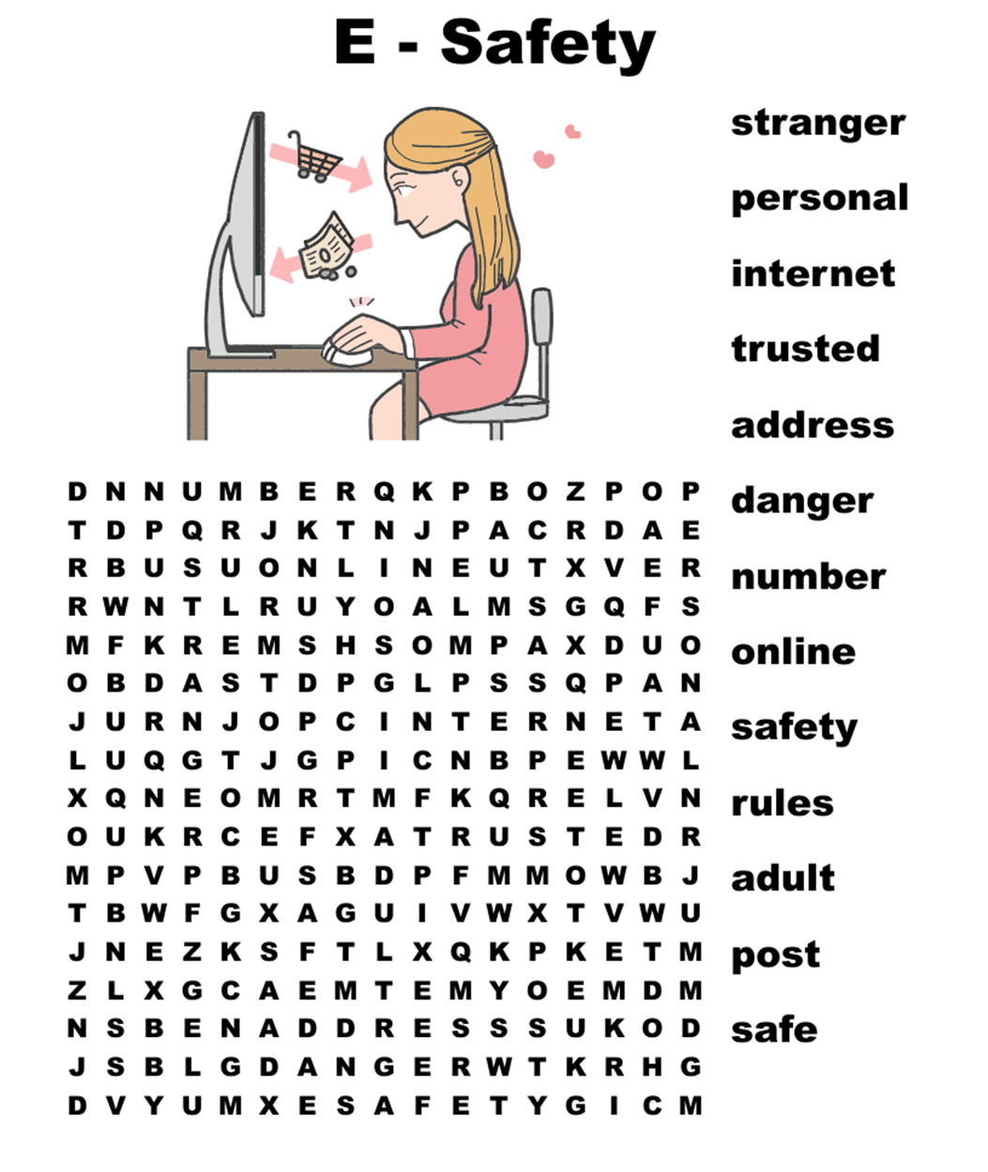
Let’s find the words

Slide 3
AS A STUDENT HERE AT ASCS…

Slide 4
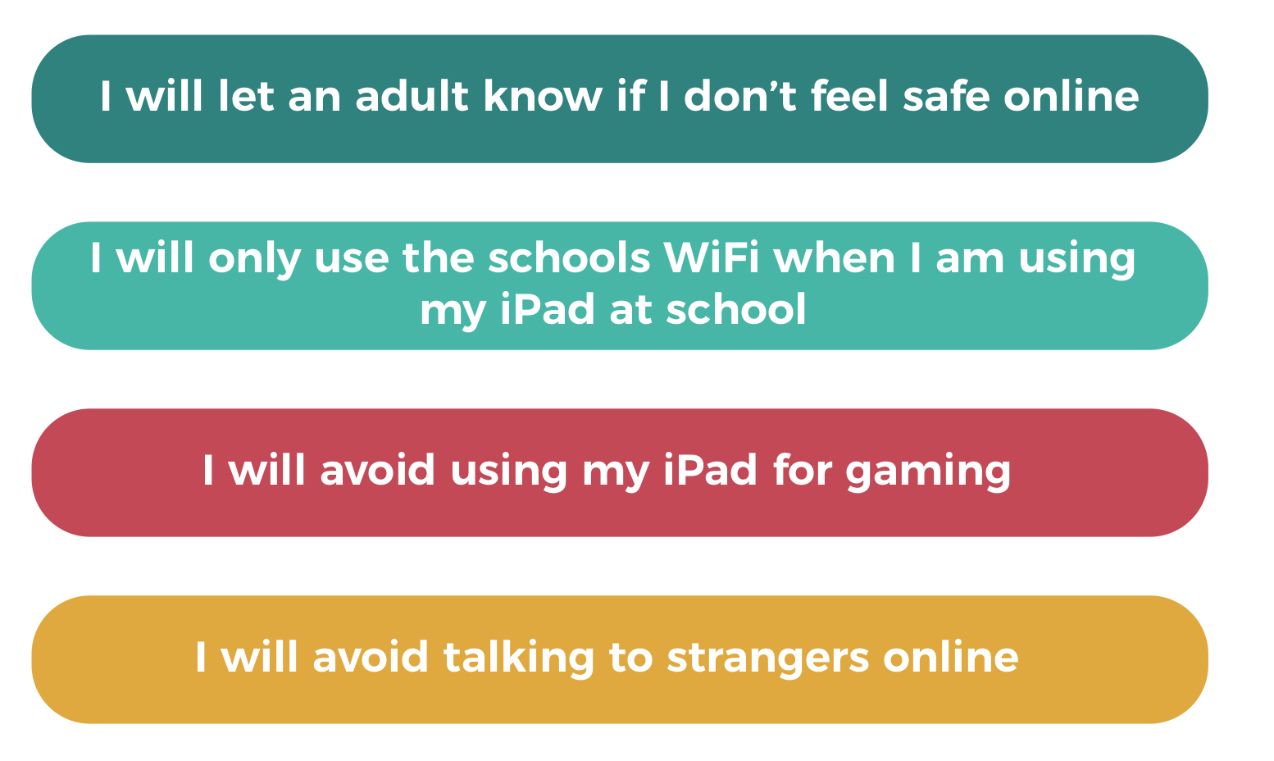
AS A STUDENT HERE AT ASCS…

Slide 5
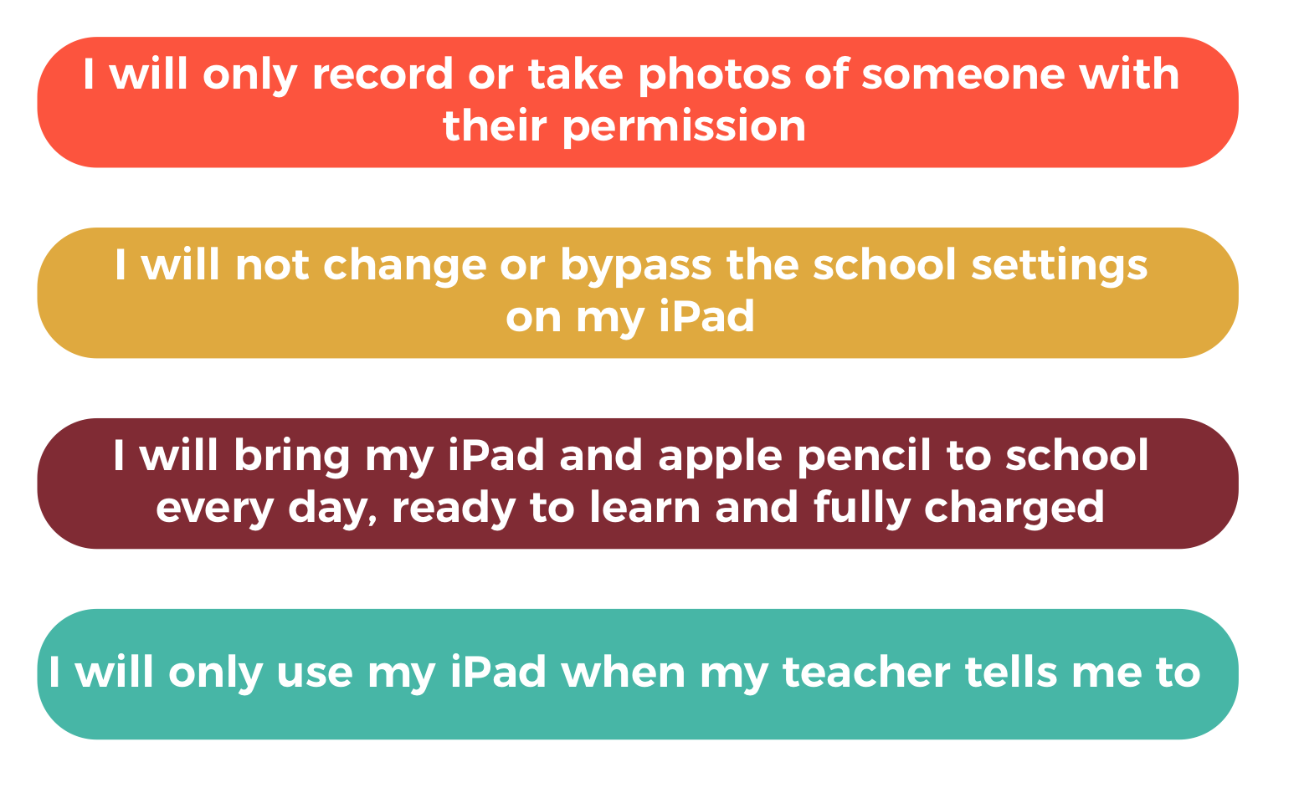
AS A STUDENT HERE AT ASCS…

Slide 6
AS A STUDENT HERE AT ASCS…

Slide 7
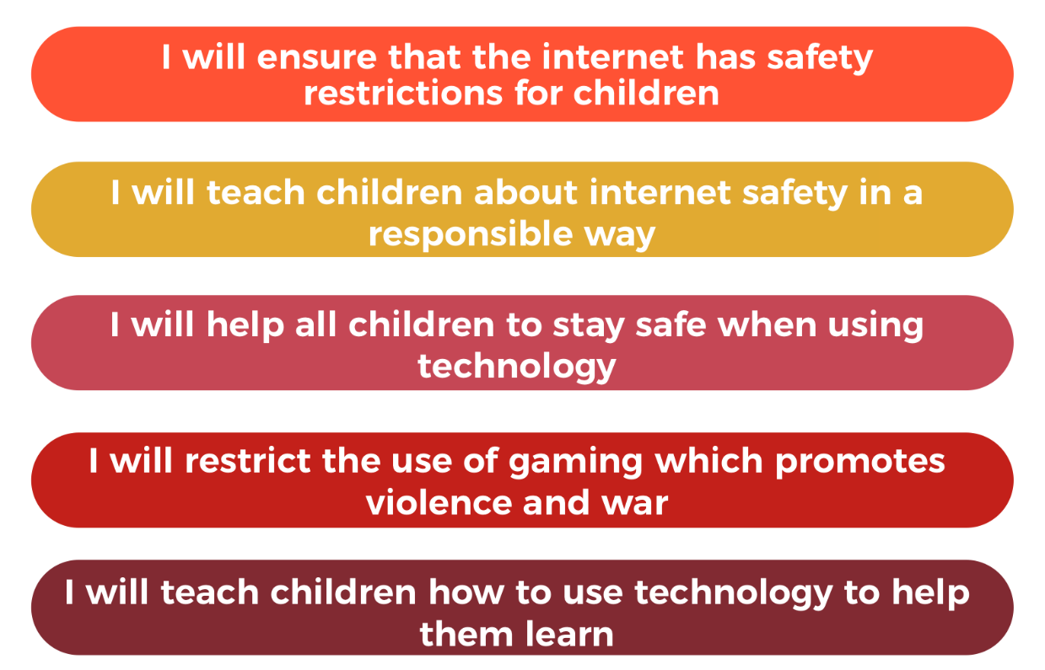
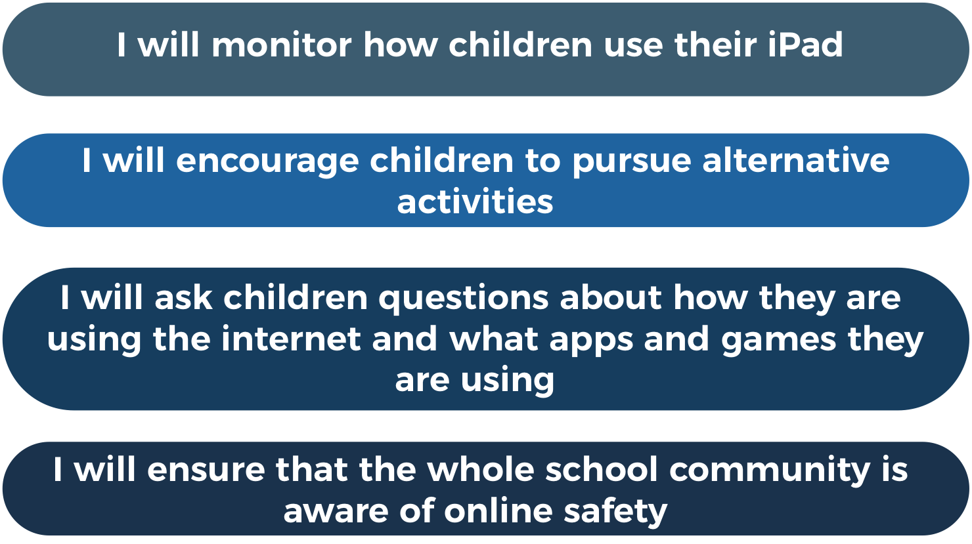
Duty of Staff here at ASCS:

Slide 8
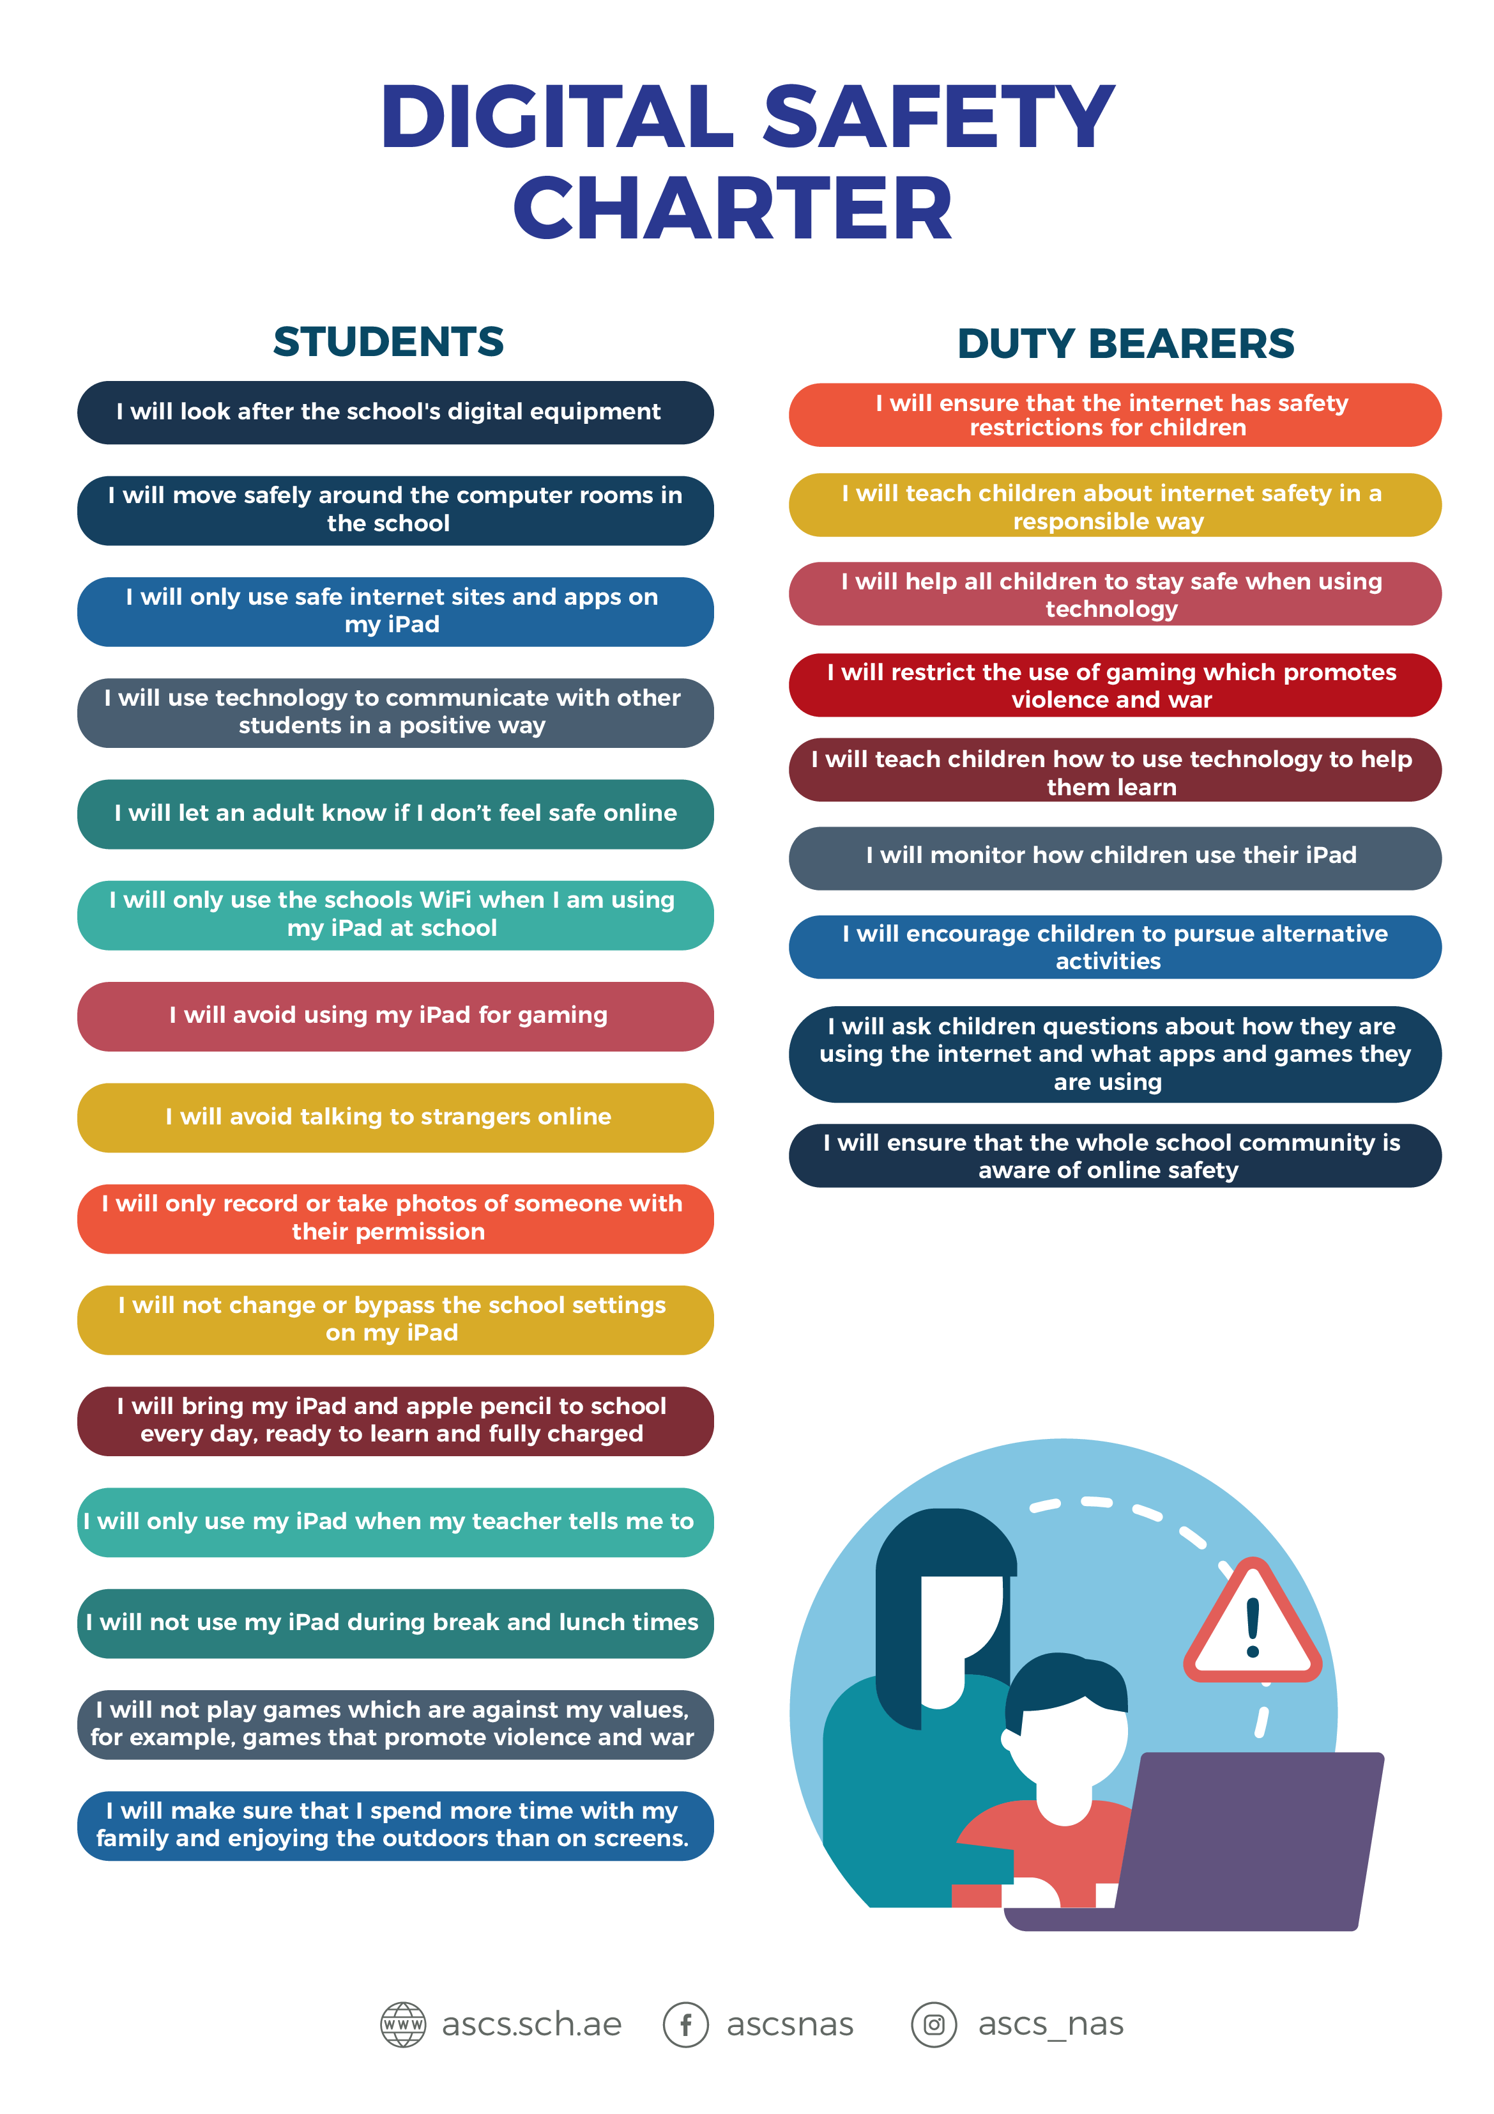
We will each now sign the DIGITAL SAFETY CHARTER to be hung outside our classroom.

