Slide 1
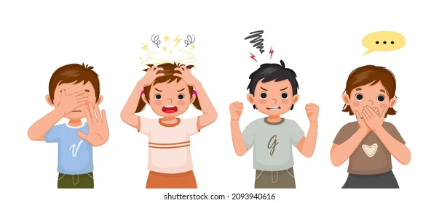
Lesson :
Stressful Feelings
Notes:
Consider using the following questions to co-develop success criteria with your students:
“How will we know we are achieving our learning goals? What will that look like/sound like?”
Sample success criteria to help guide you
• I can determine what ‘strong’ feelings are.
• I can identify ways that can help me through ‘strong’ feelings.
• I can tell when someone may be having ‘strong’ feelings.

Slide 2
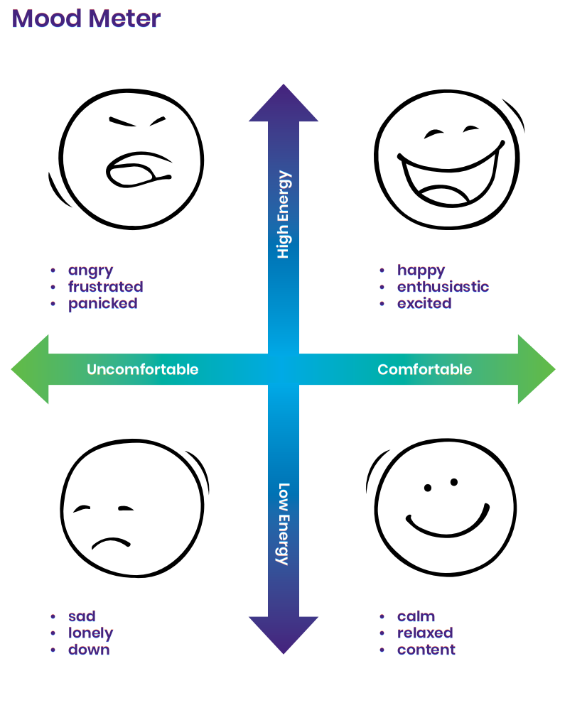
Minds On.......
What do you notice about the feelings.?
What did you do and why?
Notes:
Teacher Notes –
Gather students and tell them that today we are going to be talking about feelings. Tell them that they will be looking at the way feelings make you feel but they are not just any feelings, they are the strong feelings that may make them feel uncomfortable.
Talk with them about how that the ‘strong feelings’ tend to make us react or not react in ways we would like to sometimes. Recognize also that students may feel strong feelings in response to things in their life or in the world which are unjust. Examples could include racial inequities, police brutality, lack of access to clean drinking water in some Canadian communities. Strong feelings are completely legitimate in response to these issues.

Slide 3
I will be able to:
To be able to define what a strong feeling is and what students can do to help themselves through the feelings. Know what strong feelings are and how they can cope with them using strategies.

Slide 4
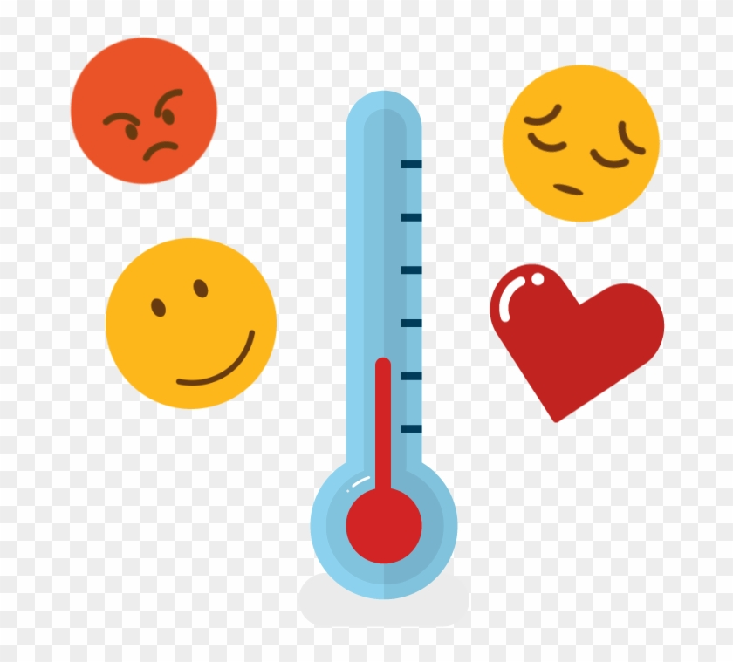
“When might you experience strong feelings in your day-to-day lives?”
Notes:
Suggested Teacher prompt:
“When might you experience strong feelings in your day-to-day lives?” [SEL 1.1]
Possible Student Answer:
“When we start a new grade in September.”
“When I have to social distance from my friends or when I have to wear a mask.”
“When someone won’t play with me.”
“When I have a fight with my friend.”
Suggested Teacher prompt: (Ontario Curriculum, Health and Physical Education, 2019, p151)
“What are some of the feelings you have in these situations? What do you do to help manage these
feelings?” [SEL 1.1, 1.2]
Possible Student Answer:
“Excited! Also, a little scared.”
“Sad, lonely.”
“Frustrated, angry.”
“Sometimes, I just take some time by myself.”
“Sometimes I talk with a teacher or another person. Or I might give it a bit of time, then try to talk with
my friend about it.”

Slide 5
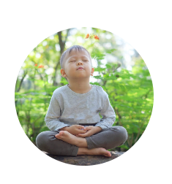
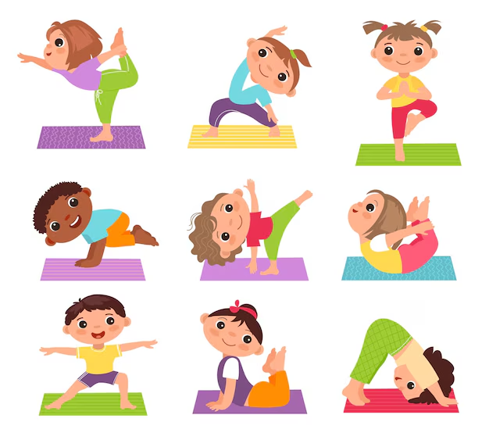
Let’s Discuss :
The different ways to help managing stressful feelings.
Deep Breath
Stretching
Pause and Reflect
Calm Classroom
Support seeking

Slide 6
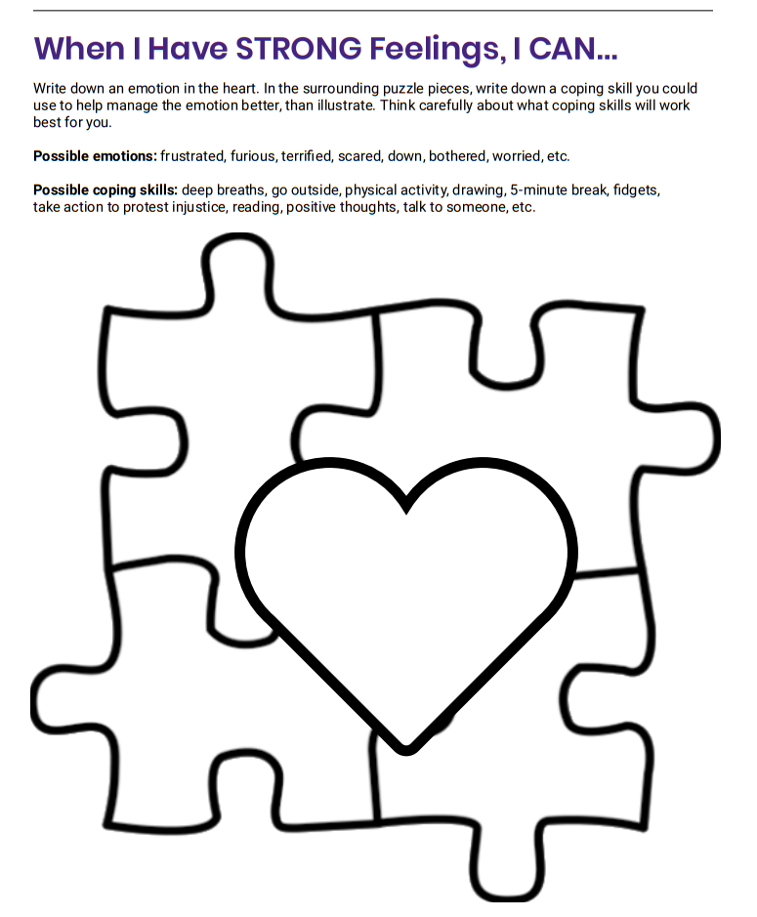
In the surrounding puzzle pieces, write down a coping skill you could use to help manage the emotion better, than illustrate. Think carefully about what coping skills will work best for you.

