Slide 1
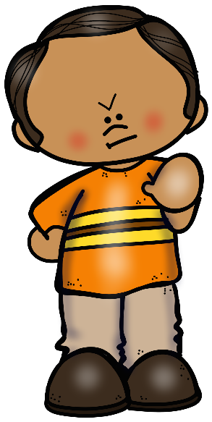
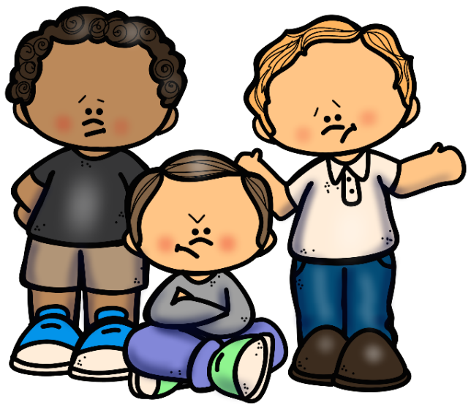
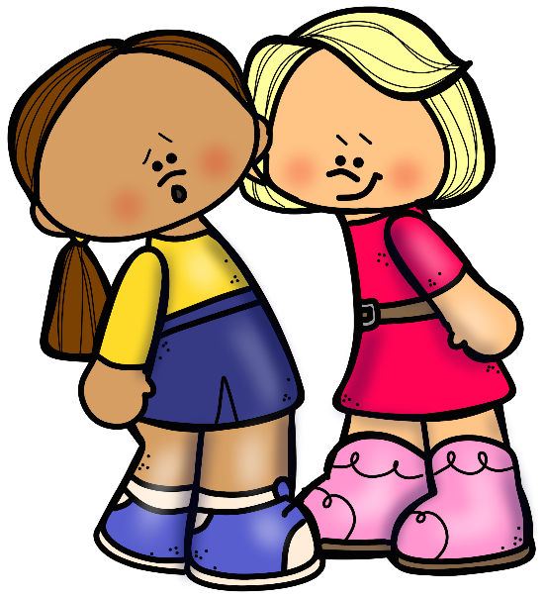
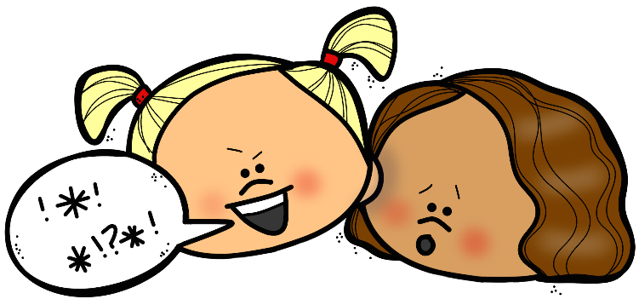
All Kinds of Conflict!
Disagreement vs. Rude vs. Mean vs. Bullying
Notes:
*Clipart used in this PPT CANNOT be extracted. It is for use in this resource only. Using it for other resources is a violation of the terms of use of The Responsive Counselor and EduClips.*

Slide 2
WHAT IS CONFLICT?
Conflict is a word used to describe when people aren’t getting along or when there is a problem between two or more people.
There are 4 kinds of conflict that we will talk about today:
Disagreement
Rude Moment
Mean Moment
Bullying
Notes:
What do you notice about these words? They are getting bigger! That’s because the size of the conflict is getting bigger. A disagreement is a much smaller conflict than bullying.
*Clipart used in this PPT CANNOT be extracted. It is for use in this resource only. Using it for other resources is a violation of the terms of use of The Responsive Counselor and EduClips.*

Slide 3
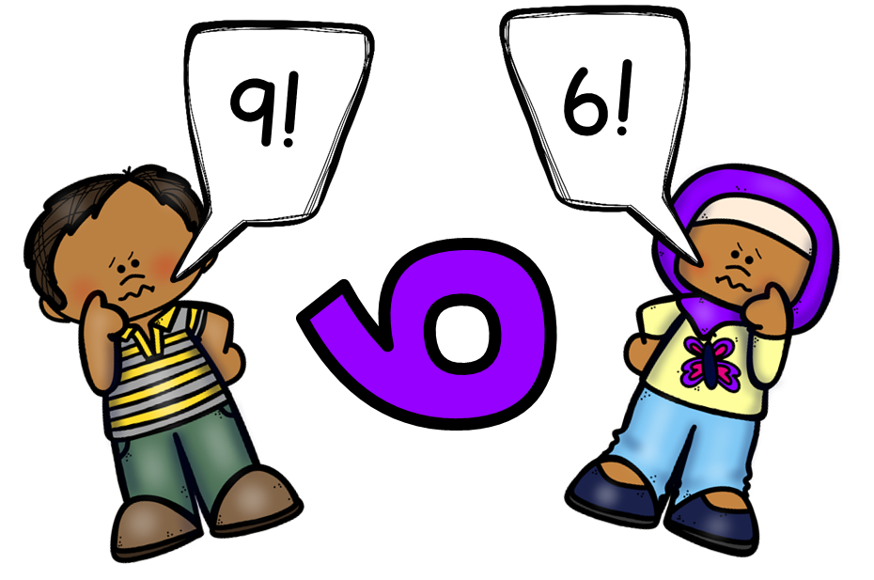
Disagreement
When people have different ideas about something.
Usually no one’s feelings are hurt.
Notes:
What is the disagreement in this picture?
*Clipart used in this PPT CANNOT be extracted. It is for use in this resource only. Using it for other resources is a violation of the terms of use of The Responsive Counselor and EduClips.*

Slide 4
DISAGREEMENTS
What the answer to a math problem is…
Which TV show is better: Spongebob or Teen Titan…
Who’s turn it is in a game…
How can you handle a disagreement?
What’s another example?
Are these bullying??
Notes:
Turn and Talk: What is another example of a disagreement? How can you handle disagreements?
*Clipart used in this PPT CANNOT be extracted. It is for use in this resource only. Using it for other resources is a violation of the terms of use of The Responsive Counselor and EduClips.*

Slide 5
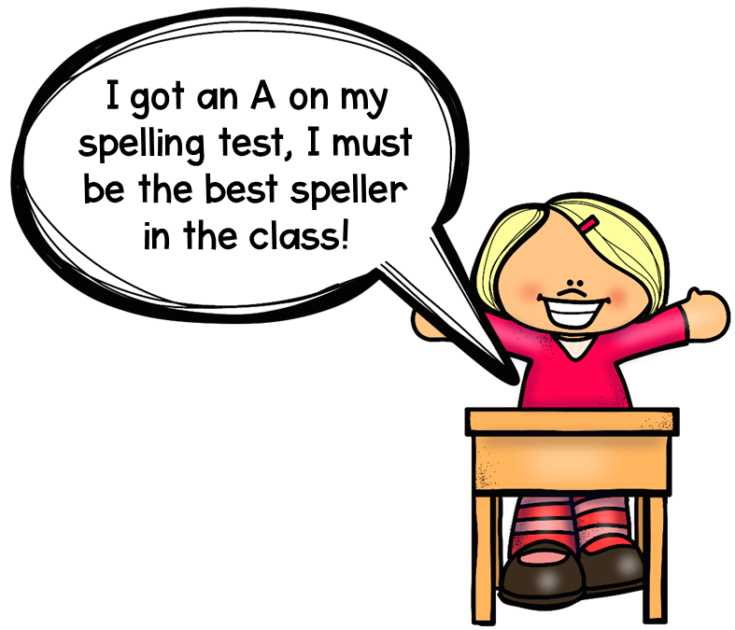
Rude Moment
Hurting someone’s body or feelings on accident.
Someone isn’t being careful with their body or someone isn’t thinking about the other person
Notes:
What is the rude moment in this picture?
*Clipart used in this PPT CANNOT be extracted. It is for use in this resource only. Using it for other resources is a violation of the terms of use of The Responsive Counselor and EduClips.*

Slide 6
RUDE MOMENTS
Burping without saying “excuse me”…
Cutting in line…
Bumping up against someone…
Interrupting…
How can you handle a rude moment?
What’s another example?
Are these bullying??
Notes:
Turn and Talk: What is another example of a rude moment? How can you handle rude moments?
*Clipart used in this PPT CANNOT be extracted. It is for use in this resource only. Using it for other resources is a violation of the terms of use of The Responsive Counselor and EduClips.*

Slide 7
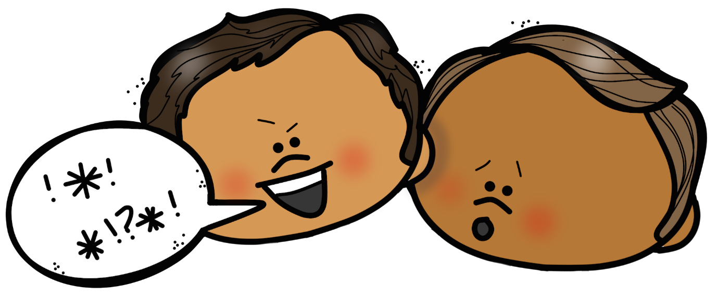
Mean Moment
Hurting someone’s body or feelings on purpose.
Happens just one time or every once in awhile.
Notes:
What is the mean moment in this picture?
*Clipart used in this PPT CANNOT be extracted. It is for use in this resource only. Using it for other resources is a violation of the terms of use of The Responsive Counselor and EduClips.*

Slide 8
MEAN MOMENTS
Calling someone a name…
Telling someone they can’t play with you…
Making fun of someone’s clothes…
Stealing from someone…
How can you handle a mean moment?
Are these bullying??
What’s another example?
Notes:
Turn and Talk: What is another example of a mean moment? How can you handle mean moments?
*Clipart used in this PPT CANNOT be extracted. It is for use in this resource only. Using it for other resources is a violation of the terms of use of The Responsive Counselor and EduClips.*

Slide 9
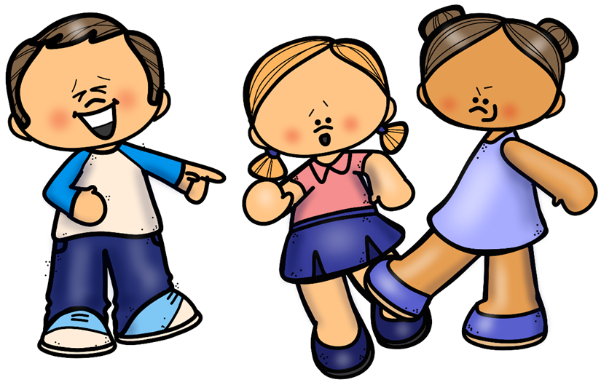
Bullying
Hurting someone’s body or feelings on purpose.
Happens more than once.
The person doing the hurting has more power:
Older OR Bigger
More than one person
Afraid of them
Notes:
What is the bullying happening in this picture?
*Clipart used in this PPT CANNOT be extracted. It is for use in this resource only. Using it for other resources is a violation of the terms of use of The Responsive Counselor and EduClips.*

Slide 10
BULLYING
Threatening someone every day…
Getting other people to be mean to someone, or to leave someone out…
Two kids who always make fun of someone because they have a really hard time reading…
What do you do if you see someone bullying or if someone bullies you?
What’s another example?
Notes:
Turn and Talk: What is another example of bullying? What can you do if you see or experience bullying?
*Clipart used in this PPT CANNOT be extracted. It is for use in this resource only. Using it for other resources is a violation of the terms of use of The Responsive Counselor and EduClips.*

