Slide 1
ANTI-BULLYING WEEK 2024

Slide 2
CALL TO ACTION
From playgrounds to online, our homes to our phones, this Anti-Bullying Week let's 'Choose Respect' and bring an end to bullying which negatively impacts millions of young lives. This year, we’ll empower children and young people to not resort to bullying, even when we disagree and remind adults to lead by example, online and offline. Imagine a world where respect and kindness thrives — it’s not just a dream, it's in the choices we make. Join us this Anti-Bullying Week and commit to 'Choose Respect'. What will you choose?

Slide 3
https://youtu.be/sZ_CkltlgS4

Slide 4
?
What does “respect” mean?

Slide 5
https://youtu.be/UmI5hbQTIUw

Slide 6
“
WHAT IS BULLYING?
Anti-Bullying Alliance’s Definition:
The repetitive, intentional hurting of one person or group by another person or group, where the relationship involves an imbalance of power. Bullying can be physical, verbal or psychological.
It can happen face to face or online.
“

Slide 7
GROUP ACTIVITY
Defining Respect

Slide 8
“
WHAT IS RESPECT?
Oxford Languages definition:
Have due regard for (someone’s feelings, wishes, or rights).
“

Slide 9
UNDERSTANDING DISAGREEMENT & CONFLICT
What happens when we disagree with someone?
What is conflict?

Slide 10
GROUP ACTIVITY
What does a respectful and disrespectful disagreement look like?

Slide 11
“
EXAMPLE DISRESPECTFUL DISAGREEMENT PHRASES
"That’s a stupid idea, mine is way better.“
"You’re wrong, and you don’t know what you’re talking about.“
"No one cares about what you think."
“

Slide 12
“
EXAMPLE RESPECTFUL DISAGREEMENT PHRASES
"I don’t think we will agree so shall we do something else we both like?”
"I get what you are saying, but I think…“
“I don’t want to argue with you, you’re my friend …”
“

Slide 13
RESPECTFUL CONFLICT TOOLS
Stay calm and listen to the other person
Use kind and respectful language.
Try to understand the other person’s point of view.
Suggest a compromise or find a solution together.
If needed, ask for help from a teacher or adult.

Slide 14
ACTIVITY
Respect in Action: Role-Playing

Slide 15
WHY RESPECT MATTERS
Why is it important to respect each other?
How does respect help in making friends and solving problems?
How does respect create a positive school environment?

Slide 16
ACTIVITY
Respect Web

Slide 18
ACTIVITY
Creating a Respect Pledge

Slide 19
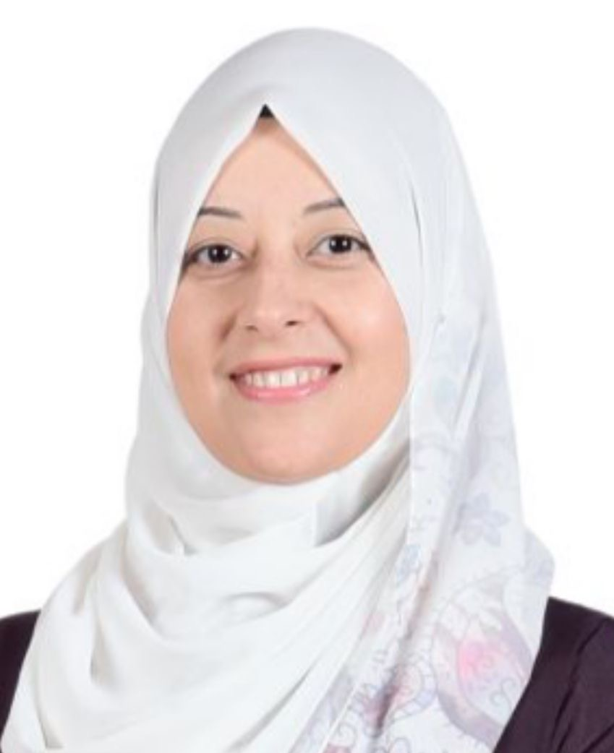
WHO CAN YOU SPEAK TO AT SCHOOL?
Ms. Sara Ossama
Ms. Mona Arshe
Ms. Dina Murad

Slide 20
ANTI-BULLYING WEEK 2024
Monday 11th to
Friday 22nd November
Odd Socks
Day 2024
Tuesday 13th November

