Slide 1
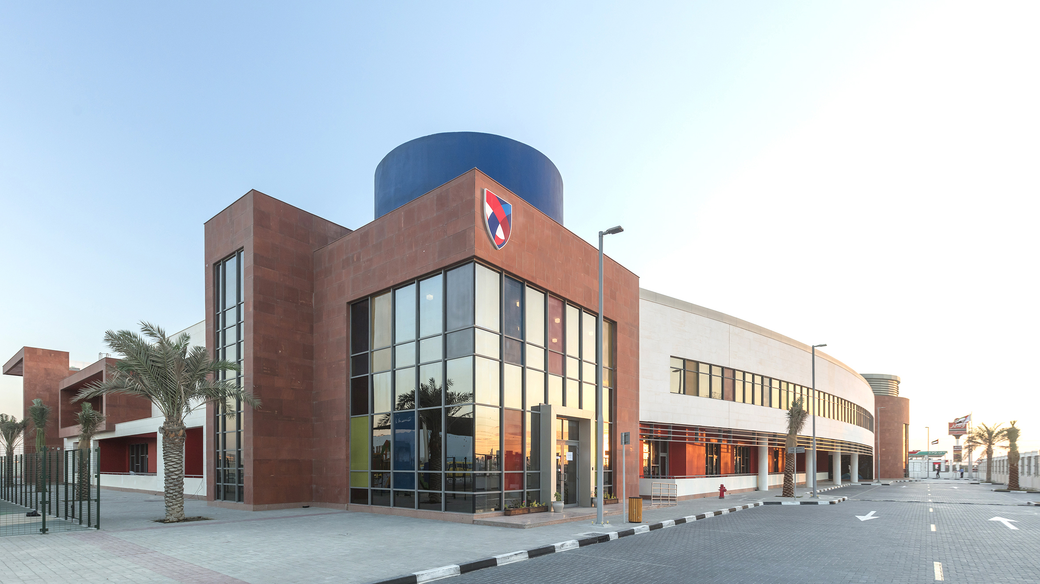
ASCS Nad Al Sheba
Who is Responsible?

Slide 2
In this lesson students will
Understand how their actions have consequences and affect others, even if they do not see it immediately.
Demonstrate the importance of following through on one’s responsibilities.

Slide 3
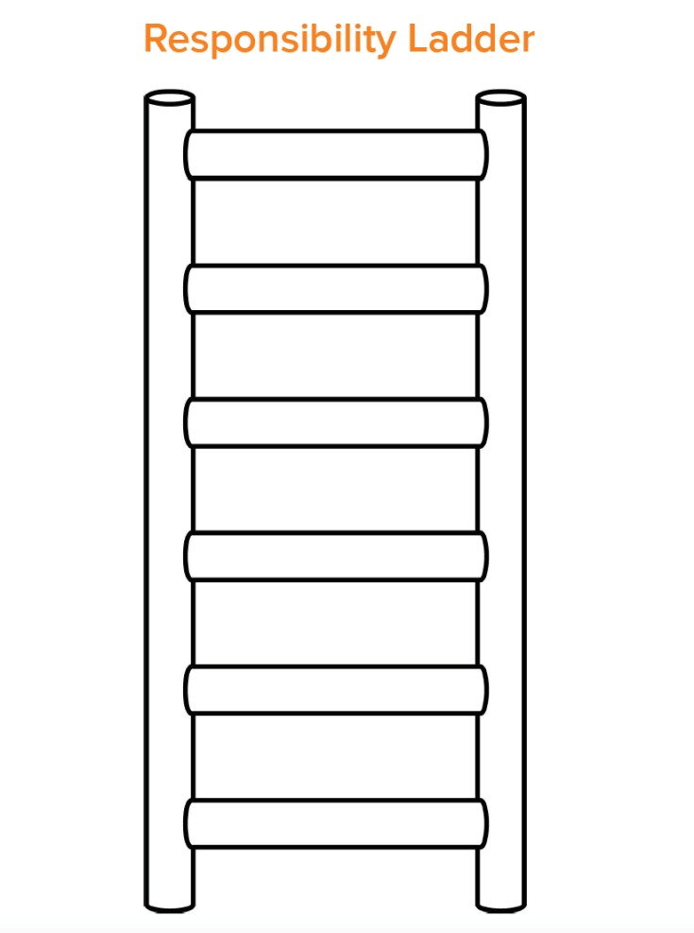
Recap
During our last lesson we talked about personal responsibilities and created our ladders to illustrate what we are responsible for at school. Think back to your ladder.
Choose one thing you wrote on it.
Do you have a special responsibility in your mind?

Slide 4
What does Responsibility look like?
Notes:
Explain that responsibility is when you can be relied on to do the things that are expected or required of you. You do what you say and you say what you do. Others can rely on and trust you with both the little things as well as the big things in life.

Slide 5
We may not think much about it, but each of us makes responsible choices all day, every day!!
We chose to get up today.
We chose to get dressed and come to school, even though we might have rather slept in or played video games!
We choose to learn.
We choose to be kind to our classmates and teacher. When we treat others with kindness and respect we are acting responsibly.

Slide 6
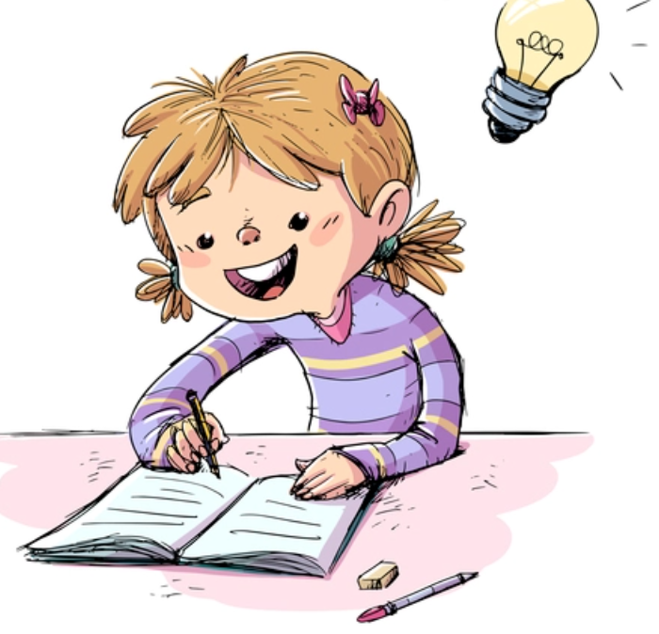
Who’s responsible for homework?”
Many people play a role in the homework you complete each night. After we are done, we will discuss what happens when each necessary person doesn’t complete their responsibilities.

Slide 7
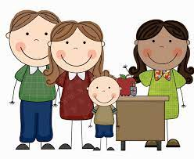
Think...
Student, Teacher, Parent/Guardian
Our goal during this activity is to identify the responsibilities of the student, the teacher, and the parent/guardian as it relates to homework.
We usually think of homework as just the student’s responsibility, but it actually takes 3 people for it to be completed successfully.
You have 10 minutes to brainstorm the responsibilities of each person.
Notes:
● Explain that the answers that have the most checkmarks are the most important responsibilities as many (if not all) of the groups agreed on them!

Slide 8
Reflection
Today we identified necessary responsibilities from the students, teacher, AND parent/guardian for homework. Who knew it took so many
people to complete one subject!
● What would happen if the teacher didn’t make enough copies of the homework?
● How might the students that didn’t get the homework suffer come test time? (less practice/review, etc.)
● Sometimes our parent or guardian isn’t able to help us with homework, but we still need help; what are some other options for receiving help? (family member, sibling, trusted neighbor, after-school program, teacher during recess, etc.)
Notes:
As a class, discuss the consequences if one of the responsibilities was not completed as promised.
Every person in our class has important personal responsibilities they must complete everyday. Sometimes we don’t feel like what we have to do is very important or necessary. However, if we all stopped being responsible, our class would be a messy, disorganized, unkind place without any teacher!
When we are kind and responsible, our class can run smooth and everyone has an opportunity to learn and grow.

